Slide 1
PS1 with PS2

Slide 2
DOI: 10.1002/smll.201300051
Photosystem I (PSI)/Photosystem II (PSII)-Based
Photo-Bioelectrochemical Cells Revealing Directional
Generation of Photocurrents
Omer Yehezkeli , Ran Tel-Vered , Dorit Michaeli , Rachel Nechushtai , and Itamar Willner *

Slide 3

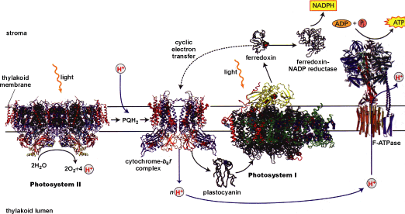
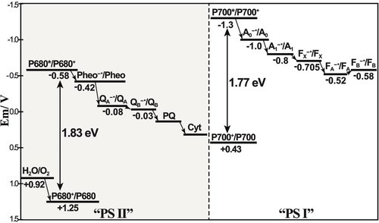
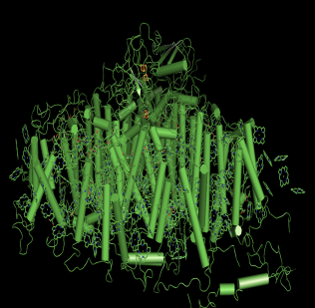
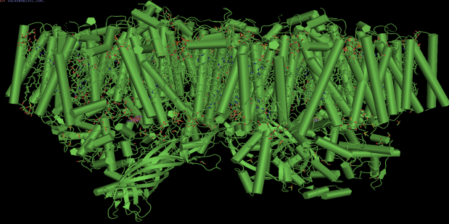
Introduction
Adv. Mater. 2013, 25, 349–377
Electron donor
Electron acceptor
H₂O
e⁻
e⁻
e⁻
Electrode
Electrode
Notes:
다음 왼 쪽위의 그림은 thylakoid membrane의 그림이고 다음과 같이 photosynthesis가 일어 납니다.
기존 관련된 연구는 광합성과 같이 빛 에너지를 화학에너지로 변환시키는 과정에서 일어나는 redox reaction중 electron transfer을 이용하여 전기에너지로 변환하는 연구를 진행하고 있습니다.
오른쪽 위의 그림은 광합성에서 일어나는 electron transfer 과정을 간단하게 보여주는 z-scheme입니다.
주로 PS2를 이용할 때는 퀴논부분인 Q potential을 이용하고 PS1일때는 ferredoxin 부분인 F를 이용합니다.
우선 PS1을 이용할때에는 각각의 position에 따라 anodic current와 cathodic current가 나누어집니다.
anodic current은 electrode donor을 이용함으로써 얻을 수있고, cathodic current은 electron acceptor를 사용하므로써 얻을 수 있습니다.
그리고 PS2를 사용할 경우는 물을 산화하여 electron을 얻어 anodic current을 얻습니다.

Slide 4
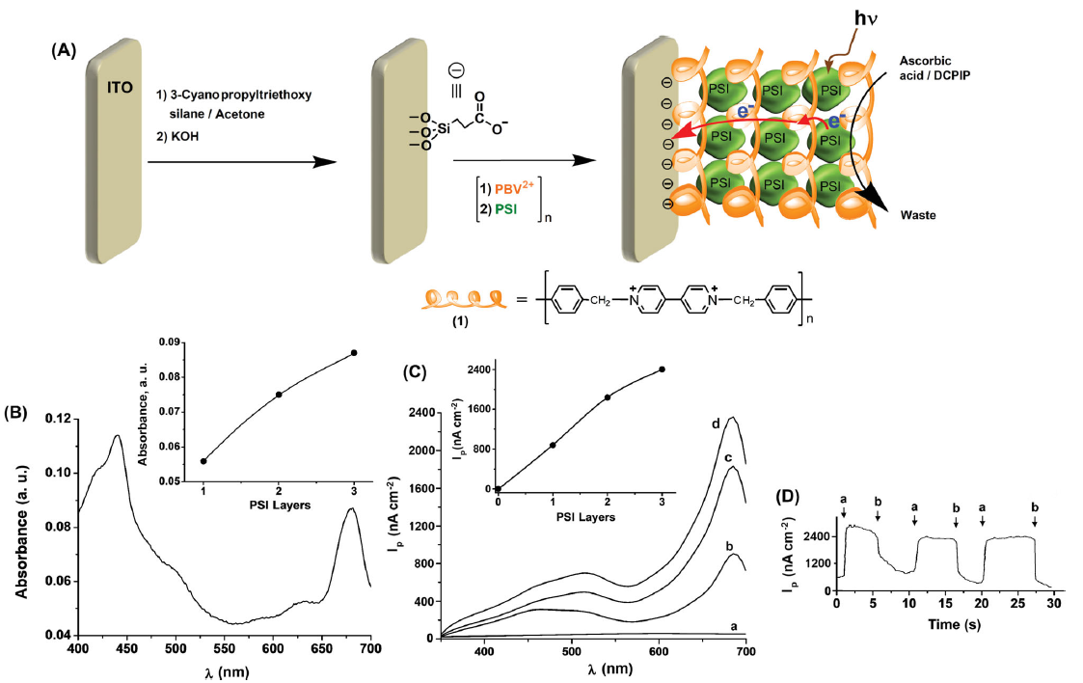
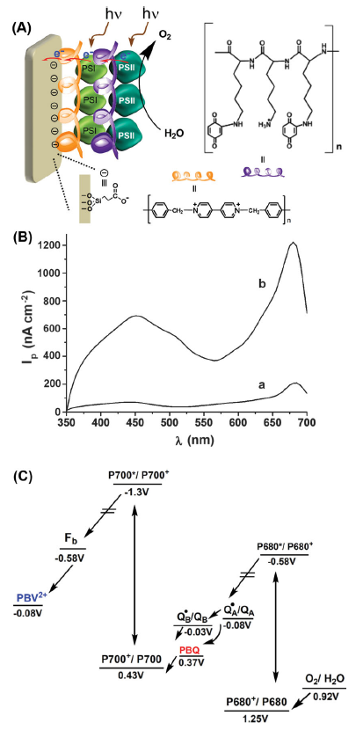
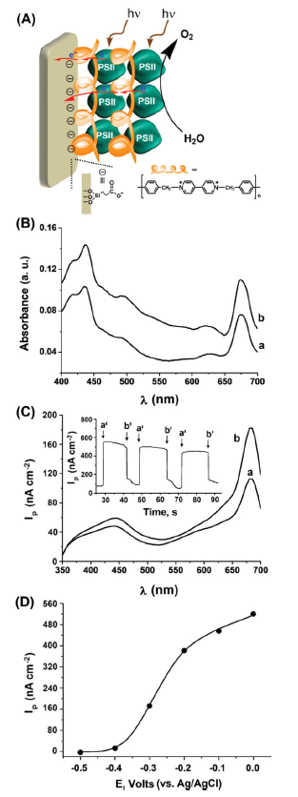
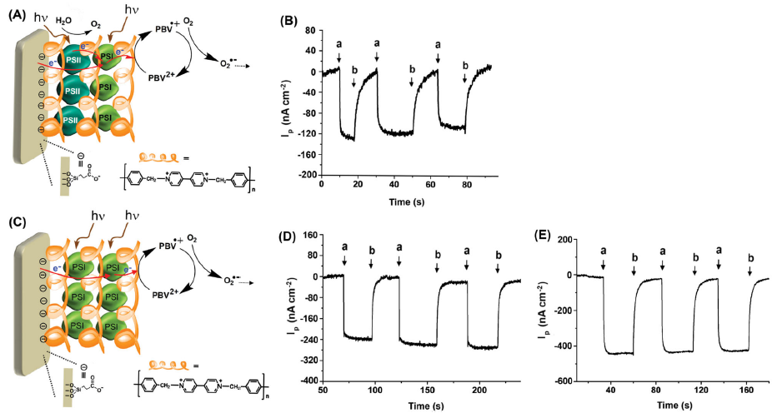
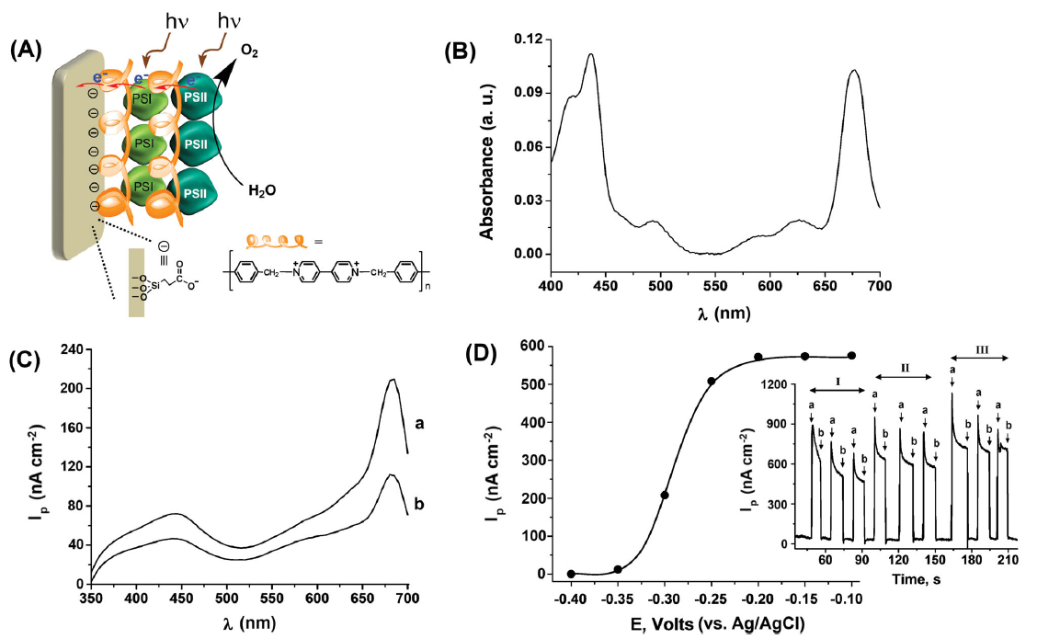
Introduction
Notes:
본 논문에서는 PS1과 PS2를 이용하였고 polymer를 사용하여 electrode에 다양한 position으로 고정하였습니다.
Data설명 전에 간단하게 설명하면, 왼쪽 상단에 있는 그림은 electrode에 polymer를 이용하여 PS1을 고정하였고 electron donor를 사용하여 anodic photocurrent를 얻었습니다.
바로 아래 그림은 동일한 방법으로 PS2를 고정시키고 물을 산화하여 anodic photocurrent를 얻었습니다.
왼쪽에서 제일 아래 있는 그림은 PS1과 PS2를 보이는 것과 같이 배열함으로써 anodic photocurrent을 증가 시켰습니다.
그리고 오른쪽 상단의 그림은 PS1과 PS2를 사용하였고 다른 postential을 갖는 polymer을 사용함으로서 electron transfer을 개선하여 효과적으로 anodic photocurrent을 증가시켰습니다.
오른쪽 2 번째와 3번째 그림은 cathodic photocurrent를 관찰 하였으며, PS1와 PS2를 배열을 왼쪽아래그림과 반대로 cathodic photocurrent가 발생한다는 것을 할 수 있습니다.
본 논문에서는 거론하지 않았지만 이 것으로 PS2에서 PS1으로 electron transfer가 유도된다는 사실을 알 수 있습니다. 따라서, PSUs의 배열의 중요성을 알 수 있습니다.
왼쪽 마지만 그림은 PS1을 사용할 경우 electron donor가 없을 경우 cathodic photocurrent를 발생한다는 것을 알 수 있습니다.

Slide 5
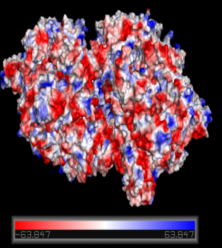
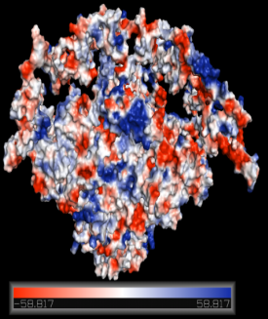
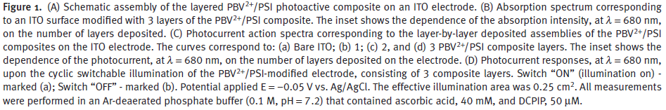
Results and Discussions.
Electron accepting polymer : poly-benzylviologen, PBV ² ⁺
Photocurrent quantum yield : 4%
Notes:
우선 이 논문에서는 electron accepting polymer인 PBV를 사용하여 PS1고정과 electron transfer가 가능하게 하였습니다.
실험방법은 간단하게 ITO electrode에 negative charge를 가지는 작용기로 modification한 후에 positive를 띠는 PBV와 그위에 negative 띠는 PS1을 deposition시켰습니다.
오른쪽 그림은 PS1의 charge를 대략적으로 보여주는 그림입니다. PS1은 대부분 negative charge를 띠고 있어서 multilayer photosystem/polymer multilaye을 형성 할 수 있습니다.
다음 Figure 1 (B)에서 처럼 PS1의 multilayer를 확인할 수 있는 방법은 PS1의 absorbance spectrum을 통해 확인 할 수 있습니다. Inset figure를 보시면 Electrode surface에 PS1의 양이 증가함에 따라서 absorbance 증가하는 것 을 확인 할 수 있습니다.
Electron donating system에서 다음과 같이 Electrode surface에 PS1의 양이 증가함에 따라 증가하는 Photocurrent를 다음 Figure 1 (C)에서 확인 할 수 있습니다.

Slide 6
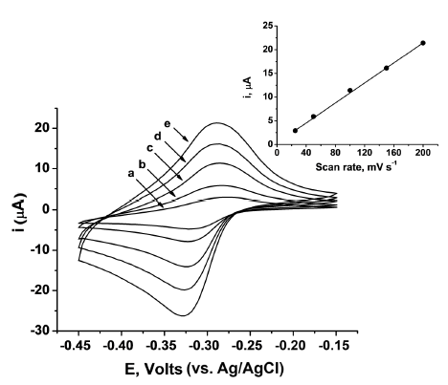
Results and Discussions.
* PSII surface concentration
(b) Second layer : 3.8 × 10 ⁻ ¹² mole/cm²
(a) First layer : 5.2 × 10 ⁻ ¹² mole/cm²
– 0.3 V vs. Ag/AgCl
Photocurrent quantum yield : 0.5%
Notes:
Figure 2 (A)는 앞에서 본 방법과 유사하게 ITO electrode를 modification한 후 PBV와 PS2를 deposition시켰습니다.
Figure 2 (B)의 a는 첫 번째 PS2 deposition의 absorption spectra이고 b는 두 번째 PS2 deposition의 absorption spectra 입니다. 보이는 것과 같이 PS2의 양이 증가함에 따라서 absorption spectra이 증가하는 것을 볼 수 있습니다.
ITO electrode에 deposition된 PS2의 concentration은 다음과 같습니다.
Figure 2 (C)에서 ITO electrode에 deposition된 PS2의 absorbance 따른 anodic photocurrent을 볼 수 있으며, PS2의 흡수 파장인 675nm에서 가장 높은 photocurrent가 나오는 것으로 보아 PS2에 의한 photocurrent가 발생한 것을 알 수 있습니다.
Figure 2 (D)는 applied potential에 따른 photocurrent변화를 보여주는 data입니다. 보이는 것과 같이 applied potential이 – 로 적용 될수록 photocurrent가 감소 하는 것을 볼 수 있습니다.
그리고 -0.4V에서 완전히 감소 하는 것을 볼 수 있으며, 그 이유는 bipyridinium polymer matrix의 redox potential을 보면 알 수 있습니다.
다음 Figure S3는 PBV modified ITO electrode의 CV data이며, -0.3V부분에서 가역적인 redox peak을 볼 수 있습니다. 즉, -0.4V에서는 PBV가 reduction 상태이며 PS2에서 발생하는 전자를 electrode로 electron transfer하는 역할을 할 수 없어 photocurrent가 감소하는 것을 알 수 있습니다.

Slide 7
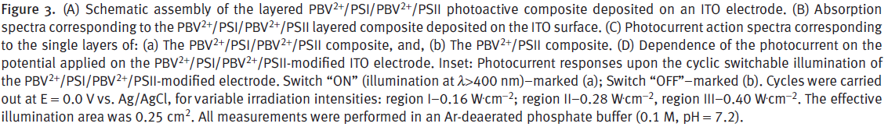
Results and Discussions.
PBV²⁺ /PSI / PBV²⁺ /PSII
215 ± 19 nAcm ⁻ ²
(b) single PBV²⁺ /PSII
115 ± 10 nAcm ⁻ ²
Notes:
앞의 PS1/PBV 와 PS2/PBV실험을 바탕으로 두 photosystem을 Figure 3 (A) 처럼 ITO electrode에 적용시키으로써 electron donor가 필요 없는 system을 만들 수 있습니다.
Figure 3 (B)는 ITO electrode에 형성된 PBV ² ⁺ /PSI/PBV ² ⁺ /PSII layer의 absorption spectrum을 보여 주며, PSUs의 존재여부를 확인 할 수 있습니다.
Figure 3 (C)a는 두 photosystem을 PBV를 사용하여 deposition한 photocurrent이며 b는 이를 비교하기 위한 PS2만 deposition한 photocurrent입니다.
electron donor가 없는 system에서 PS1과 PS2를 deposition한 electrode의 photocurrent가 PS2만 있는 electrode보다 2배정도 증가된 photocurrent를 발생하는 것을 볼 수 있습니다.
PBV ² ⁺ /PSI/PBV ² ⁺ /PSII layer의 증가된 photocurrent는 두 photosystem의 excitation으로 인해 electron transfer chain이 형성되며, 또한 두 photosystem에 의한 증가된 charge separation으로 인해 photocurrent가 증가한 것으로 볼 수 있습니다.
즉, 간단하게 말하면 빛에 의한 charge separation으로 인해 PS2에서 물분해가 일어나 생성된 전자는 PBV에 전달되며, 동시에 charge separation이 일어난 PS1에서 이를 받아 궁극적으로 electrode로 전달하게 됩니다.
이와 같이 두 Photosystem의 charge separation으로 인해 electron transfer가 가능하게되며 두개의 charge separation으로 인해 증가된 photocurrent를 관찰 할 수 있습니다.
Figure 3 (D)는 applied potential에 따른 photocurrent변화를 보여주는 data입니다. Inset figure는 빛세기에 따른 photocurrent변화입니다.

Slide 8
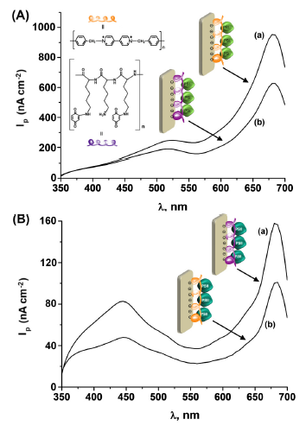
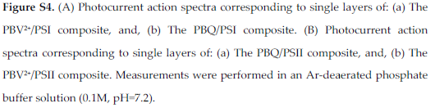
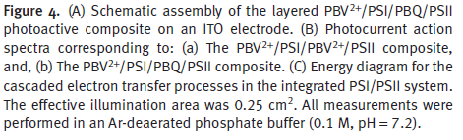
Results and Discussions.
PSI
PSII
(b) PBV²⁺ /PSI/PBQ/PSII
6-fold increase
(a) PBV²⁺ /PSI/ PBV²⁺ /PSII
Notes:
앞에서 설명한 PBV만을 사용하여 PS1과 PS2를 deposition한 electrode는 PBV의 같은 redox potential로 인해 완전한 전자전달이 되지 않아 효율이 떨어지는 단점이 있습니다.
이러한 문제점을 보안하여 Figure 4 (A)처럼 각각 potential이 다른 electron acceptor 역할을 하는 redox polymer을 사용하므로써 electron transfer를 원할하게 하여 증가된 photocurrent를 유도 할 수 있습니다.
Figure 4 (A)에서 우선 먼저 PBV를 먼저 deposition시키고 그 위에 PS1을 그 다음 PBQ, 마지막으로 PS2를 고정한 그림입니다.
Figure 4 (B)에서 보이는 것과 같이 PBV만 사용한 system보다 다른 potential을 갖는 PBV와 PBQ를 사용한 system이 6배 정도 photocurrent가 증가한 것을 볼 수 있습니다.
Figure S4는 다른 potential을 갖는 PBV와 PBQ를 사용하여 증가된 photocurrent에 대한 control 실험입니다. 이 실험을 통해 각각의 PSUs에 따른 electron transfer가 용이한 polymer를 찾아 electrode위에 modification을 할수 있습니다. 이러한 control실험 결과 PS1에서 PBV가 PBQ보다 50%정도 electron transfer효과가 좋으며, PS2에서는 PBQ가 PBV보다 60%정도 electron transfer효과가 좋은 것을 알 수 있습니다.
각각 알맞은 polymer를 적용함으로써 electron transfer가 효과적으로 되게하여 증가된 photocurrent를 얻은 것을 알 수 있습니다.
이러한 결과는 열역학적으로 이해가 되지 않지만 본 논문도 이해를 완전히 못하겠다고 하며… 몇 가지 추측만 하고 있습니다.

Slide 9
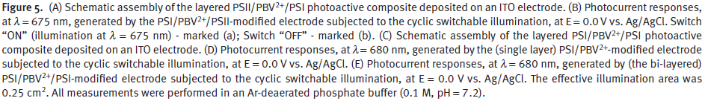
Results and Discussions.
Cathodic current : 140 nA cm⁻²
Cathodic current : 240 nA cm⁻²
Cathodic current : 440 nA cm⁻²
Notes:
다음 Figure 5 (A)는 Figure 3 (A)의 반대라고 생각하시면됩니다. 이와 같이 반대의 경우에는 최외각에 있는 PS1이 electrode와 PS2로부터 전자를 받아 산소를 reduction시킴으로써 cathodic current가 발생하게 됩니다.
Figure 5 (C)에서는 PS1으로만 layer를 형성하였고 최외각에 있는 PS1에 의해 electron accepter 역할을 할 수 있는 산소가 reduction됨으로 cathodic current가 발생하게 됩니다.
그리고 one layer PS1인 D보다 two-layer PS1인 E에서 cathodic current가 증가한 것을 관찰 할수 있습니다.
이와 같이 cathodic current가 발생하는 이유는 PS1의 Ferredoxin으로 부터 polymer가 electron을 전달 받아 산소를 reduction하고 P700+는 아래 electrode쪽에 있는 polymer를 통해 reduction되는 것을 알 수 있습니다.
두 system을 비교해보면, Figure 5 (A)는 PS2의 물 분해로 인한 electron 생성으로 Figure 5 (C)보다 적은 cathodic current가 발생한 것으로 추측 할 수 있습니다.

Slide 10
Conclusion.
The present study has introduced the construction of photosystem I (PSI)- and photosystem II (PSII)-based photo-bioelectrochemical cells using layer-by-layer deposition processes.
The layered assembly of PSI generates an anodic photocurrent only in the presence of a sacrificial electron donor system, such as dichlorophenol indophenol (DCPIP)/ascorbate, the PSII-modifi ed electrode leads, upon irradiation, to the formation of an anodic photocurrent (while evolving oxygen), in the absence of any sacrificial component.
The ordering of the PSI and PSII layers on the electrode controls the efficiency and direction of the resulting photocurrents. While the PSI/PBV²⁺ /PSII configuration revealed a relatively high anodic photocurrent, the PSII/PBV²⁺ /PSI configuration revealed a lower, cathodic, response.
By the further nano-engineering of the two photosystems on the electrode using two different redox polymers, vectorial electron transfer to the electrode is demonstrated, resulting in a ca. 6-fold enhancement in the photocurrent.
Notes:
이 논문에서는 PS1과 PS2를 redox poylmer을 통해 electrode에 deposition시켜 photo-bioelectrochemical cell을 제작하였습니다.
PS1에서는 ascorbate와 같은 electron donor가 있는 경우 anodic photocurrent를 발생하며, PS2에서는 특별한 electron donor가 없이 물의 분해를 통해 anodic photocurrent를 발생하는 것을 알 수 있습니다.
또한, electrode에 PS1과 PS2의 배열에 따라서 photocurrent발생 효율이 변하며, 최 외각에 PS1이 있을 경우 산소를 reduction하여 cathodic photocurrent가 발생하는 것을 알 수 있습니다.
본 논문과 같이 redox polymer사용과 알맞은 PSUs의 배열을 통해 electron transfer을 원할하게 유도할 수 있고, 그로 인해 증대되는 photocurrent를 유도 할 수 있습니다.

Slide 11
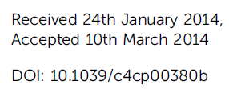

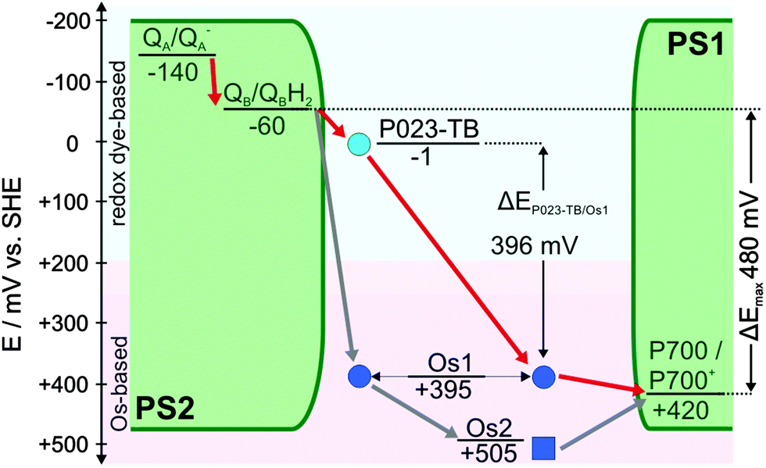
Redox hydrogels with adjusted redox potential for improved efficiency in Z-scheme inspired biophotovoltaic cells
Notes:
I have chosen this paper.
This paper title is "Redox hydrogels with adjusted redox potential for improved efficiency in Z-scheme inspired biophotovoltaic cells".
This paper combines the PS1-based cathode with the novel toluidine blue O/PS2 based anode in order to efficiently make use of the potential difference between PS1 and PS2.

Slide 12
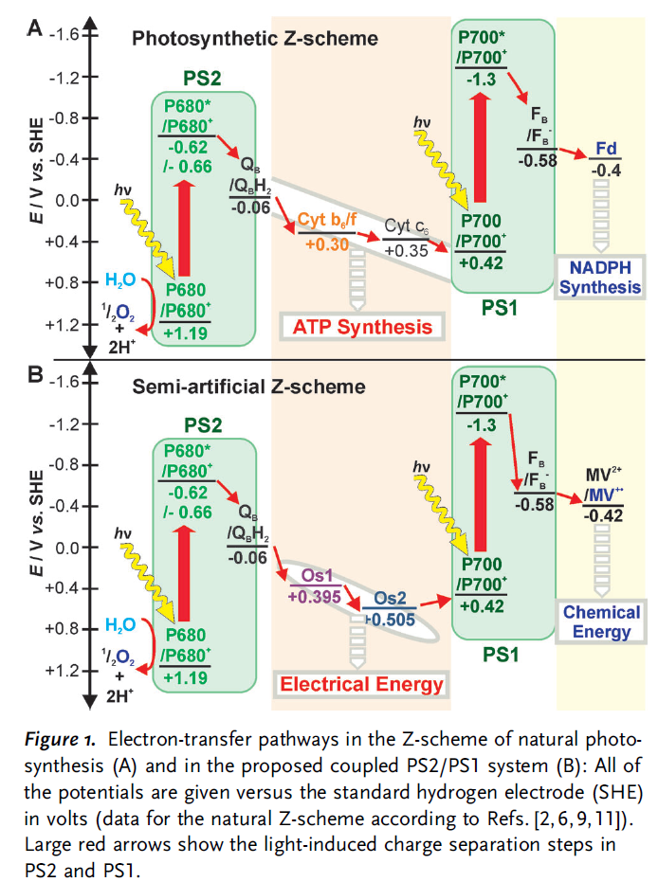
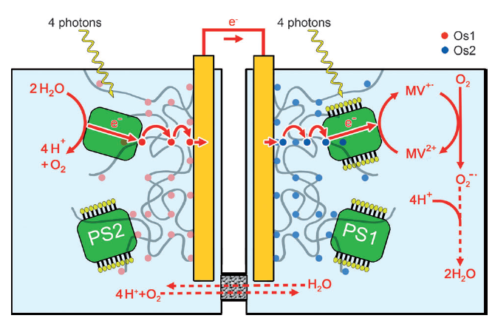
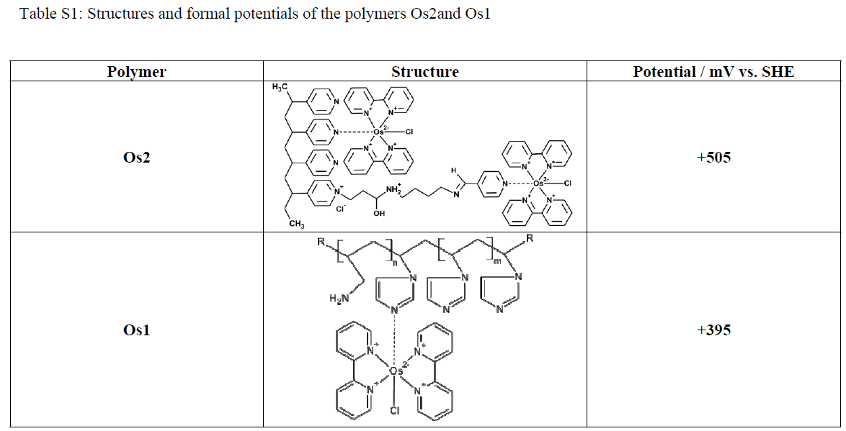
Introduction
△E_{Os1/Os2} = 100 mV
Notes:
Recently In this research group, the isolated proteins were immobilized and electrically connected by Os-complex modified redox hydrogels to the respective electrode surfaces, resulting in a potential difference of about 100 mV.
Unfortunately, this contributes considerably to the fact that most of the energy harnessed via the light induced charge separation at PS2 is dissipated as heat in the electron transfer step between the QB site of PS2 and the Os-complex.

Slide 13
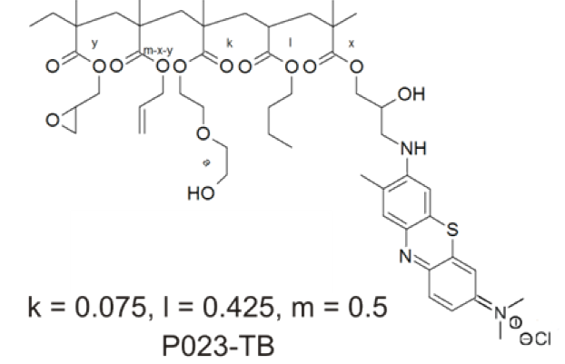
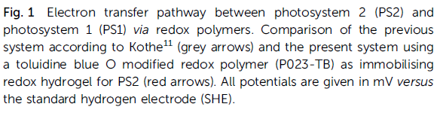
Introduction
P023-TB Formal potential (1mV vs. SHE)
△E_{Os1/Os2} = 100 mV
Notes:
In order to substantially decrease the energy loss in the anodic half-cell the redox polymer should have a formal potential which is slightly more positive than the PS2 acceptor site.
This paper exploit recently developed phenothiazine modified polymers.
Phenothiazine modified polymers typically exhibit formal potentials that match the terminal electron acceptor Q_{B} of PS2.
Redox hydrogels with a more negative formal potential than the formerly used Os1 increase the overall potential difference between both half-cells and should result in an increased open circuit voltage of the biophotovoltaic cell.

Slide 14
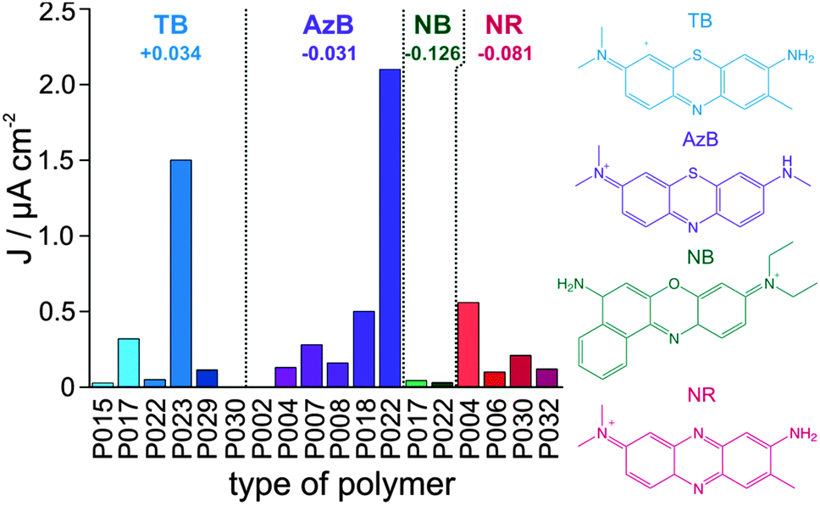
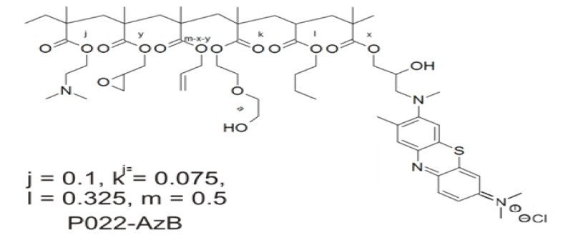
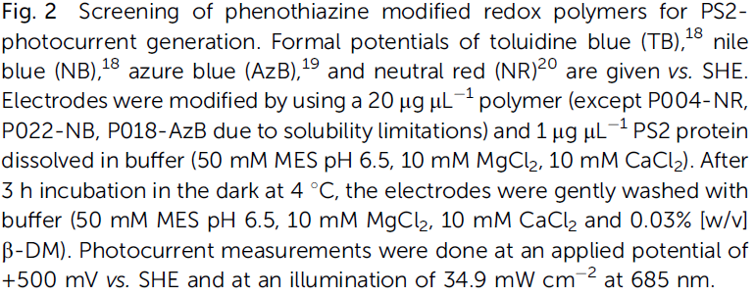
Results and Discussions.
Formal potentials (vs. SHE)
In the case of the bioanodes based on P023-TB had no impact on the hydrogel film properties than P022-AzB.
For this reason the polymer P023-TB was selected for further investigations with the related bioanodes.
Notes:
Fig. 2 is Screening of phenothiazine modified redox polymers for PS2 photocurrent generation.
From the preliminary screening the polymers P022-AzB(azure blue) and P023-TB(toluidine blue) have shown the highest photocurrents for the corresponding PS2-based anodes.
As expected the redox polymers modified with NB (nile blue) have shown the lowest photocurrents due to their substantially more cathodic formal potential.
In the case of the bioanodes based on P023-TB had no impact on the hydrogel film properties than P022-AzB.
For this reason the polymer P023-TB was selected for further investigations with the related bioanodes.

Slide 15
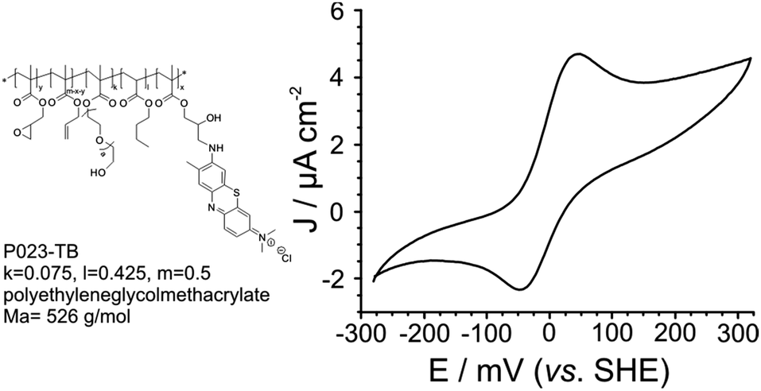

Results and Discussions.
Midpoint potential : -1 mV (vs. SHE)
More Negative
Notes:
Determination of the midpoint potential of P023-TB by cyclic voltammetry at pH 6.5 yielded a value of -1 mV.
That is considerably more negative than the 395 mV of the Os1 polymer.

Slide 16
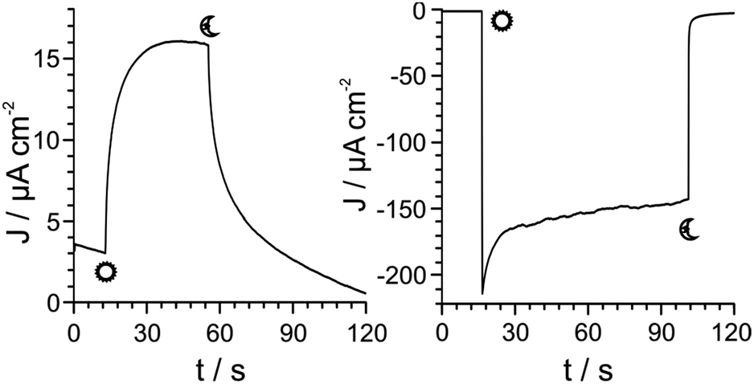
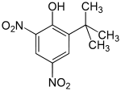
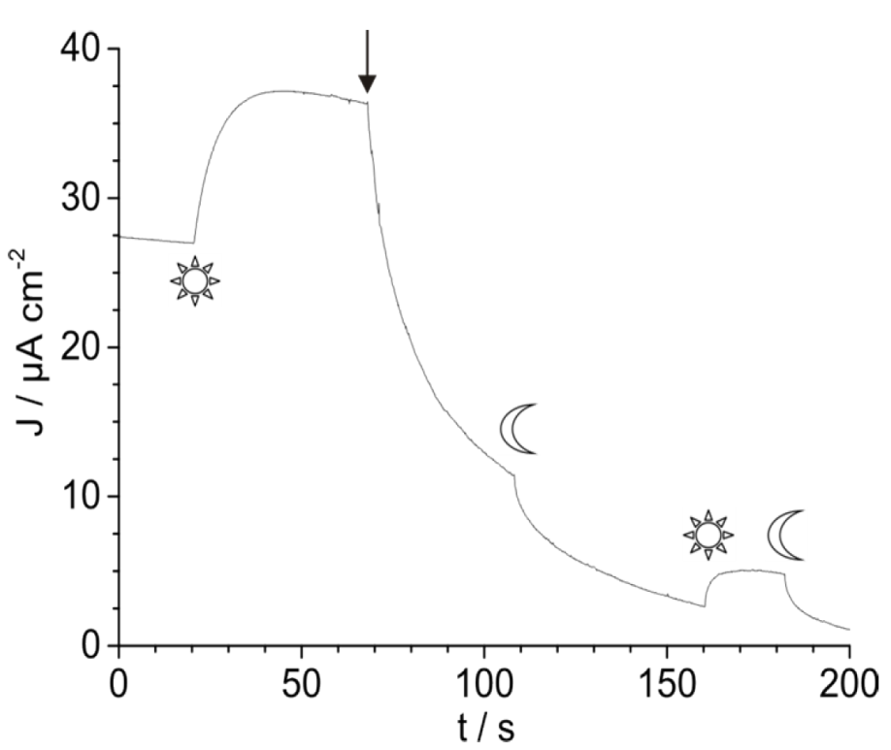
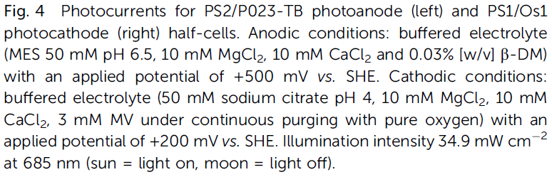
Results and Discussions.
PS2-anode
PS1-cathode
PS2-inhibitor : Dinoterb
140 μA cm⁻²
25% Decrease
210 μA cm⁻²
Fig. S2 Chronoamperometry of the PS2/P023-TB photoanode upon addition of the inhibitor dinoterb (100 μM, black arrow). Measurements in buffered electrolyte (50 mM MES pH 6.5, 10 mM MgCl₂, 10 mM CaCl₂ and 0.03 % [w/v] β-DM) with an applied potential of +500 mV vs. SHE and an illumination of 34.9 mW cm⁻² at 685 nm (sun = light on, moon = light off).
Notes:
Further characterization of the PS2-based anodic half-cells was done by chronoamperometry.
While illumination produced an average anodic photocurrent density of 10 μA cm⁻², addition of the PS2-inhibitor dinoterb reduced this current to 25%.
This clearly indicates that the light induced catalytic current originated from PS2.
The PS1-cathode half-cell was characterized by application of 200 mV vs. SHE, yielding an average cathodic photocurrent density of 150 μA cm⁻².

Slide 17
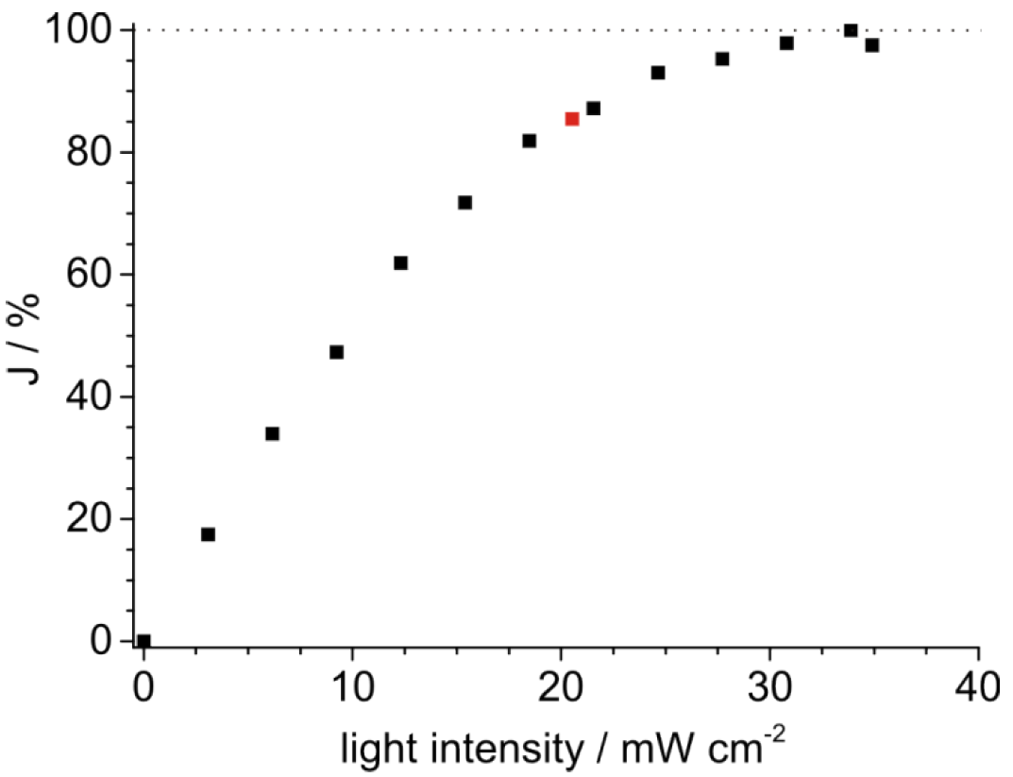
Results and Discussions.
Light saturation at 21 mW cm⁻²
Fig. S3 Determination of light saturation conditions at the PS2/P023-TB photoanode by plotting the percentage of the maximum photocurrent density (J / %) against the light intensity (mW cm⁻²). Measurements were performed in buffered electrolyte (50 mM MES, pH 6.5, 10 mM MgCl₂, 10 mM CaCl₂ and 0.03 % [w/v] β-DM) with stepwise increased light intensity (at 685 nm). Light intensity used routinely in biophotovoltaic measurements is marked red.
The assembled biophotovoltaic cell was characterized at a light intensity of 21 mW cm⁻² (at 685 nm), which is close to the light saturation of the limiting anodic half-cell.
Notes:
The assembled biophotovoltaic cell was characterized at a light intensity of 21 mW cm⁻² (at 685 nm), which is close to the light saturation of the limiting anodic half-cell.

Slide 18
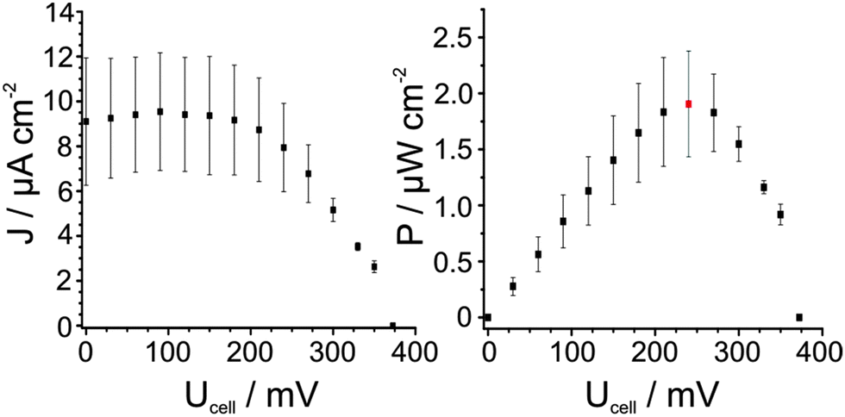
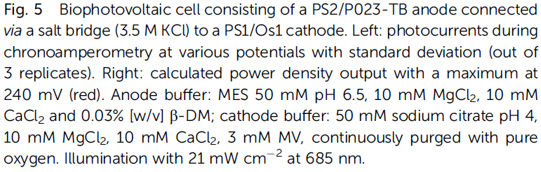
Results and Discussions.
I_{SC} : 9 ±3.1 μA cm⁻².
Maximum P_{cell} : 1.91±0.56 μW cm⁻²
V_{OC} : 372.5 ± 2.1 mV
240 mV
The obtained power output, V_{OC} and I_{SC} result in a fill factor (ff) of 0.564.
The ratio of power output (P_{cell} = 1.91 μW cm⁻²) and power input (P_{LED} = 21 mW cm⁻²) for the total illuminated surface area (i.e. both photoelectrodes), yields a conversion efficiency (ŋ) of 4.5 X 10⁻⁵.
Notes:
The J–U curve is shown in Fig.5 left exhibiting an V_{OC} of 372.5 mV which is in good agreement with the theoretical V_{OC} of 396 mV as determined from the formal
potential difference of the two redox polymers.
The short circuit current density (I_{SC}) is 9 μA cm⁻².
Based on these data, the cell power (P_{cell}) was calculated and plotted against the potential (Fig. 5 right), with a maximum P_{cell} of 1.91μW cm⁻².

Slide 19
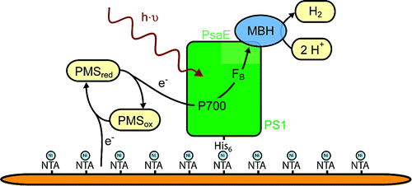
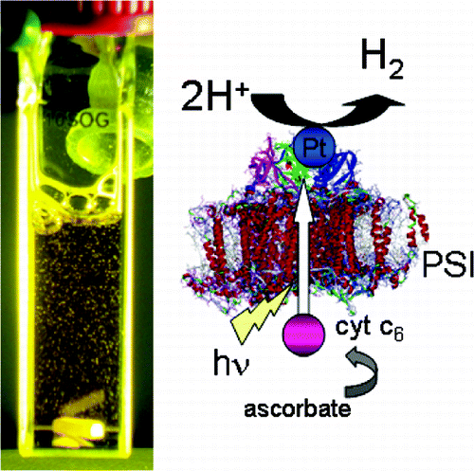
Conclusion.
This paper could significantly improve the performance of this biophotovoltaic concept by adjusting the redox hydrogel potentials for both photoanode and photocathode.
Further developments in the cathode side may use its reductive force for the production of reduction equivalents. Most promising is the reduction of protons to hydrogen via PS1–H₂ase nanohybrid constructs, PS1–H₂ase fusion complexes or PS1–Pt nanoconstructs.
This approach would lead to the conversion of solar energy into both electrical and chemical energy, the latter as H₂.

Slide 20
Article first published online: 7 NOV 2013
DOI: 10.1002/anie.201303671
Combination of A Photosystem 1-Based Photocathode and
a Photosystem 2-Based Photoanode to a Z-Scheme Mimic for
Biophotovoltaic Applications**
Tim Kothe, Nicolas Plumere, Adrian Badura, Marc M. Nowaczyk, Dmitrii A. Guschin,
Matthias Rogner,* and Wolfgang Schuhmann*
Notes:
I have chosen this paper.
This paper title is "Combination of A Photosystem 1-Based Photocathode and a Photosystem 2-Based Photoanode to a Z-Scheme Mimic for Biophotovoltaic Applications".
In this paper, The two photosystems of the natural photosynthetic Z-scheme have been connected by immobilizing them within redox hydrogels on individual electrodes.

Slide 21
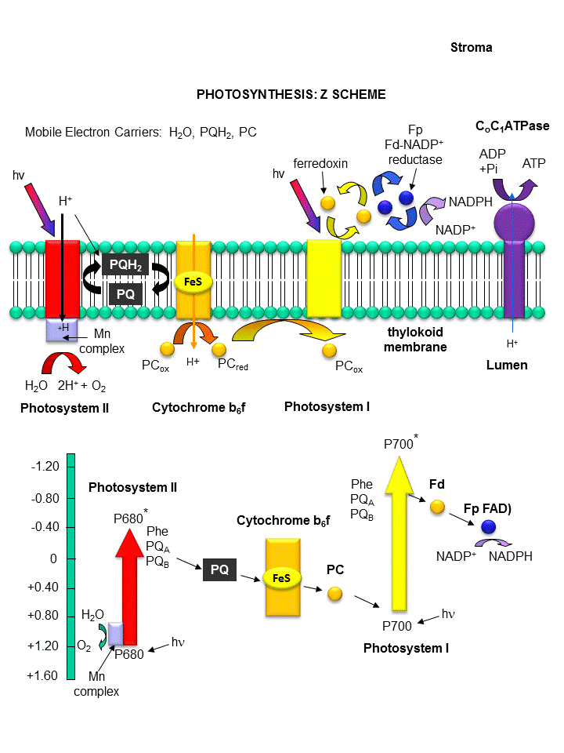
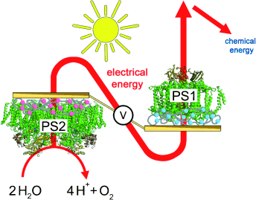
Introduction
< Z - Scheme of electron transfer pathway >
The charge separation processes in the Z-scheme inspired the design of photosynthesis-like systems based on organic and inorganic photosensitizers to convert solar energy into chemical energy.
These limitations may be overcome by the serial coupling of both light excitation steps of PS1 and PS2 in a semi-artificial photosynthesis device.
Notes:
The charge separation processes in the Z-scheme inspired the design of photosynthesis-like systems based on organic and inorganic photosensitizers to convert solar energy into chemical energy.
However, The electrons provided by PS2 are insufficiently energetic, and PS1-based systems require sacrificial electron donors.
These limitations may be overcome by the serial coupling of both light excitation steps of PS1 and PS2 in a semi-artificial photosynthesis device.

Slide 22
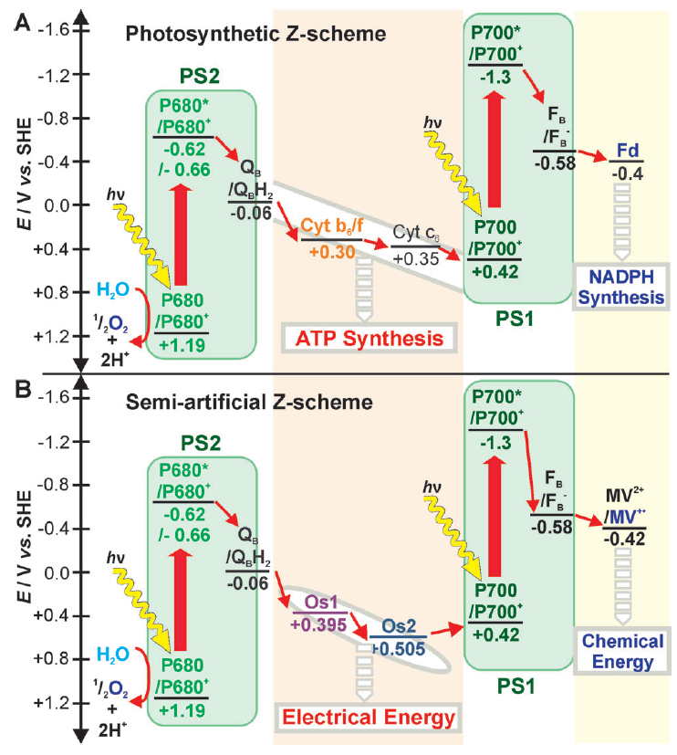
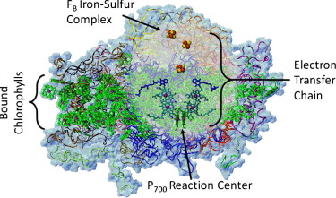
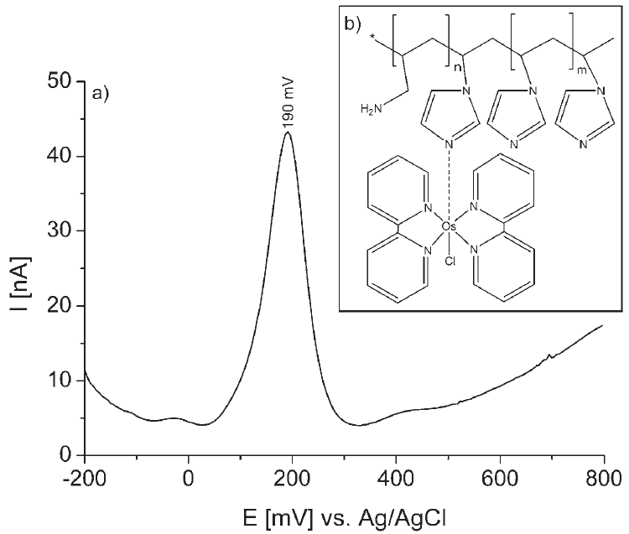
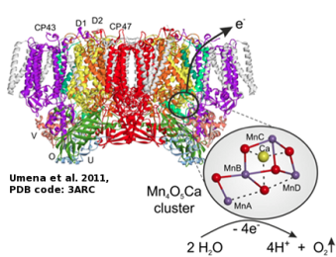
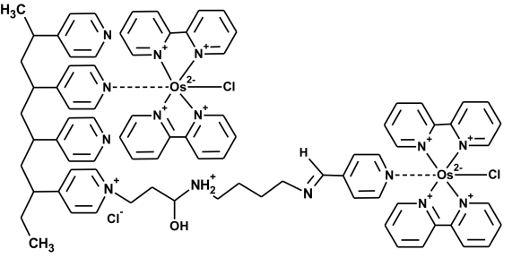
Introduction
Os1
+ 395 mV vs. SHE
- 60 mV vs. SHE
+ 420 mV vs. SHE
Os2
+ 505 mV vs. SHE
Acceptor side of PS2
Figure 1. Electron-transfer pathways in the Z-scheme of natural photosynthesis (A) and in the proposed coupled PS2/PS1 system (B): All of the potentials are given versus the standard hydrogen electrode (SHE) in volts (data for the natural Z-scheme according to Refs. [2,6,9, 11]). Large red arrows show the light-induced charge separation steps in PS2 and PS1.
Donor side of PS1
This paper focuses on the generation of electrical energy from the difference in potential between the acceptor side of PS2 and the donor side of PS1.
Notes:
In this paper, the two photosystems have been connected by immobilizing them within redox hydrogels on individual electrodes.
This paper focuses on the generation of electrical energy from the difference in potential between the acceptor side of PS2 and the donor side of PS1.

Slide 23
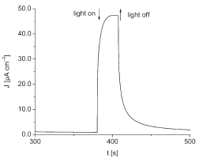
Results
Os2
Os1
+ 395 mV vs. SHE
+ 505 mV vs. SHE
Figure S2: Photocurrent of the PS1/Os2 based photocathode half-cell in buffered electrolyte at pH 5.5 containing 3 mM methyl viologen. Left: Photocurrents at various applied potentials. Right: Photocurrent vs. time at an applied potential of 0 mV vs.
Ag/AgCl.
Figure 2. Representation of the proposed biophotovoltaic cell combining a PS2-based photoanode and a PS1-based photocathode. Upon absorption of photons, water molecules are split into electrons and protons. The electrons are transferred to the cathodic half-cell via the outer circuit, where PS1 generates a reductive force of 580 mV vs. SHE and reduces the electron acceptor (methyl viologen). The methyl viologen radical cation is re-oxidized by molecular oxygen, resulting in water as final product.
The combination of a PS1-based photocathode and a PS2-based photoanode results in a photovoltaic cell that operates as a closed system without any sacrificial electron donors or acceptors.
Notes:
In the biophotovoltaic cell, the reducing site of PS2 was contacted to an electrode via an Os-complex 1 modified hydrogel, resulting in high photocurrent densities.
Similarly, the oxidizing site of PS1 was contacted with an electrode via an Os-complex 2, which resulted in the generation of high cathodic photocurrents.
Under illumination, water is oxidized to oxygen and proton in the anodic compartment by PS2, and oxygen is reduced to water in the cathodic compartment by PS1 via methyl viologen (MV) and protons.

Slide 24
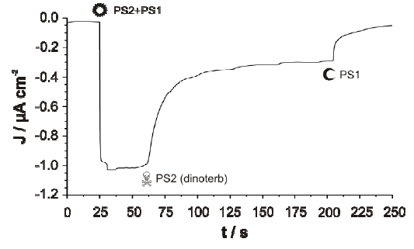
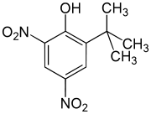
Results
Light off - Anode side (PS2)
1 μA cm⁻²
Figure 3. Photocurrent density of the proposed biophotovoltaic cell combining the PS2/Os1-based photoanode and the PS1/Os2-based photocathode as shown in Figure 2. The light status of the respective photoelectrode is indicated by O=light on and C=light off. Left: Simultaneous illumination of both half-cells with the same light intensity. Right: Starting with the same light intensity on both sides, light at the PS2 half-cell is switched off after 75 s and on again 30 s later. Finally, light was switched off at both half-cells. (Photoanode compartment: buffered electrolyte pH 6.5; photocathode compartment: buffered electrolyte pH 5.5 containing 2 mm methyl viologen.)
Dinoterb blocks the Q_{B} site of the D1 subunit of PS2
Figure S3. Photocurrent density of the proposed biophotovoltaic cell combining the PS2/Os1-based photoanode and the PS1/Os2-based photocathode. Light status of the respective photoelectrode indicated by O= light on and C = light off, using identical light intensities for both half-cells. After 30 s of continuous illumination, the PS2 inhibitor dinoterb was added, and after additional 3 min light was switched off (conditions as in Fig. 2).
Notes:
As you can see in this figure 3, Electrical connection and illumination of both half-cells generate a steady-state photocurrent of about 1 uA cm⁻².
Switching off illumination exclusively on the anode side (PS2) results in a decrease of the photocurrent.
The decreased photocurrent was restored by switching light on again.
As shown in the figure S3, the photocurrent density decreases upon addition of dinoterb.
These results indicated that the activity of PS2/Os1-based photoanode contributed to the overall photocurrent.

Slide 25
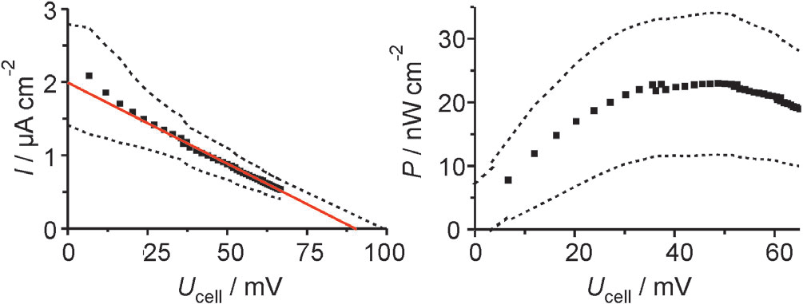
Results
I_{SC}= 2 ± 0.7uA cm⁻²
P_{cell} = 23 ± 10 nW cm⁻²
V_{OC}= ~ + 90 ± 20 mV
E_{cell}= (Os2 : +505 mV) – (Os1 : + 395mV) = ~ + 110mV
Figure 4. Determination of the short-circuit current density (I_{SC}), the open-circuit voltage (V_{OC}), and the maximal cell power density output (P_{cell}) for the biophotovoltaic cell, combining PS2/Os1-based photoanode and PS1/Os2-based photocathode via an external variable resistor (three experiments with three independently modified electrode pairs; upper and lower limits of the standard deviation given by dashed lines and linear fit given by red line). Left: I–U curve. Cell current density, I_{cell}, determined from load and cell potential U_{cell}. Right: P–U curve.
$\text{Fill} \text{Factor} (FF) =\frac{V_{max} × I_{max} }{V_{OC }× I_{SC}} = \frac{P_{max}}{V_{OC }× I_{SC}} = \frac{23 nW/{{cm}^{2}}}{0.09 V ×2 μA/{{cm}^{2}}} =0.$128
$\text{C}\text{onversion} \text{efficiency} (ŋ)=\frac{V_{OC }× J_{SC} ×FF}{P_{input}} = \frac{0.09 V ×2 μA/{{cm}^{2}}×0.128}{34.9 mW/{{cm}^{2}}} =\frac{6.6×{10}^{−7}}{2\left(electrode\right)}$ = 3.3$×{10}^{−7}$
Notes:
Figure 4 is I-V curve and P-V curve.
As you can see in this figure 4, the short-circuit current density (I_{SC}) is 2 uA cm⁻² and open-circuit voltage (V_{OC}) is 90 mV and power density is 23 nW cm⁻².
The low open-circuit voltage of biophotovoltaic cell corresponds to the potential difference between the two redox hydrogels.
And, the open-circuit voltage indicates the coupling of the two charge separation steps.
Fill factor (FF) and conversion efficiency(ŋ) of biophotovoltaic cell are calculated respectively using I_{SC} and V_{OC} and P_{cell}.

Slide 26
Conclusion.
Photosystems can be immobilized by Os-redox hydrogels.
Upon irradiation, this biophotovoltaic device produced photocurrents as a closed and autonomous system.
This result has shown the serial coupling of two independent processes of light capturing by PS2 and PS1 yielding a fully closed biophotovoltaic cell.

