Slide 1
Photosystem 2

Slide 2
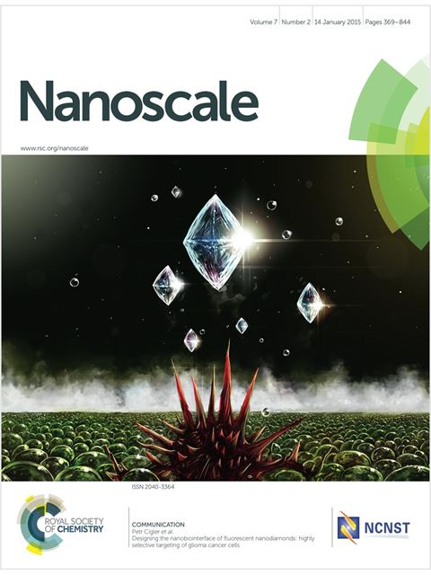
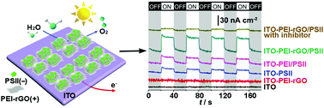
Nanoscale, 2015, 7, 10908
Co-assembly of photosystem II/reduced graphene oxide multilayered biohybrid films for enhanced photocurrent
Peng Cai,ª Xiyun Feng,ª Jinbo Fei,ª Guangle Li,ª Jiao Li,^{a,b} Jianguo Huang^{b} and Junbai Li^{*a}
This paper constructs a biohybrid photoanode with enhanced photocatalysis by integrating PSII with modified rGO via a very convenient and controllable layer-by-layer (LbL) assembly technique driven by electrostatic interaction.

Slide 3

Experimental Section
Washing
Washing
Dry
Dry
< PEI-rGO solution >
< PSII solution >
PS2 was isolated and purified from spinach chloroplasts.
In order to introduce the PS2 on the electrode surface, the reduced graphene oxide (rGO) with the polyethyleneimine (PEI) were used.
The biohybrid photoanode was fabricated by layer-by-layer assembly technique.
Positively charged PEI-rGO was first absorbed on the substrates by immersing these substrates into PEI-rGO solution.
And then, the resultant substrates were immersed in PSII solution.
This process was repeated until the desired number of layers was obtained.
Fig. 1 (a) Schematic representation of an ITO electrode functionalized with LbL co-assembly of negatively-charged PSII and positively-charged PEI–rGO multilayered films as a photoanode. (b) Schematic illustration for the relevant energy diagram.
Notes:
In this paper, PS2 was isolated and purified from spinach chloroplasts.
In order to introduce the PS2 on the electrode surface, the reduced graphene oxide (rGO) with the polyethyleneimine (PEI) were used.
The biohybrid photoanode in this paper was fabricated by layer-by-layer assembly technique.
Positively charged PEI-rGO was first absorbed on the substrates by immersing these substrates into PEI-rGO solution.
And then, the resultant substrates were immersed in PSII solution.
This process was repeated until the desired number of layers was obtained.

Slide 4
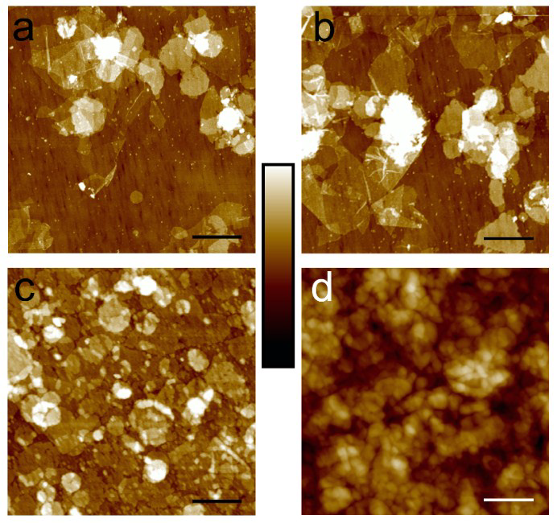
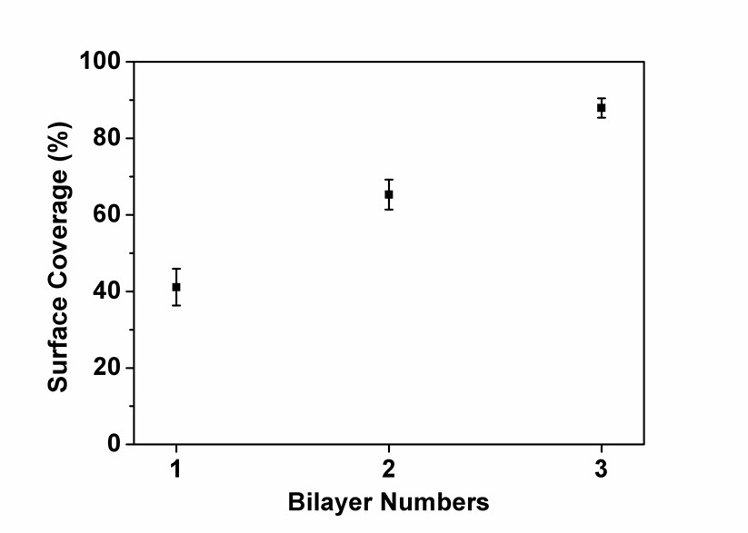
Results
Negatively charged (−14.8 mV)
Positively charged (+29.2 mV)
GO
PEI–rGO
(PEI-rGO/PSII)₁
(PEI-rGO/PSII)₂
(PEI–rGO/PSII)₂
Fig. 2 AFM images of (a) GO and (b) PEI–rGO on silicon wafers. Insets show the corresponding photographs of the GO and rGO aqueous dispersions. (c) UV-vis spectra of PEI–rGO/PSII multilayered films with varying numbers of LbL depositions on the ITO substrate. The inset shows the absorbance difference at 680 and 720 nm of PEI–rGO/PSII films on the ITO substrate. (d) SEM image of (PEI–rGO/PSII)₂ films on the ITO substrate. The inset shows an AFM image of the (PEI–rGO/PSII)2 films on the ITO substrate. PSII enriched membranes are circled by green dashed lines. Z-scale bar is 30 nm for (a) and (b), and 40 nm for the inset of (d).
(PEI-rGO/PSII)₃
(PEI/PSII)₃
Figure S8. AFM images of (a) (PEI-rGO/PSII)₁, (b) (PEI-rGO/PSII)₂, (c) (PEI-rGO/PSII)₃ and (d) (PEI/PSII)₃ multilayered films on ITO substrates. Z-scale bar is 40 nm for (a), (b) and (c), 160 nm for (d), respectively.
Figure S9. Surface coverage of PEI-rGO/PSII multilayered films.
The relative amount of PSII absorbed was quantified by calculating the absorbance difference (ΔA_{680–720}) at 680 and 720 nm considering the absorption background.
Notes:
As shown in the atomic force microscopy (AFM) image (Fig. 2a), the average thickness of GO sheets is about 1.1 nm, which is a typical thickness of GO sheets.
Fig. 2b is AFM images of PEI–rGO on silicon wafers. These spots are the PEI adsorbed on RGO sheet.
The PEI–rGO nanosheets are positively charged (+29.2 mV) and PSII enriched membranes are negatively charged (−14.8 mV).
So, they can be co-assembled by the electrostatic interaction.
As you can see in the fig 2c, the light absorbance was gradually increased according to the deposition cycles of PEI–rGO/PSII bilayer.
Also, the surface coverage of PEI–rGO/PSII multilayered films increases when the number of bilayers increases.
Fig. 2b is SEM and AFM images of (PEI–rGO/PSII)2 films on the ITO substrate.

Slide 5
Results
( ITO–PEI–rGO/ PSII )n
37.2 nA cm⁻²
19.9 nA cm⁻²
9.2 nA cm⁻²
Fig. 3 (a) Photocurrent response upon cyclically switched illumination of PEI–rGO/PSII multilayered films supported by the ITO substrate. (b) Comparison of the photocurrent response of (i) pure ITO, (ii) ITO–rGO, (iii) ITO–PSII, (iv) ITO–PEI/PSII, (v) ITO–PEI–rGO/PSII and (vi) ITO–PEIrGO/PSII with additional 30 μM 3-(3,4-dichlorophenyl)-1,1-dimethylurea (DCMU) as the inhibitor of PSII in an electrolyte buffer solution. The latter four films possess the identical amount of PSII. (c) Dependence of the photocurrent on the external potential applied on ITO–PSII, ITO–PEI/PSII and ITO–PEI–rGO/PSII, respectively. (d) Photocurrent stability of different electrodes under continuous light irradiation. The above photocurrents were measured with a bias potential of 0.25 V vs. saturated calomel electrode (SCE) in an aqueous electrolyte buffer solution (pH 6.5, 20 mM 4-morpholinoethanesulfonic acid (MES), 50 mM KCl, 5 mM MgCl₂ and 3 mM CaCl₂) under light illumination (800 nm > λ > 550 nm, P₆₈₀ nm = 10 mW cm⁻²) at 25 °C.
With the increase of deposition cycle, no further enhancement of the photocurrent was observed.
This result probably is due to an increasing resistance between the PSII and the electrode and long electron transfer distances.
Figure S14. Photocurrent response of PEI-rGO/PSII and PEI/PSII multilayered films as a function of different bilayer numbers. All data points represent the average of three independent data sets with standard deviation.
Figure S11. Photocurrent action spectrum of PSII films on ITO substrate.
Notes:
As you can see in fig 3a, the photocurrents of the ITO–(PEI–rGO/ PSII)n increase gradually with the number of bilayers.
Fig. 3b is comparison of the photocurrent response of different kinds of anodes possessing a similar amount of PSII.
The highest photocurrent is 37.2 nA cm⁻² of ITO–PEI–rGO/PSII.
This could be attributed to the close contact between PSII and electrodes and the high electron transportation efficiency of graphene.
As you can see in fig S14, the photocurrent of both multilayered films reaches a maximum at three bilayers.
With the increase of deposition cycle, no further enhancement of the photocurrent was observed.
This result probably is due to an increasing resistance between the PSII and the electrode and long electron transfer distances.
The photocurrent action spectrum indicated that the photocurrent was generated from PS2.

Slide 6
Results
35%
65%
Fig. 3 (a) Photocurrent response upon cyclically switched illumination of PEI–rGO/PSII multilayered films supported by the ITO substrate. (b) Comparison of the photocurrent response of (i) pure ITO, (ii) ITO–rGO, (iii) ITO–PSII, (iv) ITO–PEI/PSII, (v) ITO–PEI–rGO/PSII and (vi) ITO–PEIrGO/PSII with additional 30 μM 3-(3,4-dichlorophenyl)-1,1-dimethylurea (DCMU) as the inhibitor of PSII in an electrolyte buffer solution. The latter four films possess the identical amount of PSII. (c) Dependence of the photocurrent on the external potential applied on ITO–PSII, ITO–PEI/PSII and ITO–PEI–rGO/PSII, respectively. (d) Photocurrent stability of different electrodes under continuous light irradiation. The above photocurrents were measured with a bias potential of 0.25 V vs. saturated calomel electrode (SCE) in an aqueous electrolyte buffer solution (pH 6.5, 20 mM 4-morpholinoethanesulfonic acid (MES), 50 mM KCl, 5 mM MgCl₂ and 3 mM CaCl₂) under light illumination (800 nm > λ > 550 nm, P₆₈₀ nm = 10 mW cm⁻²) at 25 °C.
Light-induced decrease of photosynthetic activity, generally known as photoinhibition, is a general phenomenon in all photosynthetic organisms, especially in PSII.
The stability of the films decreased as PEI–rGO/PSII > PEI/PSII > PSII.
The photogenerated electrons from PSII can be transferred to the rGO sheets quickly through the delocalized π electrons, leading to enhanced photocurrent and reduced photo damage of PSII.
Notes:
The influence of applied bias potential on the resulting photocurrent is displayed in Fig. 3c.
The photocurrent of ITO–PEI–rGO/PSII is always higher than the other two anodes at the same bias potentials.
Fig 3d is photocurrent stability of different electrodes under continuous light irradiation.
The stability of the films decreased as PEI–rGO/PSII > PEI/PSII > PSII.
the PEI–rGO/PSII films remain about 65% of the initial photocurrent after illumination for 20 min.
This can be attributed to a fast electron transfer process between PSII and PEI–rGO which reduces the photoinhibition of PSII caused by the formation of reactive oxygen species or damage of the manganese clusters.
Thus, the rGO sheets serve as an excellent electron acceptor and mediator in the hybrid films.

Slide 7
Conclusion.
This paper has demonstrated a facile layer-by-layer (LbL) assembly approach for the construction of ITO–PEI–rGO/PSII as photoelectrochemical cells.
The PEI–rGO sheets act as both the electron acceptor and mediator that electrically wire the photosystems with the electrodes.
Higher photocurrent could be achieved by means of appropriate functionalization of graphene and an optimized assembly process.

Slide 8

Adv. Mater. Interfaces 2017, 4, 1600619
Interfacial Assembly of Photosystem II with Conducting Polymer Films toward Enhanced Photo-Bioelectrochemical Cells
Guangle Li, Xiyun Feng, Jinbo Fei, Peng Cai, Jiao Li, Jianguo Huang, and Junbai Li*
In this study, they develop a biohybrid photoanode with enhanced photocurrent by assembling PSII-enriched membranes with redox mediator-doped conducting polymer hierarchical nanostructures.
Upon illumination, the electrons generated from PSII by water splitting are transferred to the ITO electrode through benzoquinone (BQ) doped PPy nanowires.
Notes:
In this study, they propose the simple approaches for low-cost, porous, and conducting well-defined nanoplatforms for enhanced solar-to-electrical conversion.

Slide 9
Experimental Section
The light intensity is 10 mW cm⁻² at 680 nm.
PSII enriched membranes were isolated from spinach.
PPyBQ nanowires were synthesized by anodic electropolymerization on ITO substrates from a mixed aqueous solution containing BQ and pyrrole.
The surface area of polymer films : 0.7 cm²
The isolated PSII was dropped onto ITO/PPyBQ, and then dried in a vacuum drier.

Slide 10
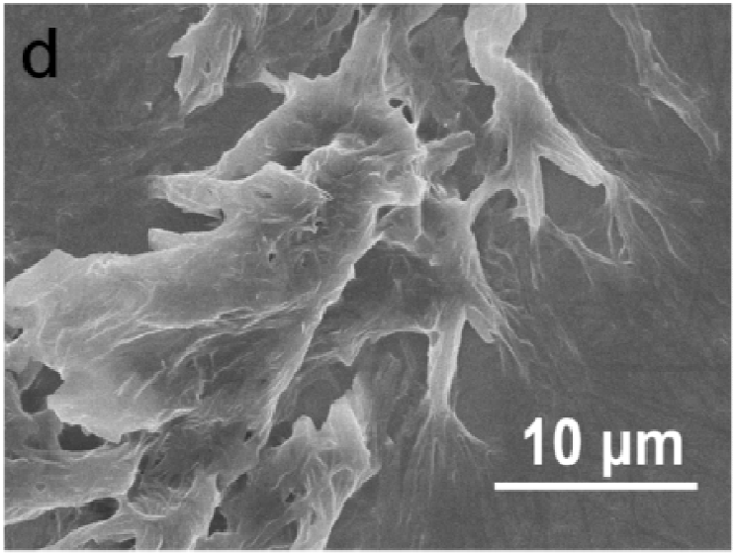
Results - Comparison of ITO/PPy and ITO/PPy film
PPyBQ
PPyBQ
Thickness of benzoquinone doped polypyrrole(PPyBQ) nanowire film is 2 μm, and the average diameter of nanowire is about 130 nm.
In the polypyrrole(PPy) nanostructures synthesized under the same conditions without BQ, the well-defined nanowires could not be obtained.
This result indicates that the BQ serves as the template to induce the formation of PPyBQ nanowires under applied voltage.
PPy
Notes:
This Figure shows the SEM and TEM image of purified benzoquinone doped polypyrrole (PPyBQ) nanostructures.
As you can see, the thickness of benzoquinone doped polypyrrole (PPyBQ) nanowire film is 2 μm, and the average diameter of nanowire is about 130 nm.
In the polypyrrole (Ppy) nanostructures synthesized under the same conditions without BQ, the well-defined nanowires could not be obtained.
This result indicates that the BQ serves as the template to induce the formation of PPyBQ nanowires under applied voltage.

Slide 11
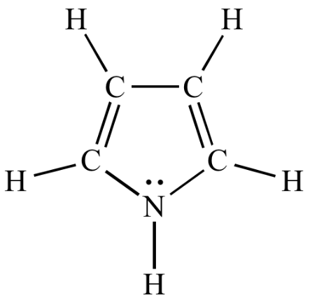
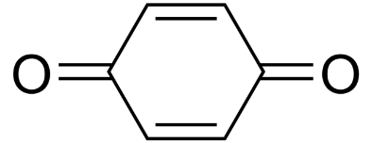
Results - Characterization for ITO/PPyBQ nanowires
3417
C-H
N-H
C-C
C-N
In the FTIR data of PPyBQ, the phenomenon of certain peaks shift and a narrow band may be caused by the conjugation of BQ to the pyrrole ring.
All in all, the results of chemical bonding states of PPyBQ nanowires disclose that PPy nanowires were doped by BQ.
<Benzoquinone>
<Pyrrole>
Notes:
This figure shows the FTIR spectra and XPS spectrum of PPy and purified PPyBQ nanostructures.
In the FTIR data, the black curve corresponds to the stretching vibrations of the pyrrole ring.
And, the red curve is PPyBQ nanowires FTIR spectrum.
The pyrrole ring peaks were also found in the FTIR spectrum of PPyBQ nanowires.
And, the emerging oxygen peak in XPS spectrum demonstrates the existence of BQ.
All in all, the results of chemical bonding states of PPyBQ nanowires disclose that PPy nanowires were doped by BQ.

Slide 12
Results - Construction of ITO/PPyBQ/PSII photoanode
vs.
PPyBQ
PPy
PPyBQ/ PSII
PPyBQ/ PSII
Compared to conventional planar electrodes, this nanostructured electrode with increased effective surface area would immobilize more PSII, which could facilitate enhanced photocurrents.
Notes:
This Figure shows the SEM images of PSII-enriched membranes deposited on purified PPyBQ nanostructures.
Compared to conventional planar electrodes, this nanostructured electrode with increased effective surface area would immobilize more PSII, which could facilitate enhanced photocurrents.

Slide 13
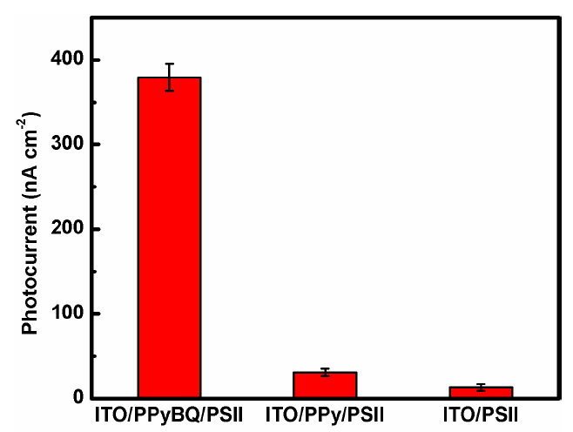
Results – Photocurrent response of ITO/PPyBQ/PSII photoanode
DCMU treated ITO/PPyBQ/PSII
ITO/PPyBQ/PSII
Increase
ITO/PPyBQ
ITO/PPy/PSII
ITO/PPy
ITO/PSII
11.8-fold
ITO
39.0-fold
ITO/PPyBQ
When compared in the presence of PSII, the photocurrent is increased about 11.8 and 39.0-fold for ITO/PPyBQ/PSII, compared to ITO/PPy/PSII and ITO/PSII, respectively.
This result could be attributed to the surface area increased by the nanostructured PPyBQ and the efficient electron transfer between the immobilized PSII and the electrode by redox molecule such as BQ.
From the DCMU test, they confirmed that the photocurrent was generated from PSII coated on the electrode.
Notes:
This figure shows the photocurrent responses of different photoanodes.
As you can see in the photocurrent responses of different photoanodes, the photocurrent density for ITO/PPyBQ/PSII was considerably enhanced, compared to other assemblies.
When compared in the presence of PSII, the photocurrent is increased about 11.8 and 39.0-fold for ITO/PPyBQ/PSII, compared to ITO/Ppy/PSII and ITO/PSII, respectively.
This result could be attributed to the surface area increased by the nanostructured PPyBQ and the efficient electron transfer between the immobilized PSII and the electrode by redox molecule such as BQ.
And, in the presence of DCMU as an inhibitor of PSII, photocurrent for ITO/PPyBQ/PSII is decreased sharply.
This result indicated that the photocurrent was generated from PSII coated on the electrode.

Slide 14
Results – Photocurrent response of ITO/PPyBQ/PSII photoanode
The photocurrent of ITO/PPyBQ/PSII is always higher than that of the ITO/PSII photoanode at the same applied potential.
ITO/PPyBQ/PSII displays a reduced photocurrent along with the diffusion of the free BQ from the polymer film.
The performance of PSII-based device will be enhanced if the concentration of BQ is increased.
BQ
Notes:
This figure shows the influence of applied bias potential on the resulting photocurrent.
The photocurrent of ITO/PPyBQ/PSII is always higher than that of the ITO/PSII photoanode at the same applied potential.
This result is the relative photocurrent responses depended on rinsing times.
As you can see, ITO/PPyBQ/PSII displays a reduced photocurrent along with the diffusion of the free BQ from the polymer film.
This result indicates that the efficient electron transfer between the immobilized PSII and the electrode was facilitated by BQ.
That is, the performance of the PSII-based device will be enhanced if the concentration of BQ is increased.

Slide 15

Results
Under the same continuous red light irradiation, the ITO/PPyBQ/PSII electrode exhibits a significantly slower photocurrent decay than the ITO/PSII electrode.
After illumination for 15 min, about 46 % of the initial photocurrent remains for the ITO/PPyBQ/PSII electrode.
This improvement of stability can be attributed to an efficient electron transfer between PSII and PPyBQ nanowires.
The efficient electron transfer reduces the photoinhibition of PSII caused by the formation of reactive oxygen species or damage of the oxygen-evolving complex.
46 %
15 %
Notes:
This figure shows the photocurrent stability of the ITO/PPyBQ/PSII and ITO/PSII electrodes.
Under the same continuous red light irradiation, the ITO/PPyBQ/PSII electrode exhibits a significantly slower photocurrent decay than the ITO/PSII electrode.
After illumination for 15 min, about 46% of the initial photocurrent remains for the ITO/PPyBQ/PSII electrode.
This improvement of stability can be attributed to an efficient electron transfer between PSII and PPyBQ nanowires.
The efficient electron transfer reduces the photoinhibition of PSII caused by the formation of reactive oxygen species or damage of the oxygen-evolving complex.

Slide 16
Conclusion.
In this study, they construct a novel biohybrid photoanode with enhanced photocurrent and increased stability by integrating PSII with 3D doped conducting polymer nanostructures.
BQ-doped PPy nanowires could promote the effective loading of PSII and facilitate the electron transfer.
Such assembled system combining natural photoactive protein with artificial low-cost conducting polymer shows great potential for advanced solar energy conversion.
Notes:
In this study, they construct a novel biohybrid photoanode with enhanced photocurrent and increased stability by integrating PSII with 3D doped conducting polymer nanostructures.
BQ-doped PPy nanowires could promote the effective loading of PSII and facilitate the electron transfer.
Such assembled system combining natural photoactive protein with artificial low-cost conducting polymer shows great potential for advanced solar energy conversion.

Slide 17
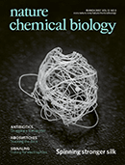
Nature Chemical Biology 12, 1046–1052 (2016)
Competing charge transfer pathways at the photosystem II–electrode interface
Jenny Z Zhang¹, Katarzyna PSokol¹, Nicholas Paul¹, Elisabet Romero², Rienk van Grondelle² & Erwin Reisner^{1*}
This study provides a fuller picture of the electron-transfer pathways at the PSII–electrode interface.
Notes:
This study provides a fuller picture of the electron-transfer pathways at the PSII–electrode interface.

Slide 18
Numerous attempts to use PSII as a photocatalytic unit
Turnover frequency(TOF)
3.2 mol O₂ (mol PSII)⁻¹ s⁻¹
J. Am. Chem. Soc. 2012, 134, 8332−8335
Turnover frequency(TOF)
12.9 mol O₂ (mol PSII)⁻¹ s⁻¹
J. Am. Chem. Soc. 2015, 137, 8541−8549
Notes:
Recently, numerous studies for photolysis of water using PSII as a photocatalyst has been attempted by various approaches.
Despite extensive efforts to optimize the ET efficiency between PSII and the electrode, the turnover-frequency values reported for immobilized PSII on electrodes are typically below 15 s⁻¹.
The low ET efficiency exhibited by PSII at the electrode interface is currently poorly understood.

Slide 19
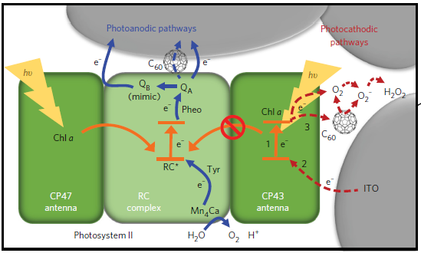
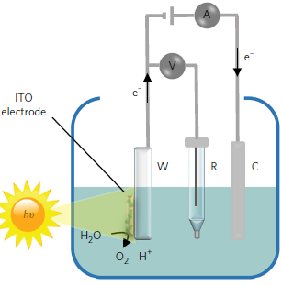
A new light-induced charge transfer pathway
Authors identified a new light-induced charge transfer pathway at the PSII–electrode interface that competes against the known water-oxidation pathway.
Results demonstrate that anaerobicity enhances the photo-response of PSII and unmasks the true onset potential of the photoanodic currents, allowing the Q_{A}/Q_{B} charge transfer step to be studied using protein-film photoelectrochemistry(PF-PEC).
Notes:
In this study, they identified a new light-induced charge transfer pathway at the PSII–electrode interface that competes against the known water-oxidation pathway.
This figure shows that the competing pathway arises from antenna Chla pigments participating in the photo-induced reduction of O₂ near the electrode.
This pathway could be attenuated or amplified by the O₂ concentration and the presence of an electron-accepting matrix.
In this study, their results demonstrate that anaerobicity enhances the photoresponse of PSII and unmasks the true onset potential of the photoanodic currents, allowing the Q_{A}/Q_{B} charge transfer step to be studied using protein-film photoelectrochemistry(PF-PEC).

Slide 20
Inverse opal structure
J. Am. Chem. Soc. 2015, 137, 8541−8549
Ag/AgCl
Reference
electrode
Pt
counter
electrode
0.25 cm²
Microporous electrodes (12 μm thick)
PSII from spinach and Thermosynechococcus elongatus.
Notes:
In this study, they carried out protein-film photoelectrochemistry using PSII isolated from spinach and Thermosynechococcus elongates.
The hierarchically structured ITO electrodes were prepared according to a previously published procedure.
Working electrode, ITO film thickness is 12 μm and surface area is 0.25 cm².
The light source is a halogen lamp collimated by a plano-convex lens and filtered by a bandpass filter (679 nm; full-width at half-maximum, 10.3 nm).
The light intensity is 5 mW/cm² (679 nm).

Slide 21
Both photoanodic and photocathodic currents flow
Photoanodic current
Notes:
This figure shows the photoresponses for PSII, antenna CP43, RC, Chla and β-carotene on applied potential.
As you can see, both PSIIs gave rise to photoanodic currents at applied potentials greater than 0.2 V.
This photoanodic response can be explained by the energy/charge transfer mechanisms depicted in Fig 1b.
When the Fermi level of the electrode is more positive than the redox potentials of the QA/QB cofactors, PSII can transfer electrons directly to the electrode.

Slide 22
Results
Chl a–containing
components
Photocathodic currents were observed at PSII and Chla-containing components under a relatively negative applied potential.
Notes:
In addition, the photocathodic currents were observed at PSII and Chla-containing components under a relatively negative applied potential.
This results indicate that photo-induced electron-transfer can occur from the ITO to free Chl a molecules, as well as to Chl a within the protein shell.

Slide 23
Relatively large photocathodic current for the adsorbed RC complex and chlorophyll a.
  → Attributed to the charge-transfer active Chla pigments within the exposed RC complex forming electronic contact with the electrode surface.
Notes:
As you can see, the adsorbed RC complex shows the larger photocathodic currents than the adsorbed PSII complexes and the antenna subunit.
This result may be attributed to the charge-transfer-active Chl a pigments within the exposed RC complex forming electronic contact with the electrode surface.
And, the relatively smaller photocathodic response of antenna CP43 subunit may be attributed to less favorable protein–electrode interactions owing to the presence of the hydrophobic transmembrane domain.

Slide 24
At 680, the maximum photoanodic and photocathodic response were observed for both PSII complexes, which is in agreement with their respective absorption profiles.
Notes:
(Fig S4 b and c) These figures show the unnormalised action spectra of PSII and Chla pigments at 0.5 V and 0 V.
At 680 and 660 nm, the maximum photoanodic and photocathodic response were observed for both PSII complexes, which is in agreement with their respective absorption profiles.
As you can see, the adsorbed Chla molecules exhibited no photoanodic response, but the photocathodic response was observed at 0 V.
This is further evidence that the photocathodic response stems from the PSII complexes, with substantial involvement from the Chla pigments.

Slide 25
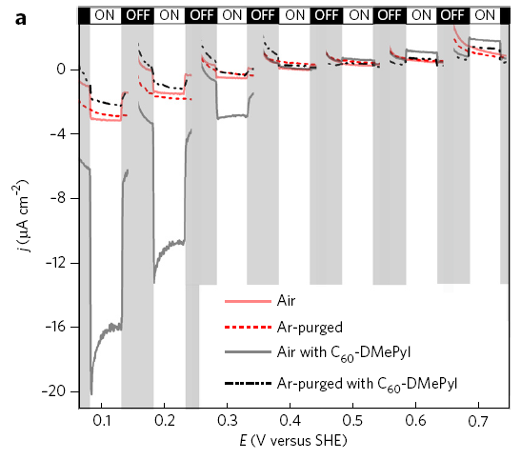
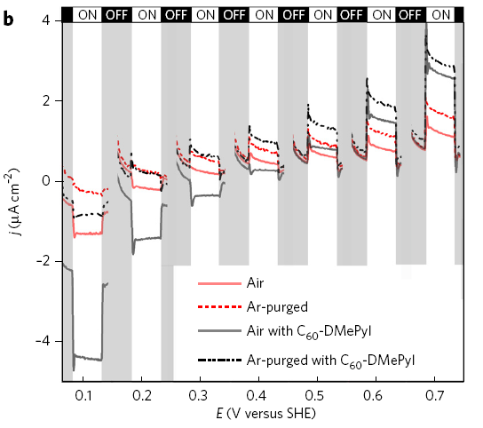
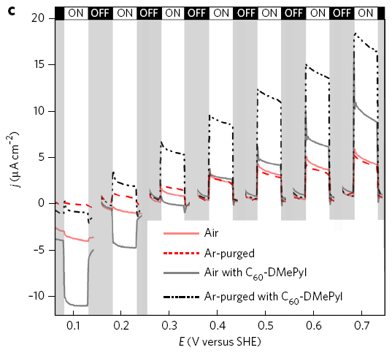
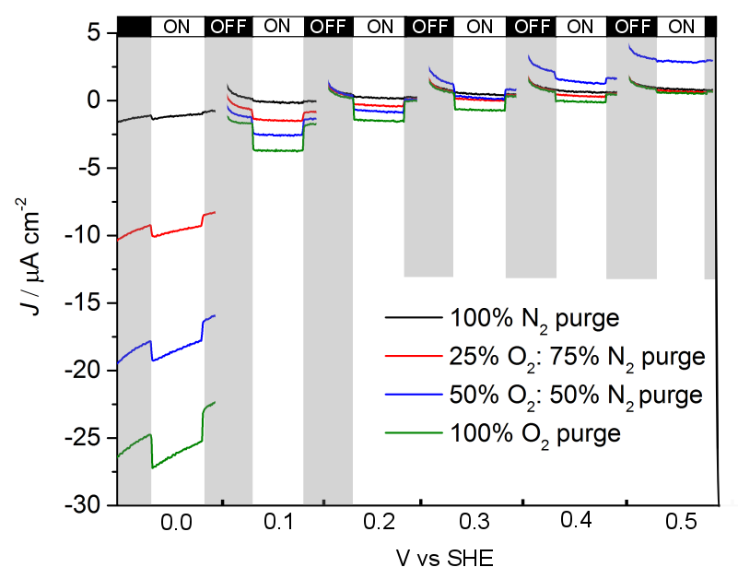
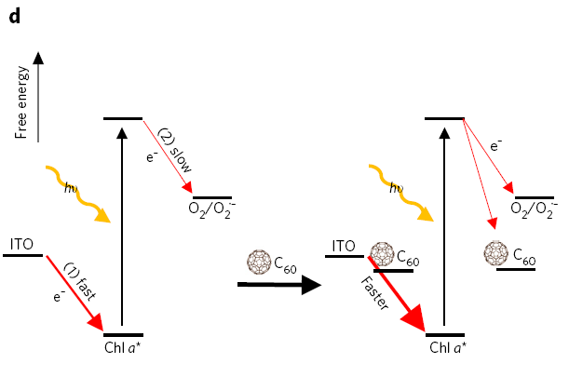
Results
Chla
Spinach-PSII
T. elongates-PSII
The reactive O₂ generated by water-splittng system of PSII can be reduced by the photoexcited Chla under a relatively negative applied potential.
These results show the role of O₂ as an electron acceptor.
The photocathodic currents increased with the concentration of O₂ introduced into the system, which is consistent with the ET from Chla to O₂ being the rate-limiting step.
Chla
Notes:
They proposed that the reactive O2 generated by water-splittng system of PSII can be reduced by the photoexcited Chla under a relatively negative applied potential.
These fiures show the photoresponse of adsorbed Chla molecules and PSII complexes in the presence and absence of O₂.
In anaerobic conditions, the photocathodic responses were decreased in all cases.
And, the increased photoanodic responses were observed from PSII core complexes.
These results show the role of O₂ as an electron acceptor.
(Fig 5S) This figure shows the photoresponses for Chla in electrolyte solutions purged with different concentrations of O₂ gas.
As you can see, the photocathodic currents increased with the concentration of O₂ introduced into the system, which is consistent with the electron-transfer from Chla to O₂ being the rate-limiting step.

Slide 26
Results
Chla
Spinach-PSII
T. elongates-PSII
The fullerene used in this test can improved the PSII–electrode interface by its high electron mobility.
The electron-conducting matrix led to enhancements of both electron-transfer pathways at the PSII–electrode interface.
The fullerene enhances O₂ reduction pathways.
The fullerene can facilitate the electron-transfer from the reduced Q_{A}/Q_{B} to the ITO electrode.
Notes:
The fullerene used in this test can improved the PSII–electrode interface by its high electron mobility.
In the presence of fullerene under the aerobic conditions, the enhanced photoanodic and photocathodic currents were observed in all cases.
This result indicates that the electron-conducting matrix led to enhancements of both electron-transfer pathways at the PSII–electrode interface.
On the other hand, under the Ar-purged conditions, the photocathodic enhancements were dampened.
This result indicates that the fullerene enhances O₂ reduction pathways.
And, the more enhanced photoanodic responses under the Ar-purged conditions could be attributed to the diminishment of the O₂ reduction pathway.
Furthermore, this result indicates that the fullerene can facilitate the electron-transfer from the reduced Q_{A}/Q_{B} to the ITO electrode.

Slide 27
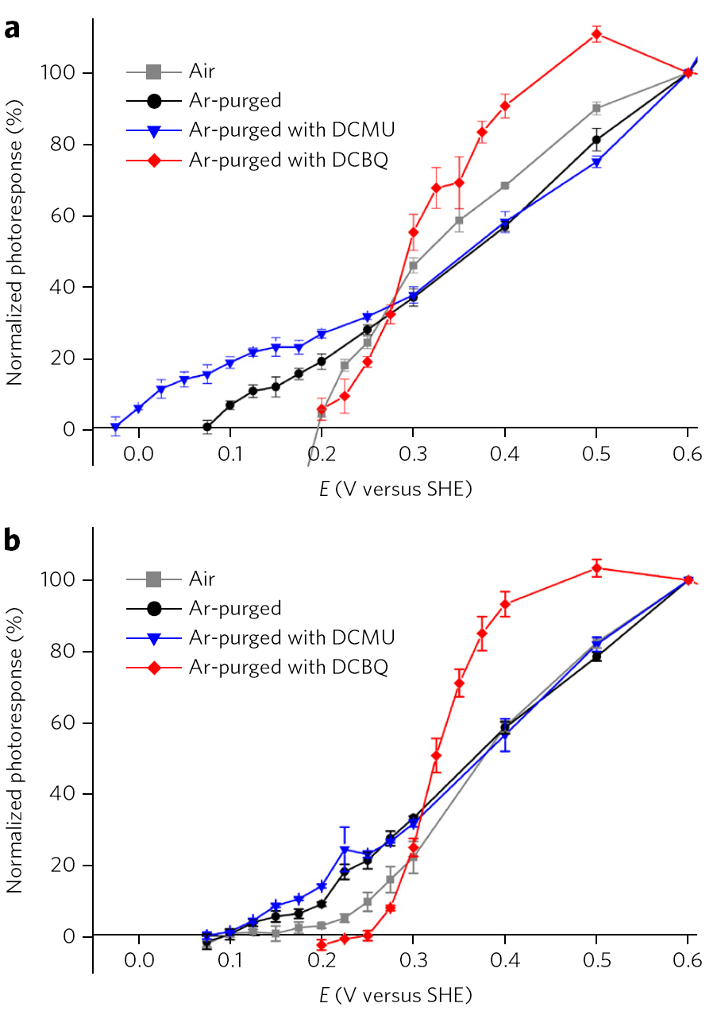
Results
Spinach
PSII
Q_{A}/Q_{A}⁻
~ -25 mV
Cathodic shift
~75 mV (Onset potential for spinach PSII )
Appropriate pairing of synthetic electron acceptors to the redox potential of the plastoquinones is essential for overall PSII water-oxidation performance.
Ar purging produced a substantial cathodic shift in the onset potentials due to the elimination of the photo-cathodic interference.
The Q_{B} electron-transfer site can be inhibited by DCMU, in which case the electrons are transferred directly from Q_{A} to the electrode.
Q_{A}/Q_{A}⁻
~ 100 mV
T. elongatus
PSII
Cathodic shift
~100 mV (Onset potential for T. elongatus PSII )
Notes:
Appropriate pairing of synthetic electron acceptors to the redox potential of the plastoquinones is essential for overall PSII water-oxidation performance.
This figure shows the normalized photoresponses scanned in the anodic direction, plotted as a function of the applied potential.
Under the Ar-purged conditions, the onset potentials of spinach and T. elongatus PSII were observed at ~75 and 100 mV, respectively.
In the scans of both PSIIs, Ar purging produced a substantial cathodic shift in the onset potentials due to the elimination of the photo-cathodic interference.
The Q_{B} electron-transfer site can be inhibited by DCMU, in which case the electrons are transferred directly from Q_{A} to the electrode.
Therefore, the DCMU inhibitor treatment can allow that the Q_{A} to be more selectively studied.
As you can see, the presence of DCMU shifted the onset potential of spinach PSII by ~100 mV.
However, the presence of DCMU did not affect the onset potential of T. elongatus PSII.

Slide 28
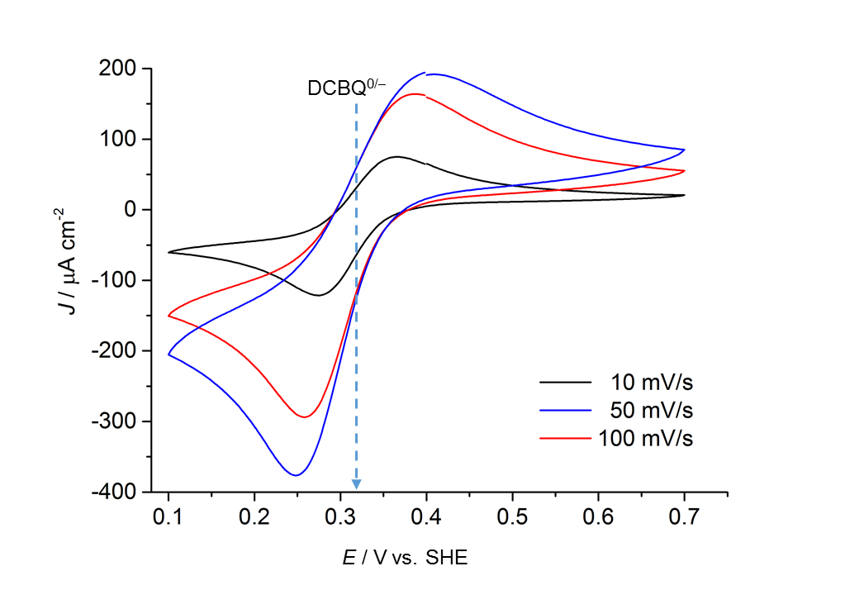
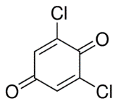
Results
~310 mV
(E_{m} for spinach PSII )
Spinach
PSII
~250 mV (Onset potential for spinach PSII )
320 mV
~310 mV
(E_{m} for spinach PSII )
To prove the onset potential for Q_{A} and PSII, they added the DCBQ in the both PSII systems and identified the onset and midpoint potential for DCBQ.
This value is consistent with the value of 320 mV derived from CV scans performed in the same buffer conditions.
T. elongatus
PSII
~250 mV (Onset potential for T. elongatus PSII )
Notes:
To prove the onset potential for Q_{A} and PSII, they added the DCBQ in the both PSII systems and identified the onset and midpoint potential for DCBQ.
In the presence of DCBQ, the onset potentials for both PSIIs were observed at ~250 mV.
And, the midpoint potential of DCBQ is ~310 mV.
This value is consistent with the value of 320 mV derived from CV scans performed in the same buffer conditions.

Slide 29
Summary of the photoanodic and photocathodic charge transfer pathways
These findings impart a fuller understanding of the charge transfer pathways within PSII and at photosystem–electrode interfaces.
Knowledge of the competing pathway will affect photobioelectrodes incorporating photosystems, RCs, and whole cells with respect to energy-conversion efficiency and device stability.
Notes:
Figure 5 shows a summary of the photoanodic and photocathodic charge transfer pathways within PSII and at the PSII–electrode interface.
These findings impart a fuller understanding of the charge transfer pathways within PSII and at photosystem–electrode interfaces.
Knowledge of the competing pathway will affect photobioelectrodes incorporating photosystems, RCs, and whole cells with respect to energy-conversion efficiency and device stability.

Slide 30
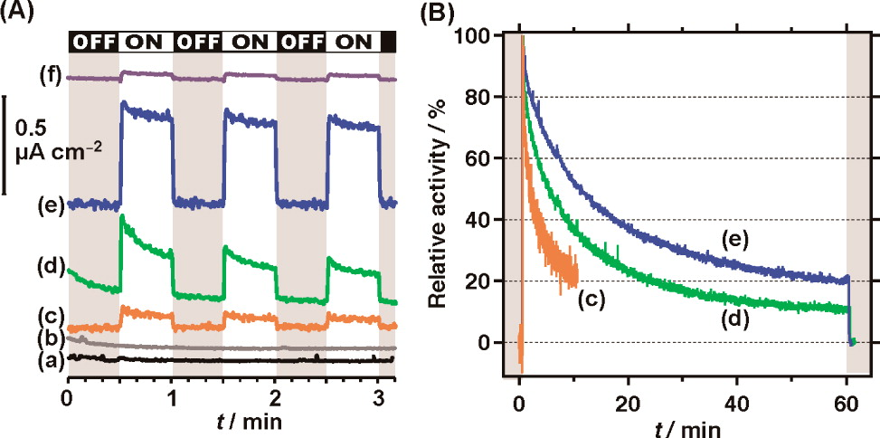
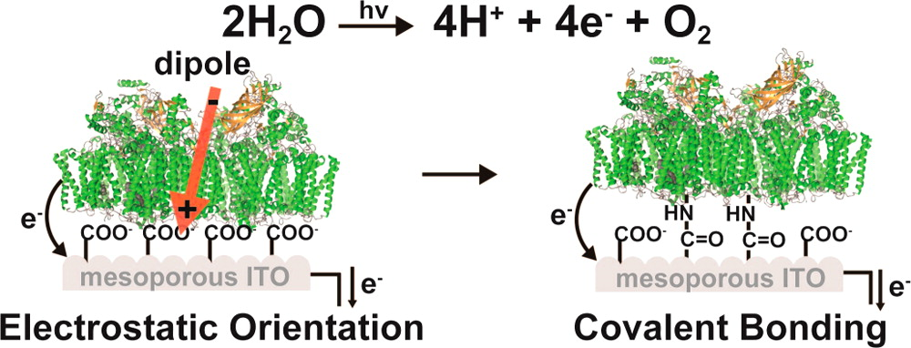
J. Am. Chem. Soc. 2013, 135, 10610−10613
Covalent Immobilization of Oriented Photosystem II on a
Nanostructured Electrode for Solar Water Oxidation
Masaru Kato,† Tanai Cardona,‡ A. William Rutherford,‡ and Erwin Reisner*,†
e-mesoITO|SAM-C₂CO₂⁻|PSII
c-mesoITO|SAM-C₂CO₂⁻|PSII

Slide 31
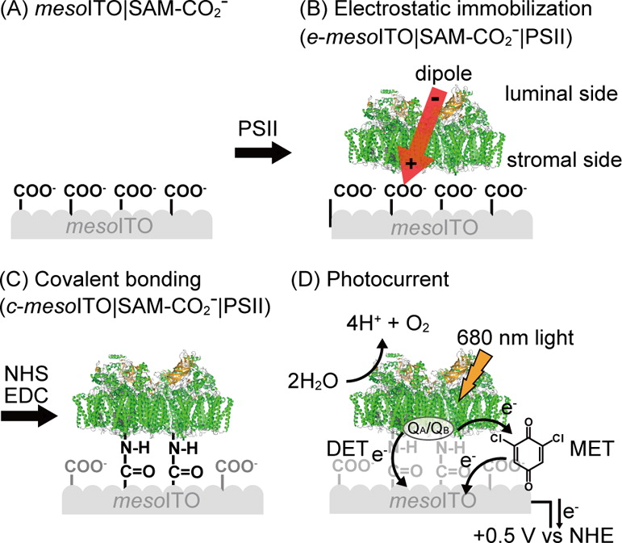
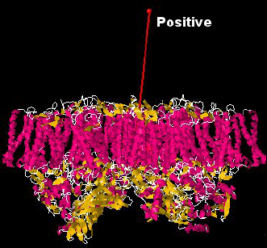
Experimental Section
Positive dipole vector is located on the stromal side of the thylakoid membrane, where the potential electron donor sites, in particular the quinones Q_{A} and Q_{B}, are located.
Notes:
우선 간단히 실험방법에 대해서 설명하겠습니다.
ITO electrode를 carboxyl group을 갖는 linker molecule로 modification합니다. 그 다음 PS2를 electrostatic immobilization시킵니다.
옆에 보이는 그림처럼 PS2는 QA와 QB부분으로 positive dipole이 형성되어 있어 carboxyl group의 negative charge에 다음과 같은 형태로 배향될 수 있습니다.
다음과 같은 배향은 QA와 QB부분에서 electrode로 electron transfer가 일어날 수 있습니다.
다음 다음과 같이 배향된 PS2에 EDC/NHS를 처리를 하면 electrode의 carboxyl group과 PS2의 amine group이 bioconjugation되어 PS2에서 물 분해로 생성된 electron이 electrode로 transfer될 수 있습니다.

Slide 32
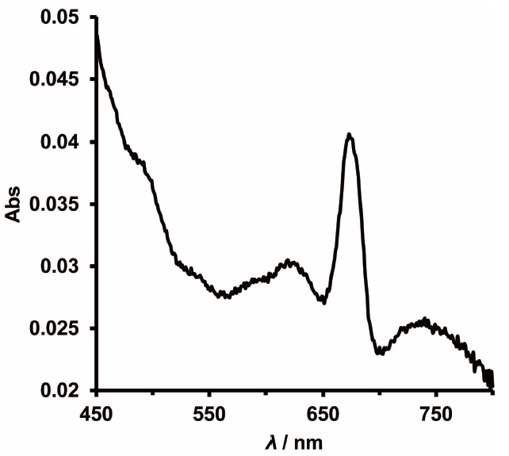
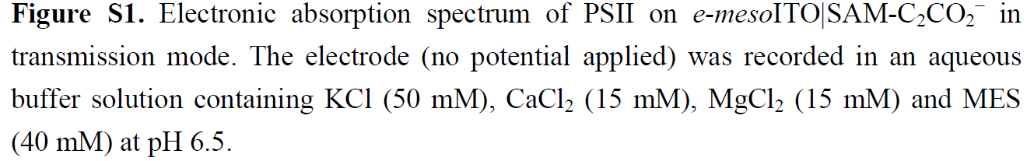
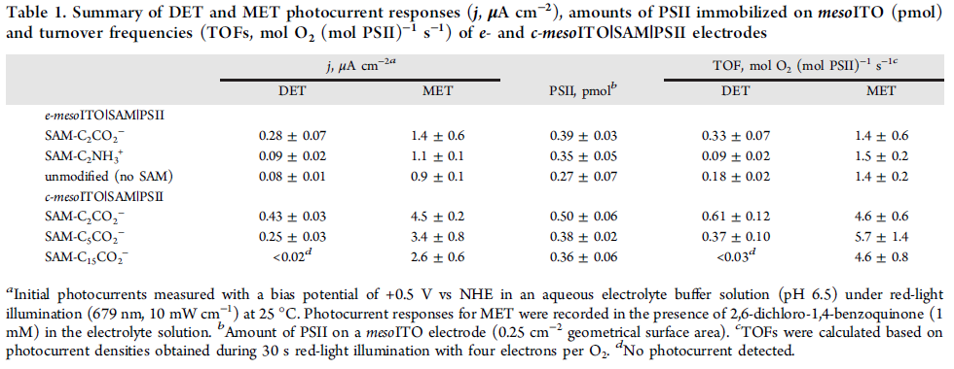
Results and Discussions.
675 nm
3-fold increase
* Mediated Electron Transfer (MET)
Notes:
다음은 PS2를 ITO electrode에 electrostatic immobilization 시킨 data입니다.
Figure S1은 PS2를 ITO electrode에 electrostatic immobilization시키고 absorption spectrum을 측정한 data이며, 보이는 것과 같이 675nm에서 PS2의 absorption peak이 측정된 것을 볼 수 있습니다.
Table 1에서 보면 각각의 electrode에 PS2의 흡착량이 비슷한 것을 볼 수 있습니다.
PS2를 ITO electrode에 electrostatic immobilization 시킨 photocurrent를 보면 ITO에 carboxyl group으로 modification된 electrode에서 가장 높은 photocurrent가 나오는 것을 알수 있습니다.
이와 같이 negative charge를 띠는 electrode에 배향된 PS2의 QA와 QB부분이 electrode에 인접해 있어 electron transfer가 다른 것들에 비해 잘 된 것을 알 수 있습니다.

Slide 33
Results and Discussions.
* Mediated Electron Transfer (MET)
Notes:
다음은 EDC와 NHS로 PS2를 ITO electrode에 고정시킨 data입니다. EDC/NHS를 통해 electrode에 peptide bond를 형성 할 수 있으며, peptide bond으로 인해 PS2에서 물 분해로 생성된 electron이 직접적으로 electrode에 transfer되게 됩니다.
Table 1을 보시면 electrostatic으로만 고정시킨 electrode보다 peptide bond과 같은 covalent bond를 형성하는 electrode에서 증가된 photocurrent를 볼 수 있습니다.
EDC/NHS 실험방법 두 가지 설명, 장점

Slide 34
Half-life time ∼12 min
c-mesoITO|SAM-C₂CO₂⁻|PSII
e-mesoITO|SAM-C₂CO₂⁻|PSII
mesoITO|PSII without SAM
Notes:
다음 figure 2 은 PS2를 covalent bond를 통해 고정시킨 electrode와 electrostatic만으로만 고정시킨 electrode의 비교 data입니다.
보이는 것과 같이 covalent bond로 고정된 electrode의 photocurrent가 가장 높은 것을 볼 수 있으며, 반감기 또한 가장 안정적인 것을 확인 할 수 있습니다.

Slide 35
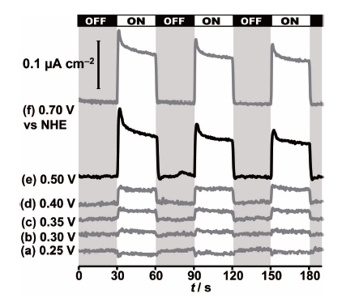
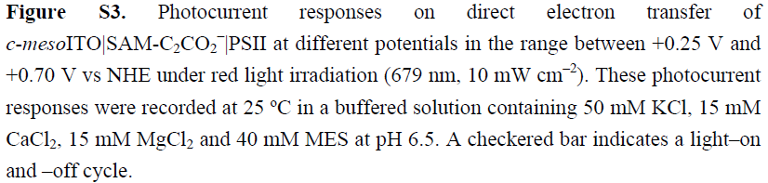
The photocurrent response of c-mesoITO|SAM-C₂CO₂⁻|PSII also reflects the intrinsic activity of PSII with the highest activity at pH 6.5.
Decreased DET photocurrents were observed at pH 5.5 (0.053 ± 0.003 μA cm⁻²) and pH 7.5 (0.08 ± 0.03 μA cm⁻²).
The Q_{B} site inhibitor DCMU (3-(3,4-dichlorophenyl)-1,1-imethylurea) binds to the Q_{B} pocket and blocks electron transfer from Q_{A} to Q_{B}.
Addition of 3-(3,4-dichlorophenyl)-1,1-dimethylurea (1 mM) to the electrolyte solution for c-mesoITO|SAM-C₂CO₂⁻|PSII resulted in a two-third reduction in photocurrent of DET (0.15 ± 0.01 μA cm⁻²), suggesting a DET pathway via Q_{A} to the electrode in addition to the dominating electron delivery by Q_{B}.
Notes:
다음 figure S3는 각각 potential에 따른 photocurrent입니다.
Photocurrent는 최소 0.3V에서 나오는 것을 볼 수 있으며, pH 6.5 상태에서 가장 높은 photocurrent가 나오는 것을 할 수 있습니다.
이 논문에서는 QB부분을 block하는 제초제를 넣어 Q부분에서 electrode로 electron transfer되는 것을 억제하였습니다.
그 결과 photocurrent가 감소 하였으며, 이 것으로 PS2의 배향을 통해 Q부분에서 electrode로 electron transfer된다는 것을 알 수 있습니다.

Slide 36
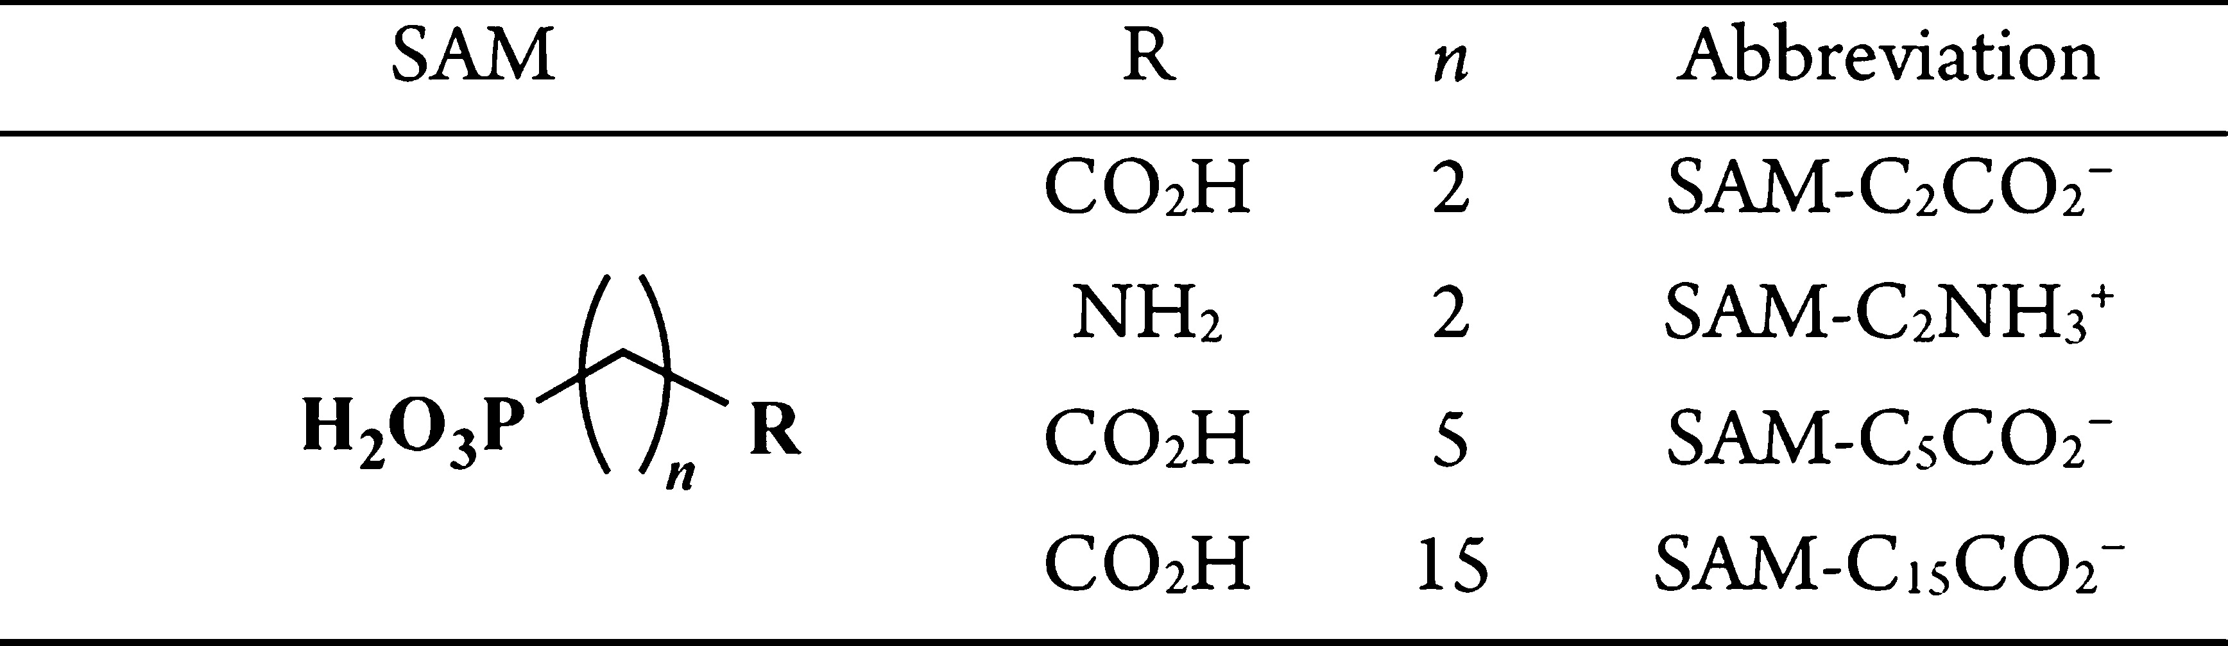
Effect of length of a linker on the photocurrent
Long linker : low photocurrent
Notes:
다음은 ITO electrode에 modification된 linker molecule 길이에 따른 photocurrent data입니다.
다음 linker molecule의 길이가 증가 할 수록 photocurrent가 감소하는 것을 볼 수 있으며, redox mediator을 첨가 하면 linker molecule의 길이가 길어도 어느 정도 photocurrent가 발생하는 것을 볼 수 있습니다.
이 것으로 보아 linker molecule을 통해 electrode로 electron transfer가 일어난다는 것을 알 수 있습니다.

Slide 37

Conclusion.
Electrostatic interactions between PSII and the negatively charged meso ITO electrode orient PSII via its dipole moment in its favorable orientation for interfacial electron transfer.
The carboxylates from the SAM can be covalently coupled with EDC and NHS to amine residues from amino acids in PSII.
Covalent attachment of PSII in its electrostatically improved orientation to the SAM-modified ITO electrode was accomplished via an amide bond to further enhance red-light-driven, direct electron transfer and stability of the PSII hybrid photoelectrode.
The photon-to-current conversion efficiency of cmesoITO| SAM-C₂CO₂⁻|PSII was determined to be ∼0.01% and 0.1% for DET and MET, respectively.

