Slide 1
Microbial fuel cells that have been performed in my lab
김성현

Slide 2
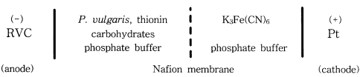
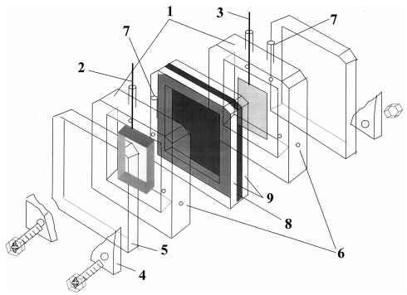
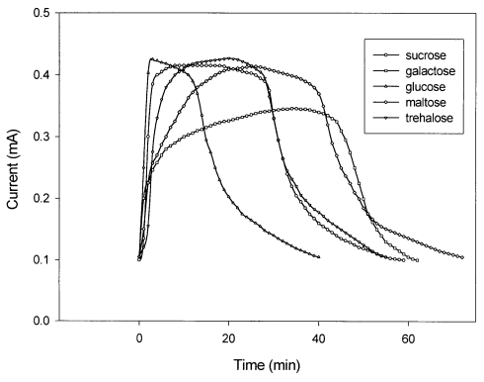
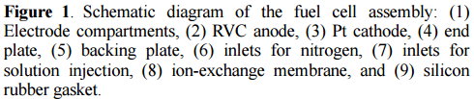

Development of Microbial Fuel Cells Using Proteus vulgaris
Bull. Korean Chem. Soc. 2000, 21, 44

Slide 3
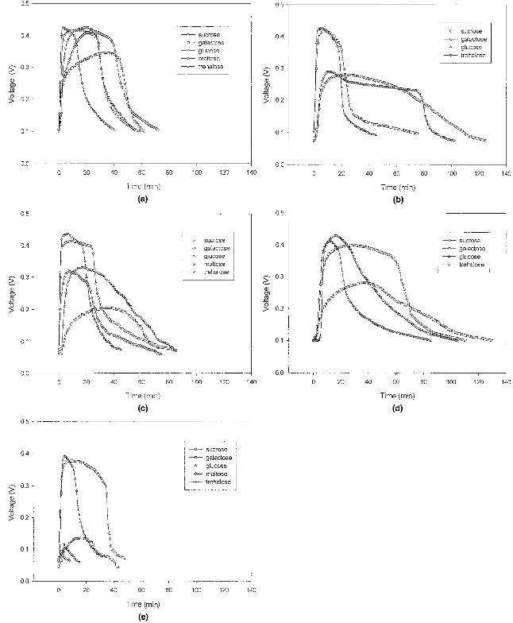
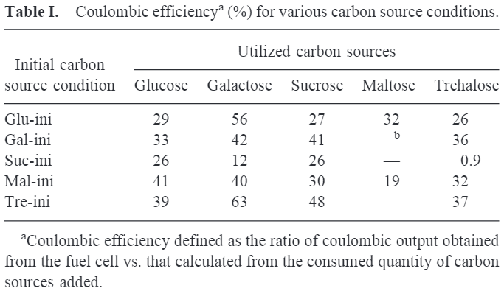
Effect of Initial Carbon Sources on the
Performance of Microbial Fuel Cells
Containing Proteus vulgaris
Biotechnology and Bioengineering. 2000, 70, 119.

Slide 4
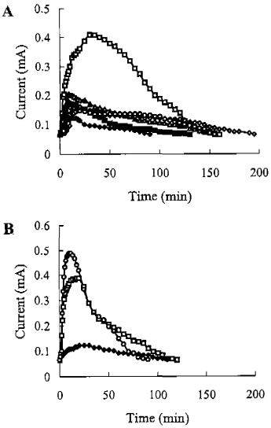
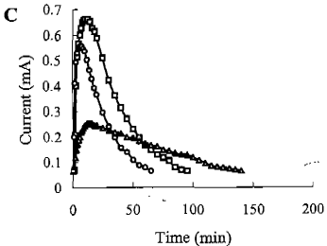
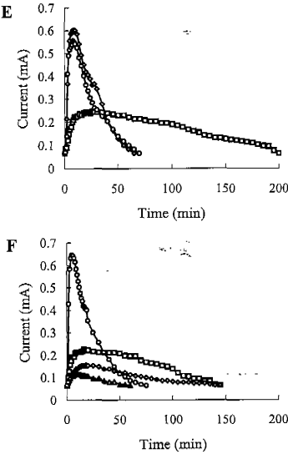
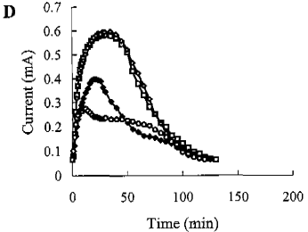
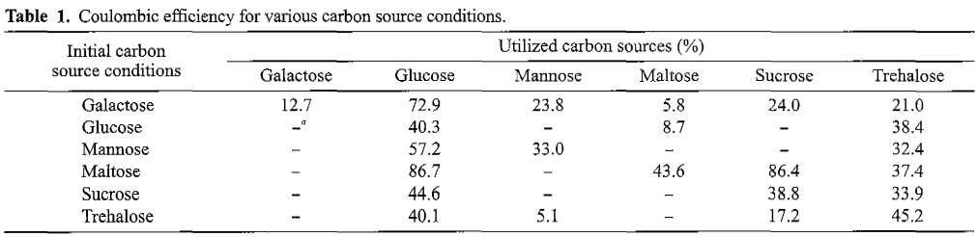
Optimization of the performance of microbial fuel cells containing alkalophilic Bacillus sp.
J. Microbial Biotechnol. 2001, 11, 863.

Slide 5
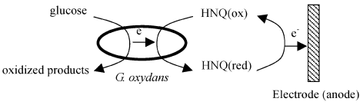
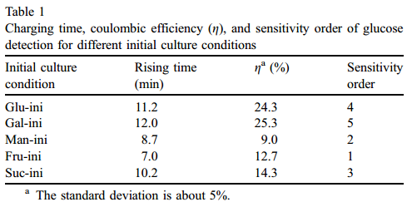
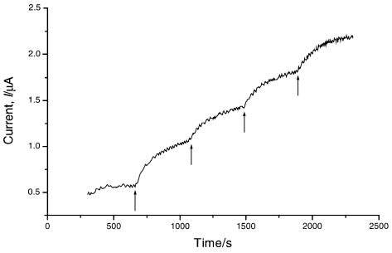
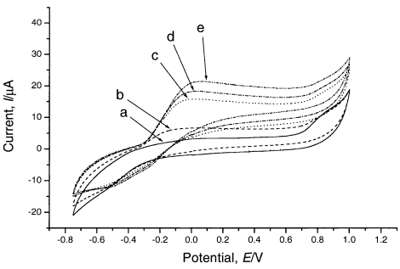
Effect of initial carbon sources on the electrochemical detection of glucose by Gluconobacter oxydans
Bioelectrochemistry 57 (2002) 173 – 178
Amperometric detection of glucose

Slide 6
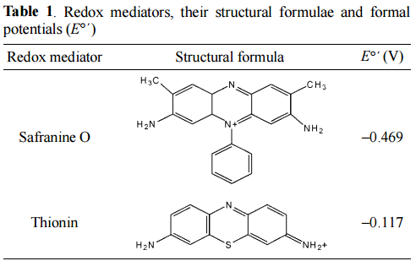
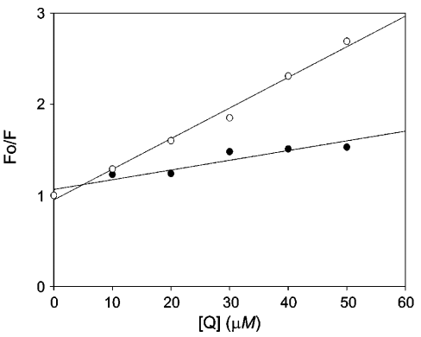
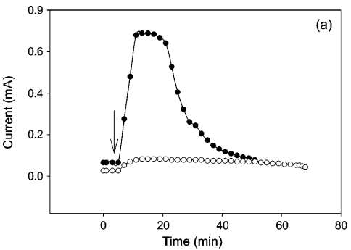
Dynamic Behaviors of Redox Mediators within the Hydrophobic Layers as an Important Factor for Effective Microbial Fuel Cell Operation
Bull. Korean Chem. Soc. 2003, Vol. 24, No. 4 437
Quenching experiments
Fo/F = KSV [Q] + 1

Slide 7
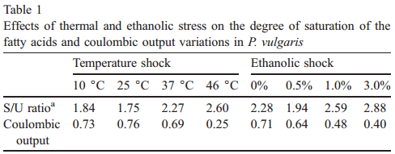
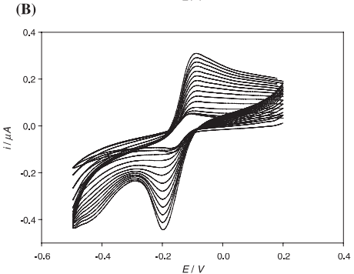
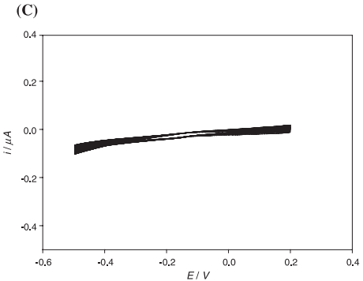
Membrane Fluidity Sensoring Microbial Fuel Cell
Bioelectrochemistry 59 (2003) 121 – 127
Temperature shock
25 ºC
46 ºC

Slide 8
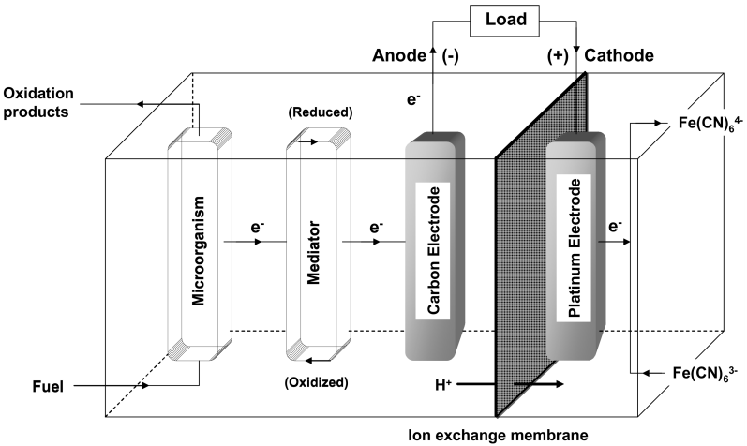
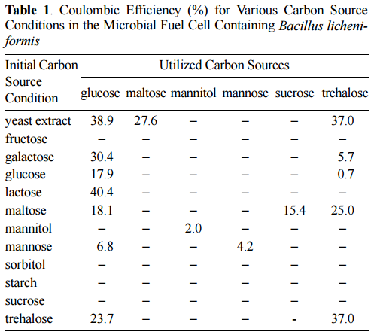
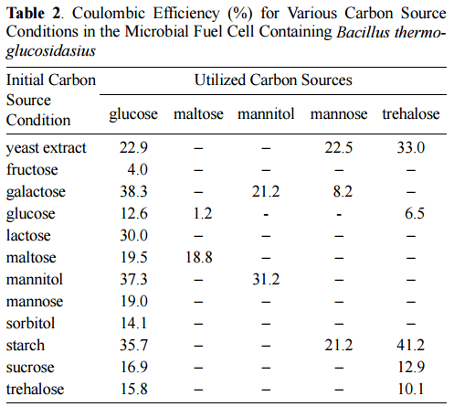
Construction of Microbial Fuel Cells Using Thermophilic Microorganisms, Bacillus Licheniformis and Bacillus thermoglucosidasius
Bull. Korean Chem. Soc. 2004, 25, 813.

Slide 9
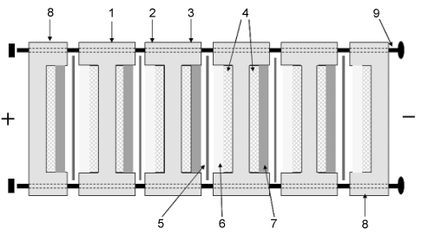
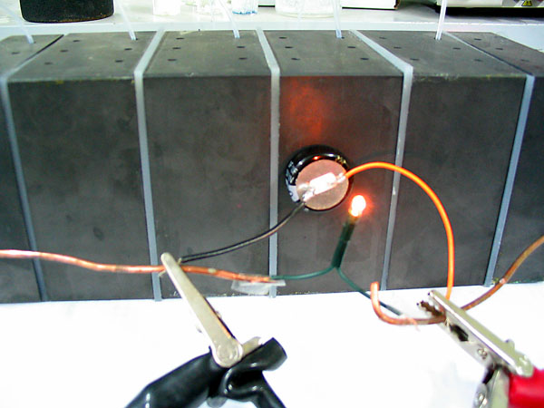
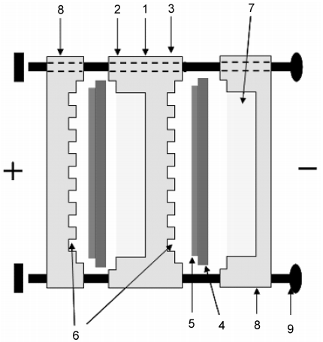
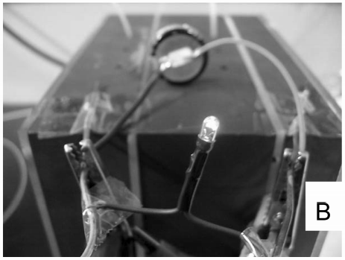
Development of bipolar plate stack for microbial fuel cells.
Bull. Korean Chem. Soc. 2006, 27, 281

Slide 10
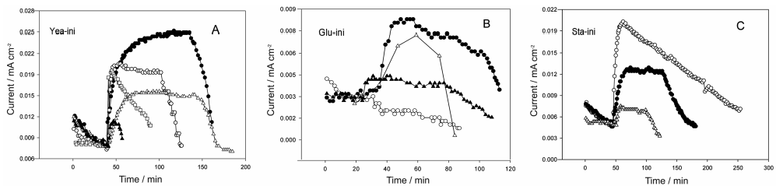
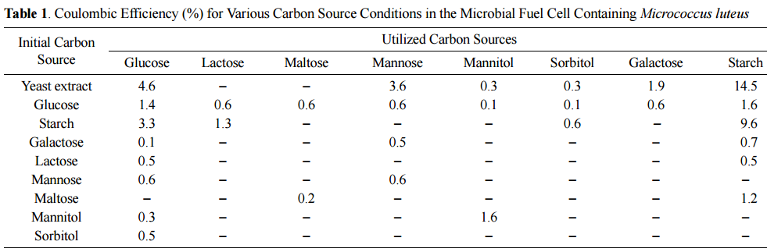
Effect of initial carbon sources on the performance of a microbial fuel cell containing environmental microorganism Micrococcus luteus
Bull.Korean Chem. Soc. 2007, 28, 1591.

Slide 11
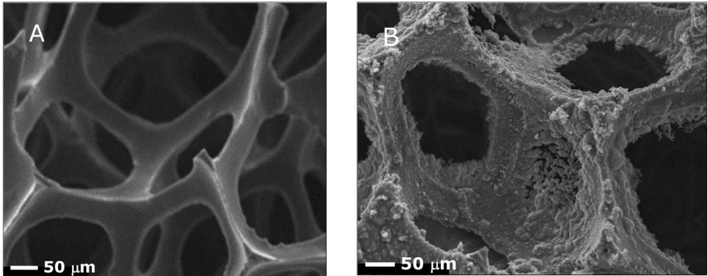
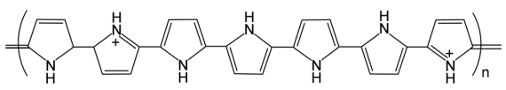
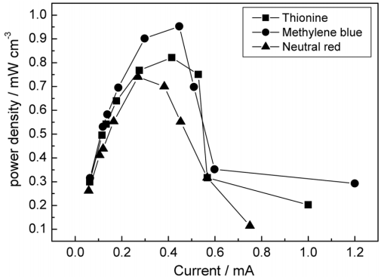
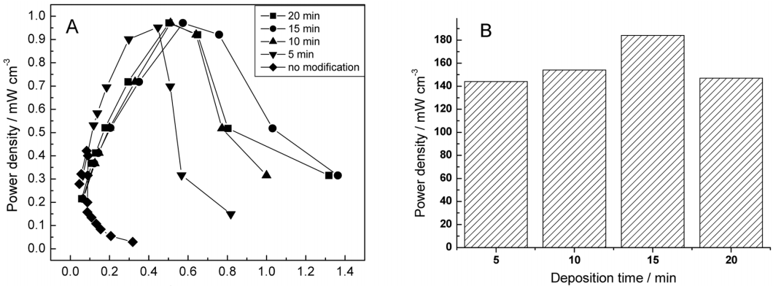
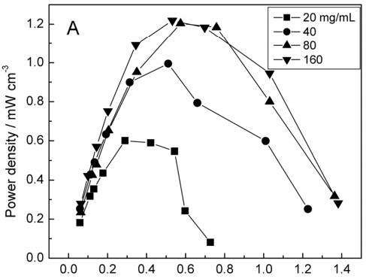
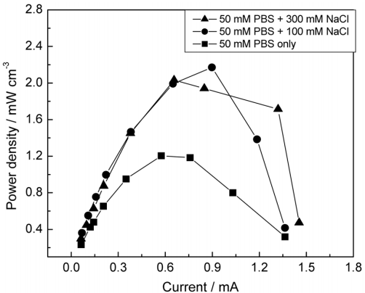
Polypyrrole-coated reticulated vitreous carbon as anode in microbial fuel cell for higher energy output.
Bull. Korean Chem. Soc. 2008, 29, 1344

Slide 12
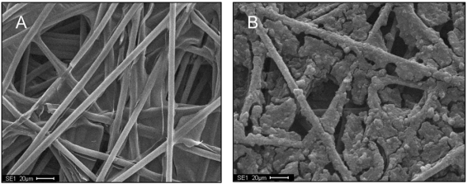
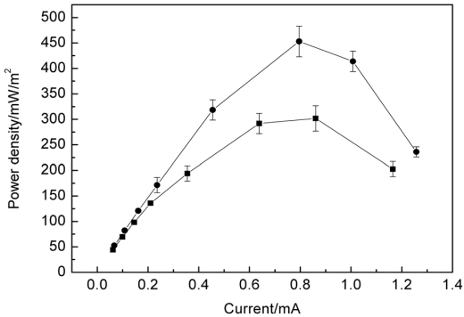
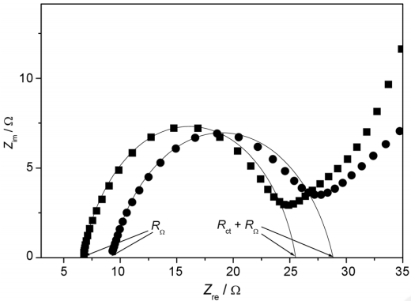
Improved performance of a microbial fuel cell with polypyrrole/carbon black composite coated carbon paper anodes
Bull.Korean Chem. Soc. 2008, 29, 1344
Power density plot of an MFC with different anodes, Ppy/CB (■) and electrodeposited Ppy anode (●). Electrodeposition of Ppy
Nyquist plot for the plain carbon paper and Ppy/CBcoated carbon paper. Semi-circle parts were fitted to obtain R_{Ω} and R_{ct}.

Slide 13
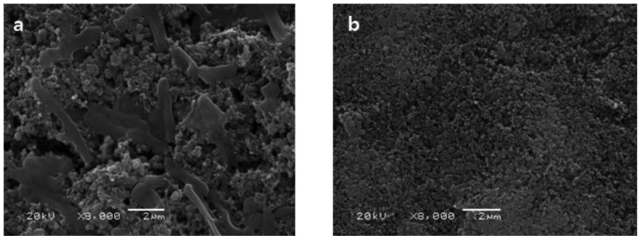
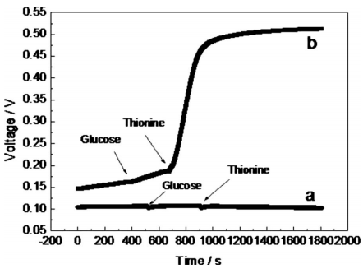
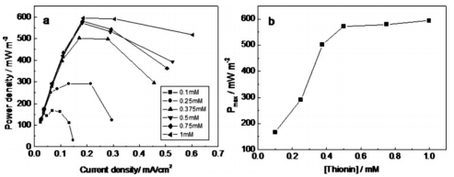
Use of Carbon Nanoparticles for Bacteria Immobilization in Microbial Fuel Cells for High Power Output
Journal of The Electrochemical Society, 2009, 156, B1238.

Slide 14
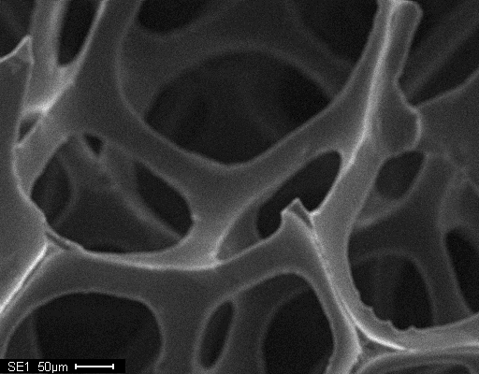
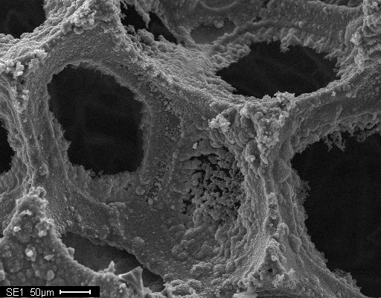
Polypyrrole-modified RVC anode in a mediator-type MFC by pure culture
Microbe: P. vulgaris
Mediator: methylene Blue
Polypyrrole
Bull. Korean Chem. Soc. 29 (2008) 168-172

Slide 15
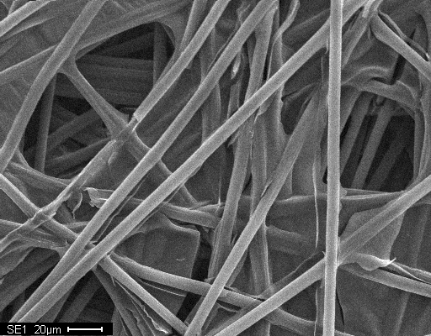
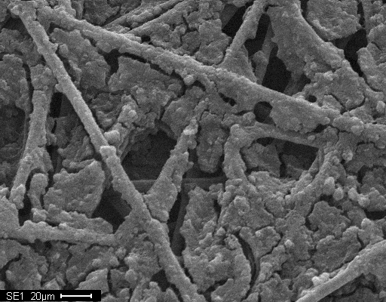
Polypyrrole/CB composite modified carbon paper anode in a mediator-type MFC
A
Microbe: P. vulgaris
Mediator: thionin
B
A: Bare carbon paper
B: CB coated carbon paper
C: Ppy/CB-coated carbon paper
B
Nyquist plots for the plain carbon paper and Ppy/CB-coated carbon paper.
Bull. Korean Chem. Soc. 29 (2008) 1344-1348

Slide 16
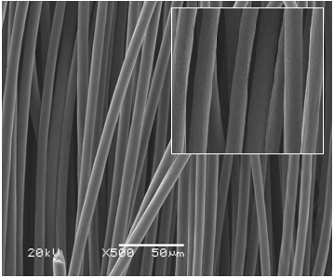
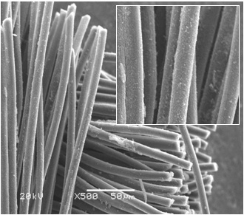
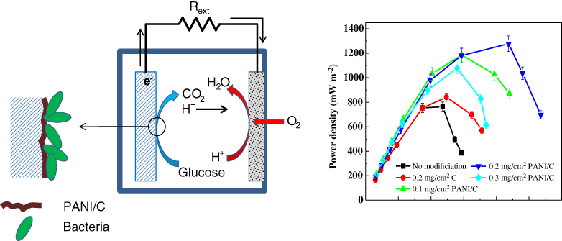
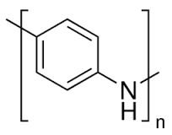
Polyaniline/Carbon composite modified carbon cloth anode in a single chamber MFC-mixed culture
Carbon cloth
PANI/C-coated carbon cloth
Bull. Korean Chem. Soc. 28 (2015) 2170-2173

Slide 17






Polyaniline nanofiber-coated macroporous RVC anode for high performance MFCs
a
b
c
X-ray photoelectron spectra (a) Survey scan for RVC, RVC-PANI & RVC-PANI-HT. (b) De-convulated N1s peaks of RVC-PANI and (c ) Deconvulated N1s peaks for RVC-PANI-HT
SEM images of (a) RVC macrospores, (b) after PANInf modification, and after PANInf modification and heat treatment at 750 ºC.

Slide 18







RVC exterior
RVC interior
RVC-PANI exterior
RVC-PANI interior
RVC-PANI-HT exterior
RVC-PANI-HT interior
Schematic presentation of typical microbial fuel cell set up
Biofilm formation on the exterior and interior of RVC

Slide 19
Charging-discharging curves
CVs at the turn-over conditions
CVs at the substrate depletion conditions
Polarization curves RVC (◇) RVC-PANI (○) RVC-PANI-HT (▷) and corresponding power density curves. MFCs run in 1g/L acetate.

Slide 20




Electricity generation from non- electroactive bacteria
Biosens. Bioelectron. 27 (2011) 106-112

Slide 21

Use of Osmium Redox Polymer

Slide 22
MFC Performance

Slide 23

Conducting polymers as cathode modifiers for oxygen reduction
Cathode is also important!
O₂ + 4H⁺ + 4e⁻ → 2H₂O
Trends in oxygen reduction activity plotted as a function of the oxygen binding energy.
J. Phys. Chem. B, 108 (2004) 17886–17892

Slide 24


Development of non-noble metal oxygen reduction catalysts for air cathodes
Materials
  1. Polyaniline nanofiber/Carbon composite
  2. Polyaniline/Carbon composite/FePc
  3. Multi-walled carbon nanotubes (MWCNT)
  p-MWCNT (pristine)
  a-MWCNT (NH₂-functionalized)
  c-MWCNT (COOH-functionalized)
  4. Iron phthalocyanine (FePc)
    MWCNT-supported FePc
  5. Carbon/Cobalt oxide/CoPc

Slide 25
Polyaniline/C composite air-cathode in a single-chamber microbial fuel cell
Voltage-time curve in a start-up period in 0.1 M PBS buffer under 1 kΩ external load. Substrate =1 g/L glucose.
Repetitive charging-discharging cycle of an MFC with PANI/C air cathode in 0.1 M PBS buffer under 1k Ω external load. Susbtrate=1 g/L glucose.

Slide 26


Polyaniline/C/FePc as air-cathode in a single-chamber microbial fuel cell
Cyclic voltammetric characterizations of PANI/C and PANI/C/FePc at a scan rate of 100mV/s (A), CVs of PANI/C/FePc with different scan rates (B), and peak current dependence on scan rates
J. Power Sources 196 (2011) 1103.

Slide 27


CV (A) and LSV of various electrodes for the oxygen reduction at scan rate of 100 mV/s (B) and 1 mV/s (C)

Slide 28



Polyaniline nanofiber as an ORR catalyst
Characterization
SEM (left) and TEM (right) images of synthesized polyaniline nanofiber.
UV/vis spectra of polyaniline nanofiber as prepared (a) and after treating in 0.2 M NH₄OH (b).
J. Electrochem. Soc. 159 (2012) B497-B501

Slide 29

XPS characterization of polyaniline nanofiber and voltage generation in start-up period
N1s XPS spectra for pristine polyaniline nanofiber (A) and polyaniline nanofiber/C (B)
Voltage generation at start-up stage of an MFC with polyaniline nanofiber (●) and polyaniline nanofiber/C (●).

Slide 30



% Coulombic efficiency for PANInf/C (a) and Pt/C (b) cathodes.
A: Plot of power density vs current density for PANInf (●), PANInf/C (●), and carbon black (▲) cathode.
B: Individual electrode potential measured with respect to SCE as a function of current density.
Effect of the amount of PANInf/C

Slide 31
Comparison of material costs
Cathode material | Price(g/$) | Power density (mW/m²) | Power per cost of cathode material (mW/$)
Polyaniline/C Pt/C Polyaniline/C/FePc Polyaniline/C/CoPc FePc/C | 3.392 29.38 3.392+7.35 3.392+9.74 0.0718+7.35 | 381.4 575.6 630.5 534.9 336.6 | 7.78 0.55 4.11 2.85 3.17

Slide 32


MWCNT and MWCNT-supported iron(ІІ) phthalocyanine based oxygen reduction catalysts as cathode in a single-chamber microbial fuel cell
Raman spectra for plain MWCNT (black), COOH-functionalized MWCNT (red), and NH₂-functionalized MWCNT (blue).
FETEM images of a-MWCNT (A) and a-MWCNT/FePc (B) samples at different magnifications
Biores. Tech. 102 (2011) 5849-5854

Slide 33

Electrochemical characterization and voltage output by MWCNT and MWCNT/FePc
Voltage output with various MWCNT/FePc and C/FePc coated cloth cathodes at 550ohm using 1 g/L glucose as fuel.
CVs of GC, a-MWCNT and a-MWCNT/FePc-coated GC in pH 7 PBS at 10 mV/s.

Slide 34
Power generation with various cathodes
1) Synthetic wastewater - glucose
2) Real wastewater from a sewage treatment plant
Biores. Tech. 102 (2011) 5849-5854

Slide 35
Table 1. Summary of MWCNTs cathode performance
Cathode | Power density mW/m²(glucose) | Power density mW/m²(wastewater) | CE/%ª | COD removal^{b}
Carbon black p-MWCNT c-MWCNT a-MWCNT | 94 146 211 249 | - 47 79 104 | 15 16 20 20 | - 83.5% 82.2% 85.0%
ª 1000ohm glucose as fuel ^{b} 1000ohm wastewater as fuel
Table 2. Summary of MWCNTs/FePc cathode performance
Cathode | Power density mW/m²(glucose) | Power density mW/m²(wastewater) | CE/%ª | COD removal^{b}
Carbon/FePc p-MWCNT/FePc c-MWCNT/FePc a-MWCNT/FePc Pt/C | 337 450 521 601 576 | 114 138 181 259 - | 21 21 23 24 25 | - 88.5% 90.2% 91.0% -
ª 550ohm glucose as fuel ^{b} 550ohm wastewater as fuel

Slide 36





Cobalt oxide Nano Particles + Cobalt Phthalocyanine on Carbon
Co(NO₃)₂·6H₂O
Vulkan XC72
C/CoOx
C/CoOx/CoPc
Heating to 110 ℃ then to 400 ℃
CoPc dissolved in chloroform
Applied to the electrode
XRD pattern for C-CoOx (black) and C-CoOx-CoPc (red)
RSC Adv. 4 (2014) 44065-44072

Slide 37






Characterization by XPS and TEM
A
B
C
TEM images of synthesized C-CoOx (A), C-CoPc (B), and C-CoOx-CoPc (C)
XPS spectra for C-CoOx-CPc (A) and C-CoPc (B)

Slide 38
Cyclic voltammetry and Tafel plot
(Left) CVs of C-CoPc (black), Co-CoOx (red), and C-CoOx-CoPc (blue) under N₂-saturated (thin lines) and O₂-saturated (thick lines) at 5 mVs⁻¹.
(Right) Tafel plots for C-CoPc (black), Co-CoOx (red), and C-CoOx-CoPc (blue) in low overpotential region constructed from CV

Slide 39
Rotating Ring-Disk Electrode Experiments
GC ring
C/CoOx/CoPc
Teflon body
RRDE experiments
Disk: C/CoOx/CoPc-modified; Ring: Glassy carbon
Condition: O₂-saturated, 1600 rpm
Scan rate = 5 mv/s
Disk potential scanned; E_{ring} = 1.2 V vs. SCE

Slide 40


Number of transferred electrons and % hydrogen peroxide yield
$$n_{e}= \left(\frac{4I_{D}}{I_{D}+I_{R}/N }\right)$$
$$\%HO_{2}^{−}= \frac{2I_{R}/N}{I_{D}+ I_{R}/N} ×100$$
N : collection efficiency
Plots of the number of electrons transferred (left) and the percent yield of hydrogen peroxide (right) during the oxygen reduction as a function of potential. All the measurements were done in pH 7 PBS buffer

Slide 41


Power density curves and individual potential monitoring
(Left) Plot of power density vs. current density for MFCs with different cathodes.
Carbon power, C-CoOx, C-CoPc, C-CoOx-CoPc and C-Pt.
(Right) Individual electrode potential measured with respect to SCE as a function of current density for each cathode material at 5 mgcm⁻².

Slide 42


Effect of C/CoOx/CoPc amount on the power density and long-term operation
Effect of the amount of C-CoOx-CoPc applied on the cathode surface on power density as a function of current density
Variation of output voltage of an MFC with C-CoOx-CoPc cathode under 1 k external load for a long term operation

Slide 43
flower-like CuInS2 (CIS)
maximum power density = 0.108 mW cm⁻²
current density = 0.62 mA cm⁻²
RSC Advances, 2014, 4, 23790-23796

Slide 44
MoS3 modified p-type Si nanowire photocathode
maximum power density = 71 mW m⁻²
Hydrogen production rate= 7.5 umol h⁻¹ cm⁻²
Energy & Environmental Science, 2014, 7, 3033-3039

Slide 45

Rutile-coated cathode
maximum power density (light irradiation)= 12.03 W m⁻³
maximum power density (dark condition)= 7.64 W m⁻³
Energy & Fuels, 2010, 24, 1184–1190

Slide 46

maximum current density = 0.68 A m⁻²
Hydrogen production rate= 1.35 mL h⁻¹
RSC Advances, 2015, 5, 82276-82281

Slide 47
MFC
power density = 987 mW m⁻²
current density = 5.39 A m⁻²
PEC
power density = 257 mW m⁻²
current density = 1.93 A m⁻²
HPMFC
power density = 1645 mW m⁻²
current density = 8.84 A m⁻²
TiO2 photoanode
Energy Technology, 2016, 4, 1–4

Slide 48
maximum power density = 1196 mW m⁻²
Chemical Science, 2015, 6, 6799–6805

Slide 49
MFC
maximum power = 50 μW
current = 0.3 mA
PEC
Hydrogen production rate= 0.16 m³/m³/d
ACS NANO, 2013, 10, 8728–8735

