Slide 1
Thylakoid

Slide 2
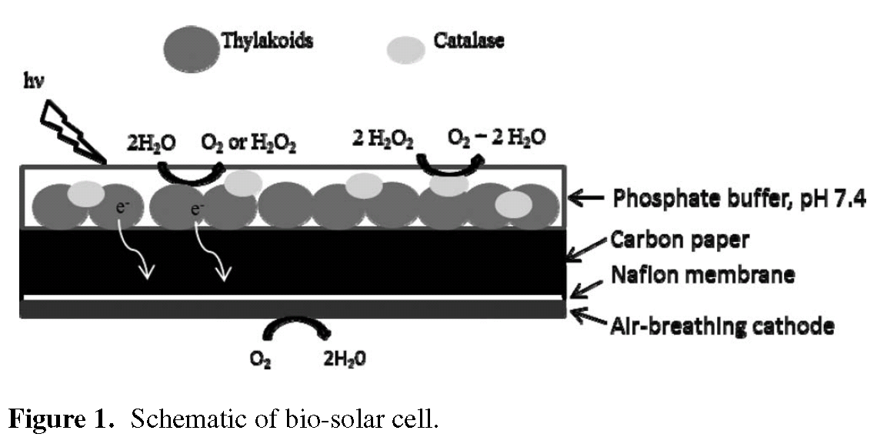
ECS Electrochemistry Letters, 1 (5) G7-G9 (2012)
Bio-Solar Cells Incorporating Catalase for Stabilization of
Thylakoid Bioelectrodes during Direct Photoelectrocatalysis
Kyle H. Sj¨oholm,∗ Michelle Rasmussen,∗ and Shelley D. Minteer^{∗∗,z}
Notes:
이 논문을 선택한 이유는 물 분해로 인한 생성되는 산소가 thylakoid 활성에 영향을 주는 것을 방지하는 것과 anode를 TMOS를 이용하여 제작이 가능하다는 것.
그리고 cathode 또한 예전에 교수님께서 말씀하신 것이 유사하게 적용되어서 선택하였습니다.

Slide 3

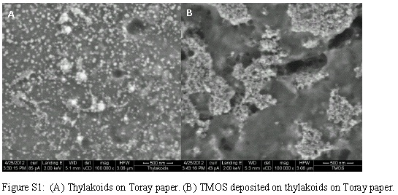
Results and Discussions.
Tetramethoxy orthosilicate ( TMOS )
The thylakoid membranes were entrapped in a silica matrix using vapor deposited tetramethyl orthosilicate (TMOS)
Elemental analysis confirmed an increase in Si after TMOS deposition to 3.47 atomic%, which corresponds to 6.78 wt%, and confirms the silicate layer formation.
Notes:
이 논문에서는 anode에 thylakoid를 사용하여 전자를 발생시켰고 생성된 전자는 air-cathode를 통해 물로 환원시키는 cell을 만들었습니다.
다음 그림은 carbon paper위에 thylakoid를 흡착시킨 SEM 사진이고 옆은 TMOS를 그 위에 흡착시켜 막을 형성한 SEM사진입니다.
Thylakoid 위에 TMOS를 사용하여 잡아 주므로써 전극에 어 잘 고정되도록 사용하였습니다.

Slide 4
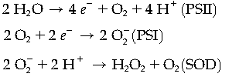
Results and Discussions.
Catalase, an enzyme that is commonly employed to reduce the damaging effects due to reactive oxygen species production by biocatalysts, was incorporated in the bioanodes.
Immobilized thylakoids ( no catalase ) : Stability of thylakoid during 10 minutes.
Immobilized thylakoids ( catalase ) : Stability of thylakoid during 30 minutes and then gradually decreased to 50% activity after 2 hours.
Thylakoids with no catalase produced 1.2 ± 0.4 mmol/min while thylakoids immobilized with catalase showed no detectable peroxide generation, indicating that the peroxide is being consumed by the catalase.
These results indicate that the addition of catalase does increase the stability of the thylakoids.
Notes:
photosynthesis으로 생성되는 oxygen species는 photosynthetic units에 손상을 주어 활성을 낮추는 문제가 있습니다.
이 논문에서는 catalase를 사용하여 photosynthesis으로 인해 생성되는 oxygen species 소비 하므로써 photosynthetic unit의 활성을 더 오래 가도록 하였습니다.
Catalase가 없는 thylakoid의 활성은 10분 정도 유지가 되었으며, 그 이후로 급격히 활성이 감소합니다.
Catalase가 있는 thylakoid에서는 활성이 30분 정도 유지가 되었으며, 그 이후로 50%정도 감소하여 오랜 시간 유지가 되는 것을 볼 수 있습니다.
결과적으로 catalase를 사용하므로써 oxygen species에 의한 손상을 줄 일수 있습니다.

Slide 5
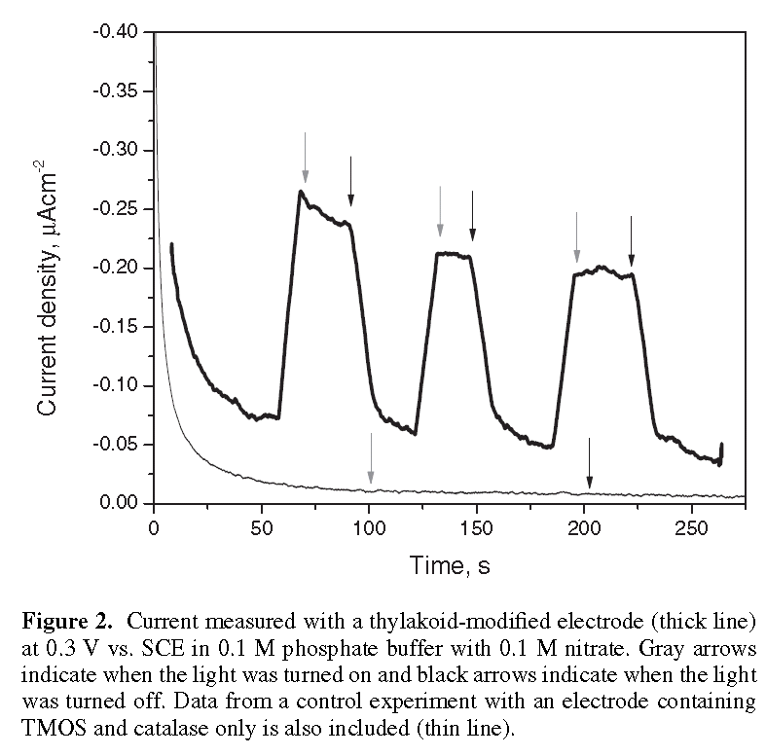
Results and Discussions.
Photocurrent approximately 150 nA/cm²
Light on
Light off
Thylakoid-modified electrode
Electrodes modified with catalase and TMOS
Amperometric measurements were conducted by measuring the current at 0.3 V vs. SCE
Notes:
다음은 anode에 대한 chronoamperometry data이며, 보이는 봐와 같이 thylakoid가 있는 electrode에서 빛의 조사에 따라 전자를 발생하는 것을 볼 수 있습니다.

Slide 6
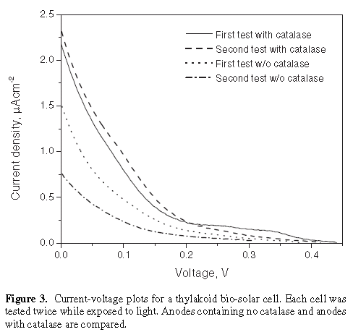
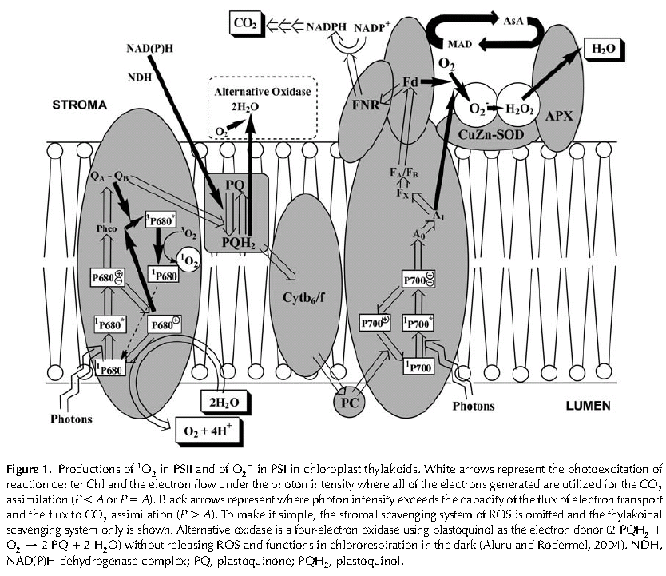
Results and Discussions.
Catalase
No catalase
Maximum current
First - 2.14 ± 0.11 μA/cm²
Seocond - 2.46 ± 0.10 μA/cm²
First - 1.53 ± 0.13 μA/cm²
Seocond - 0.90 ± 0.14 μA/cm²
The thylakoid-modified electrodes were connected to an air-breathing platinum cathode separated by a Nafion membrane and the resulting bio-solar cells were tested.
The average open circuit voltage (OCV) was 0.46 ± 0.03 V.
Notes:
다음은 air-cathode를 사용하여 전체 cell에 대한 Current-voltage plots (I-V plots)이며, catalase를 포함하는 anode와 포함하지 않는 anode를 비교 한 것입니다.
보통 식물이나 시아노박테리아와 같은 photosynthesis에서는 ascorbate peroxidase가 존재하여 oxygen species 을 제거하지만 분리한 thylakoid의 photosynthesis에서는 ascorbate peroxidase소실 되므로
photosynthetic units의 손상을 방지할 수 없습니다.
oxygen species 제거에 따라서 photosynthetic units의 활성이 좌우 되며, 이는 전자발생에 연관됩니다.
다음 그림3에서 보이는 봐와 같이 catalase존재하는 anode는 photosynthetic units의 손상이 적어 첫번째와 두번째 측정에서 전자 발생의 정도가 크게 다르지 않는 것을 볼수 있습니다.
하지만, catalase가 없는 anode는 oxygen species에 의해서 photosynthetic units이 손상되어 첫번째와 두번째 측정에서 차이를 보이며, 두번째 측정에서 전자발생이 감소하는 것을 볼 수 있습니다.

Slide 7
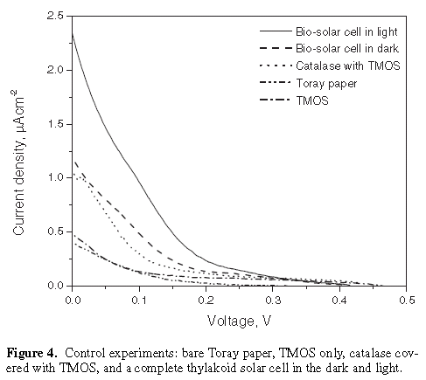
Results and Discussions.
Notes:
그림 4는 컨트롤과 bio-solar cell 측정이며, 표는 전체적인 data를 보여줍니다.
각각을 비교 분석하므로써 thylakoid에서 전자가 발생되는 것을 확인 할 수 있고, catalase를 사용하므로써 thylakoid의 손상을 방지하여 전자발생과 관련된 활성을 유지한 것을 알수 있습니다.

Slide 8
Conclusion.
Thylakoids were successfully entrapped in a vapor deposited silica matrix on a Toray carbon paper electrode to make an anode for a biosolar cell capable of direct photobioelectrocatalysis.
When combined with an air-breathing cathode, the cell was able to produce a maximum current density of 2.46 ± 0.10 μA/cm² with an open circuit voltage of 0.46 ± 0.3 V.
The current was not stable due to the formation of reactive oxygen species. The addition of the enzyme catalase to the anode corrected this problem allowing for a stable current density and extending the feasible lifetime of this bio-solar cell.
Notes:
결론은 TMOS를 사용하여 silica matrix형성 하므로써 electrode에 linker분자나 mediator사용 없이 효과적으로 thylakoid고정 시킨 것과.
Air-cathode를 사용하여 cell을 만들어 2.46 ± 0.10 μA/cm2 current와 open circuit voltage 상태에서 0.46 ± 0.3 V을 얻었다는 것입니다.
oxygen species으로 인한 손상을 catalase를 사용하므로써 thylakoid 활성 손상을 해결하였고, 활성을 유지하므로써 보다 안정적인 cell을 만들었다는 것입니다.

Slide 9
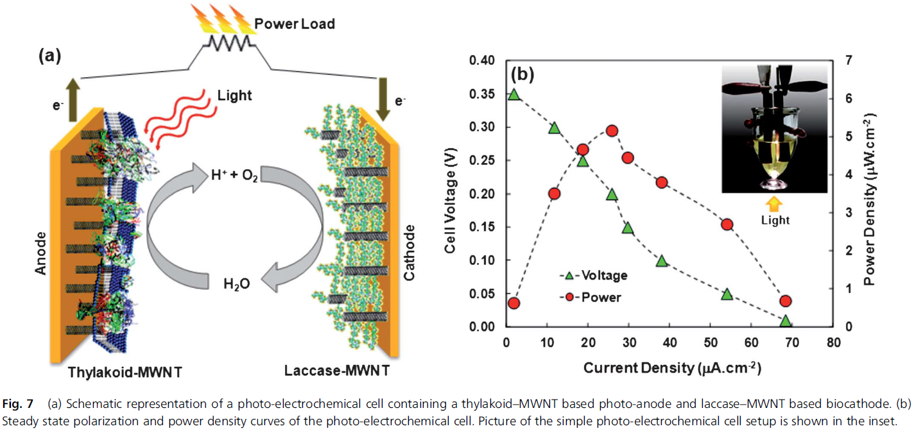
Energy Environ. Sci., 2013, 6, 1891
High photo-electrochemical activity of thylakoid–carbon nanotube composites for photosynthetic energy conversion†
Jessica O. Calkins,ª Yogeswaran Umasankar,ª Hugh O’Neill^{b} and Ramaraja P. Ramasamy^{*a}
Notes:
This paper reports a photosynthetic electrochemical cell composed of a thylakoid-based photoanode and laccase based enzymatic cathode.

Slide 10
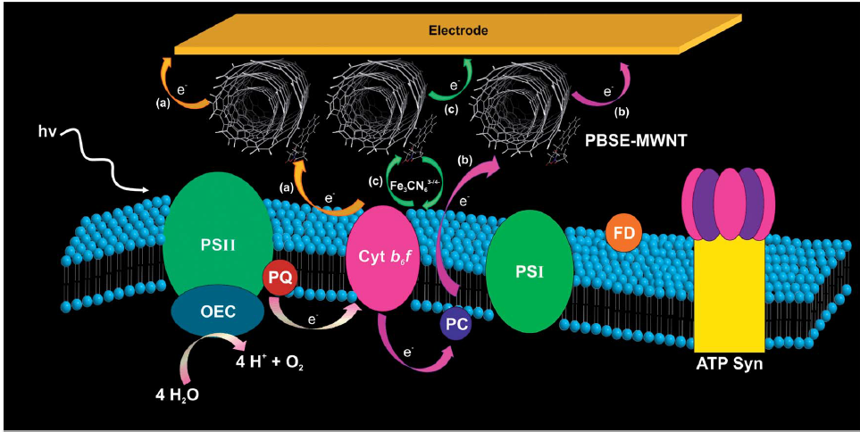
Introduction
Photosynthetic organelles or membranes possess many advantages over isolated reaction center complexes for electrochemical applications.
  High individual protein stability.
  Fairly simpler immobilization procedures and multiple electron transfer routes.
Notes:
This paper studied the photo-electrochemical activity of spinach thylakoids immobilized onto multi-walled carbon nanotube (MWNT) modified electrodes.
Photosynthetic organelles or membranes possess many advantages over isolated reaction center
complexes for electrochemical applications.
High individual protein stability.
Fairly simpler immobilization procedures and multiple electron transfer routes

Slide 11
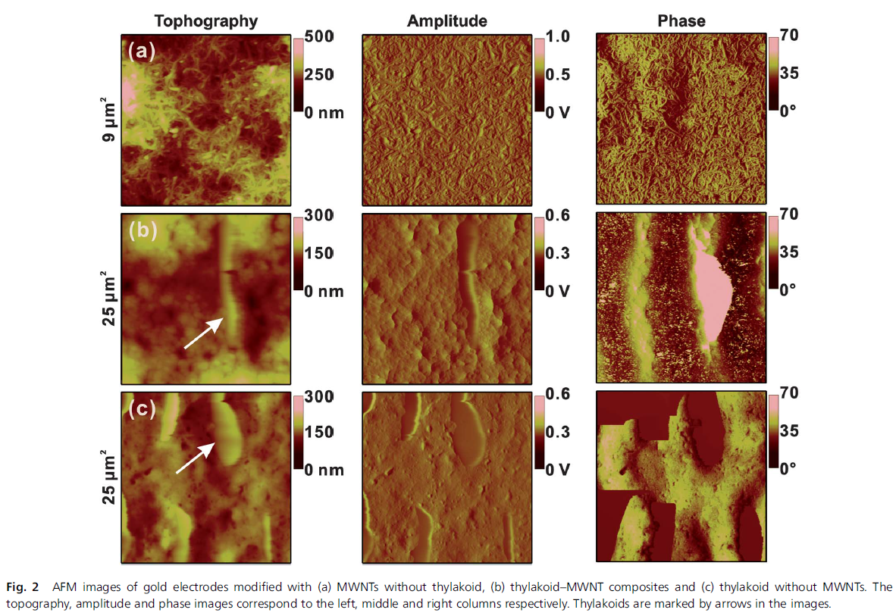
Results and Discussions.
MWNTs without thylakoid
Thylakoid length 3 μm ±0.5
Thylakoid–MWNT composites
Thylakoid
Thylakoid without MWNTs
Notes:
Fig. 2 AFM images of gold electrodes modified with (a) MWNTs without thylakoid, (b) thylakoid–MWNT composites and (c) thylakoid without MWNTs.
The unmodified control electrode with the bare MWNT matrix shows clear and identifiable nanotubes.
The presence of thylakoids is shown by the lighter extruding region in the composite, sized approximately 3 μm±0.5 in length
which agrees with the typical size of a thylakoid unit.
A thylakoid without MWNTs electrode surface is also shown in Fig 2c.
The surface roughness of the thylakoid matrix is 9 nm ± 0.5, which is close to the roughness of a monolayer.
The roughness values are similar for both thylakoids (Fig. 2c) and thylakoid–MWNT composite matrices (Fig. 2b).

Slide 12
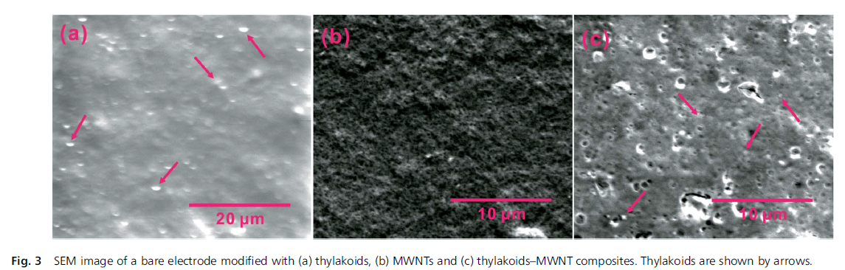
Results and Discussions.
Thylakoid without MWNTs
MWNTs without thylakoid
Thylakoid–MWNT composites
Thylakoid length 3 μm ±0.5
Thylakoid length 3 μm ±0.5
Notes:
The morphology studied using SEM also shows the length of thylakoids to be 3 μm ±1
This is in good agreement with the AFM observations.

Slide 13
Results and Discussions.
Electron transfer pathway
(a) : PSII → plastoquinone → cyt b₆f → MWNT → electrode.
(b) : PSII → plastoquinone → cyt b₆f → plastocyanin → MWNT→ electrode.
(c) : PSII → plastoquinone → cyt b6f/plastocyanin → [Fe(CN)₆]^{3-/4-} → MWNT → electrode.
Notes:
As In Fig. 1, electrons generated as a result of the photo-induced water oxidation reaction at the OEC site could be conducted to the electrode in three possible routes as indicated by arrows.
Electron transfer pathway(a) is possible if cyt b₆f is adsorbed or molecularly tethered to the MWNT surface and its redox site is placed closely to MWNTs to enable direct electron transfer.
Electron transfer pathway (b), Here the electron gets routed to plastocyanin before reaching the MWNT matrix.
Both Electron transfer pathway(a) and (b) serve as direct electron transfer routes for electrochemical charge transfer.
Electron transfer pathway (c), In this case, ferricyanide mediates the electron transfer from multiple membrane proteins in the thylakoid to the MWNT electrode.

Slide 14
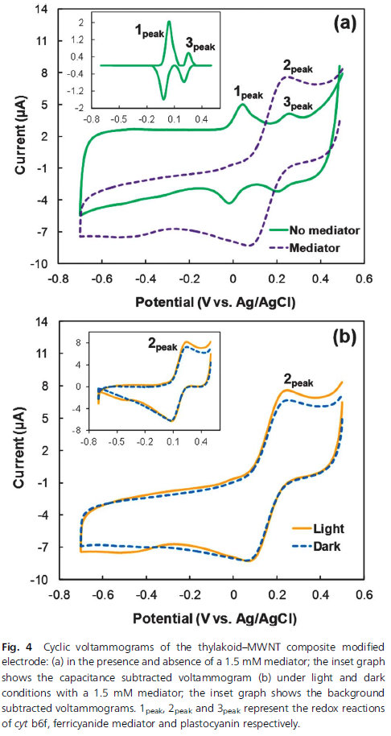
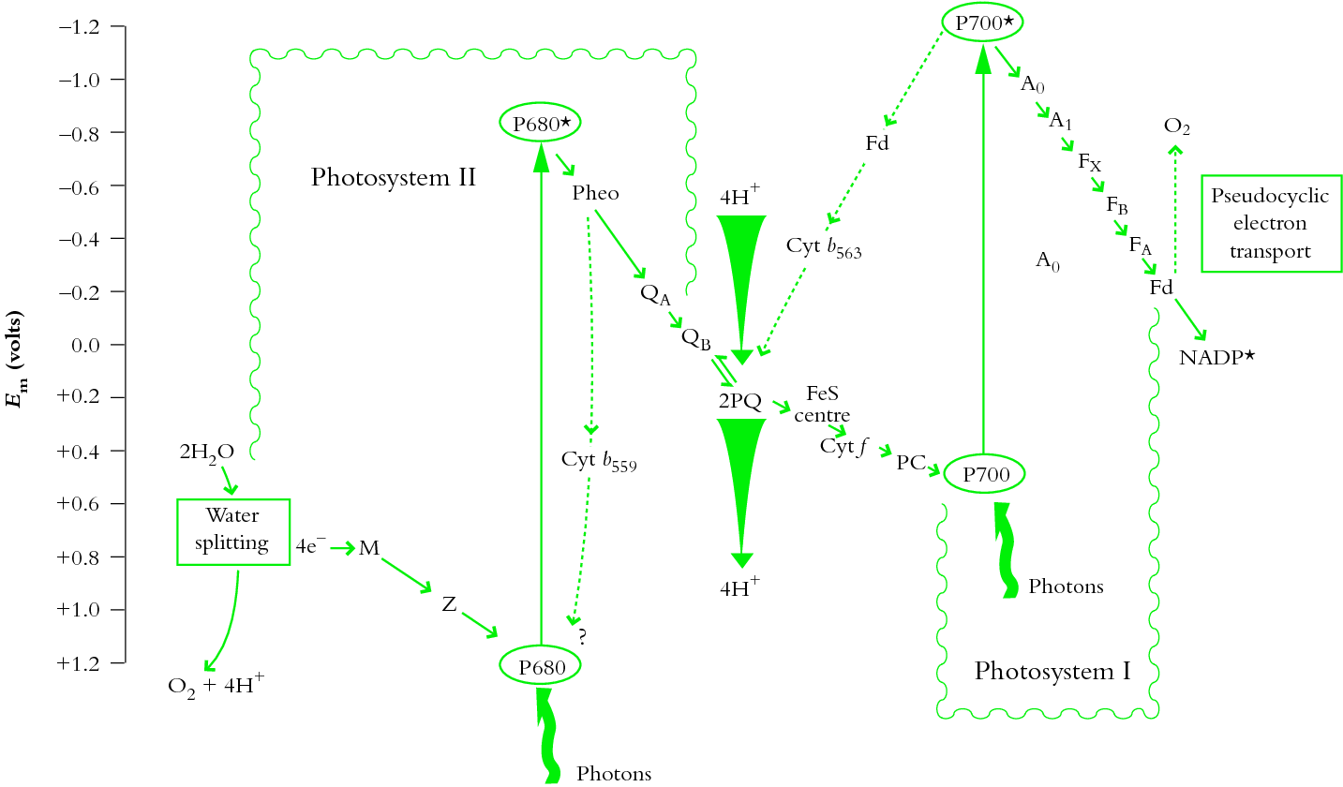
Results and Discussions.
0.035 V Cyt b₆f (1.2 X 10⁻⁹ mol/cm² )
0.2 V Plastocyanin (0.6 X 10⁻⁹ mol/cm²)
Notes:
Fig. 4a compares the cyclic voltammograms of thylakoid–MWNT composites in the presence and absence of [Fe(CN)₆]^{-3/-4} as a mediator.
The formal potential values for peaks 1peak and 3peak were 0.035 and 0.2 V , which fell close to that of the redox potentials of cyt b₆f (FeII/III) and plastocyanin (CuI/II) respectively.
The surface coverage of cyt b₆f and plastocyanin was 1.2 and 0.6 nmol cm⁻² respectively.

Slide 15
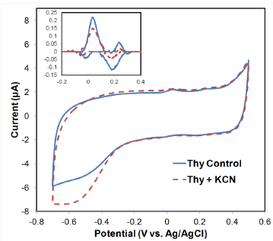
Results and Discussions.
0.035 V Cyt b₆f (1.2 X 10⁻⁹ mol/cm² )
0.2 V Plastocyanin (0.6 X 10⁻⁹ mol/cm²)
0.2 V Plastocyanin
73% reduction
Figure S3. Cyclic voltammograms of thylakoid-MWNT composites in the presence and absence of 10 mM KCN as plastocyanic inhibitor.
KCN inhibits the plastocyanin activity in photosynthesis by blocking its Cu^{I/II} active site at high concentrations (>10 mM) and high pH values (>7.5).
Notes:
To confirm that the peaks at 0.2 V can be attributed to plastocyanin redox activity, a separate plastocyanin-inhibition experiment was conducted to study the effect of inhibition on this redox peak.
As you can see, the plastocyanin-inhibition peak showed a dramatic 73% reduction in the oxidation peak at 0.2 V.

Slide 16
Results and Discussions.
Ferricyanide oxidation
Electron transport pathway (c)
PSII → plastoquinone → cyt b6f/plastocyanin → [Fe(CN)₆]^{3-/4-} → MWNT → electrode.
Upon illumination the peak currents for their reactions increased by 1.0 (I_{pa}) and 0.2 (I_{pc}) μA respectively, indicative of photo-catalysis by immobilized thylakoids.
Oxygen reduction
Notes:
As shown in Fig. 4a, in the presence of mediator, a single dominant oxidation peak was observed masking the redox responses of both cyt b₆f and plastocyanin observed.
This confirms the existence of the mediated electron transport pathway (c) as suggested in Fig. 1.
The O₂ evolution due to photo-induced water splitting in thylakoid modified MWNT electrodes upon illumination is also evident in the voltammograms shown in Fig. 4b.
Oxygen reduction and ferricyanide oxidation were observed at -0.4 V and 0.3 V respectively.
The results suggest that the electron flux to the electrode could be greatly enhanced by [Fe(CN)₆]^{-3/-4}, which acts as a mediator for electrochemical charge transfer between thylakoid and MWNT electrodes.

Slide 17
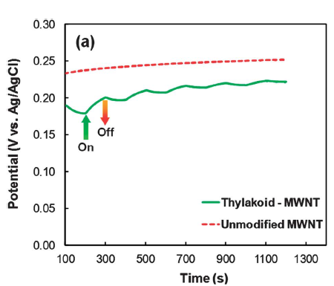
Results and Discussions.
Fig. 5 (a) Open circuit potentials of unmodified (control) and thylakoid modified MWNT electrodes in the presence of 1.5 mM [Fe(CN)₆]^{3-/4-}. (b) Photo-current responses of the unmodified (control) and thylakoid modified MWNT electrodes at a fixed potential of 0.2 V in the presence of 1.5 mM [Fe(CN)₆]^{3-/4-}. (c) Nyquist plots (Z’ vs. -Z’’) for thylakoid–MWNT composites under light and dark conditions. The inset in (c) shows the equivalent circuit model used to fit the Nyquist data. In (a and b), ↑ and ↓ represent light on and light off conditions respectively.
The slightly lower OCP for the thylakoid–MWNT electrode could be dictated by the mixed potential caused by a variety of thylakoid membrane proteins whose individual redox potentials range from -1.3 to +1.0 V vs. SHE.
Notes:
Fig. 5a compares the open circuit potentials of unmodified and thylakoid modified MWNT electrodes in the presence of a mediator.
Upon changing the illumination conditions between light and dark over several light on / light off cycles, a clear variation in the open circuit potential was observed,
indicative of photo-electrochemical activity for the thylakoid–MWNT composite electrode.

Slide 18
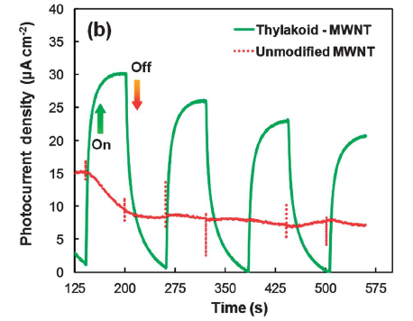
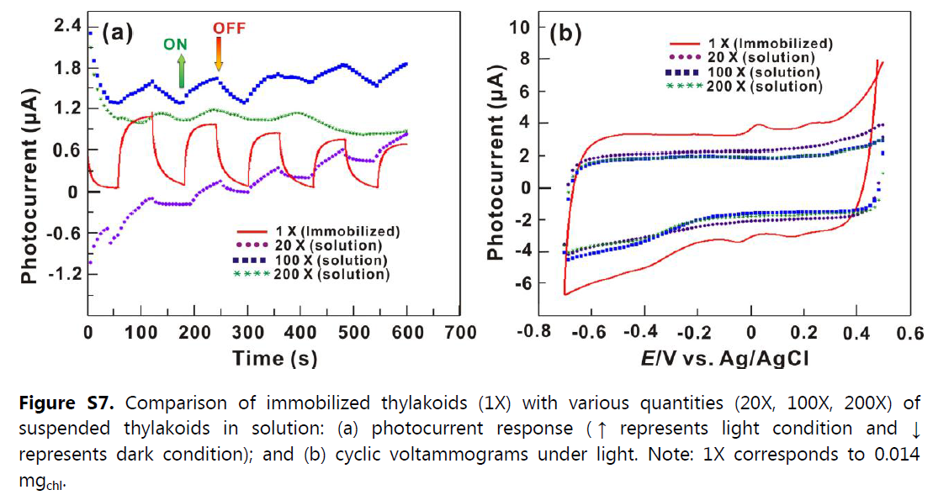
Results and Discussions.
30 μA cm⁻²
23 μA cm⁻²
Fig. 5 (a) Open circuit potentials of unmodified (control) and thylakoid modified MWNT electrodes in the presence of 1.5 mM [Fe(CN)₆]^{3-/4-}. (b) Photo-current responses of the unmodified (control) and thylakoid modified MWNT electrodes at a fixed potential of 0.2 V in the presence of 1.5 mM [Fe(CN)₆]^{3-/4-}. (c) Nyquist plots (Z’ vs. -Z’’) for thylakoid–MWNT composites under light and dark conditions. The inset in (c) shows the equivalent circuit model used to fit the Nyquist data. In (a and b), ↑ and ↓ represent light on and light off conditions respectively.
The decrease in the amplitude of photo-currents over continuous light on–off cycles
bserved in Fig. 5b could be due to a combination of two effects:
(i) transience in mediator diffusion between thylakoids and electrodes before the attainment
of a steady state.
(ii) photo-damage of proteins under extended light exposure.
Notes:
Fig. 5 (b) is Photocurrent responses of the unmodified and thylakoid modified MWNT electrodes.
The photocurrent of thylakoid modified MWNT electrode ranged from 30 μA cm⁻² during initial cycles eventually attaining steady state within ~400 s in the range of 23 μA cm⁻².
As you can see in Fig. S7, the immobilized thylakoids have significant advantages over freestanding suspended thylakoids in solution.
Therefore the immobilization method is vital for enhanced electron transfer and high photocurrents.

Slide 19
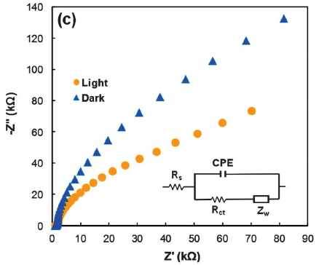
Results and Discussions.
317 kΩ
87 kΩ
Fig. 5 (a) Open circuit potentials of unmodified (control) and thylakoid modified MWNT electrodes in the presence of 1.5 mM [Fe(CN)₆]^{3-/4-}. (b) Photo-current responses of the unmodified (control) and thylakoid modified MWNT electrodes at a fixed potential of 0.2 V in the presence of 1.5 mM [Fe(CN)₆]^{3-/4-}. (c) Nyquist plots (Z’ vs. -Z’’) for thylakoid–MWNT composites under light and dark conditions. The inset in (c) shows the equivalent circuit model used to fit the Nyquist data. In (a and b), ↑ and ↓ represent light on and light off conditions respectively.
R_{s} represents the electrolyte resistance, R_{ct} is the charge transfer resistance, CPE is the constant phase element between the electrolyte solution and the modified electrode, and lastly Z_{w} represents the Warburg impedance due to the diffusion of mediator.
Notes:
Fig 5(c) is Nyquist plots for thylakoid–MWNT composites under light and dark conditions.
The shape of the Nyquist profiles shows a clear difference in the impedance between light and dark conditions.
The fitted values for R_{ct} were 87 and 317 kΩ under light and dark conditions respectively.
The results indicate an enhanced kinetic activity due to lowered charge transfer impedance for electrochemical charge transfer in thylakoid–MWNT composites under illumination.

Slide 20
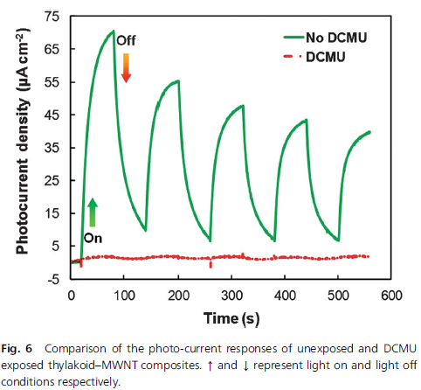
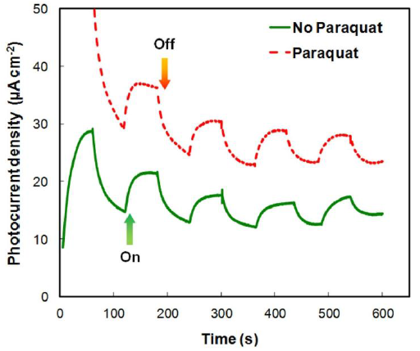
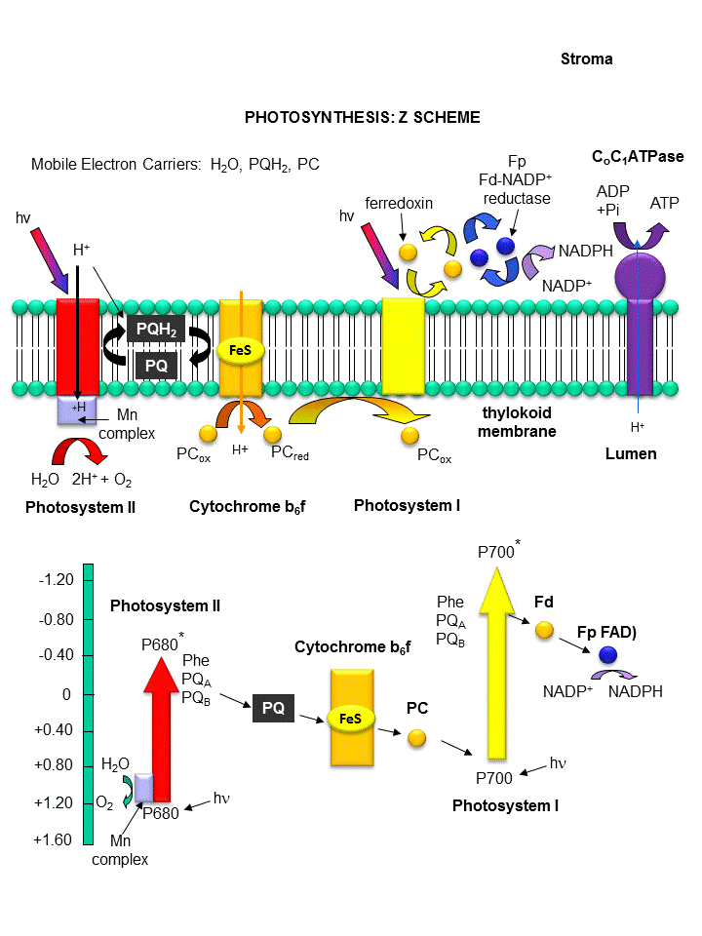
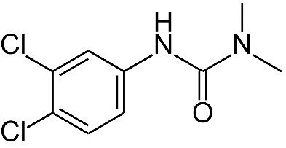
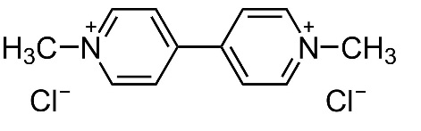
Results and Discussions.
DCMU (3-(3,4-dichlorophenyl)-1,1-dimethylurea)
Paraquat
DCMU
Paraquat N,N′-dimethyl-4,4′-bipyridinium dichloride
Notes:
As shown in Fig. 6, potentiostatic tests at 0.2 V on thylakoid–MWNT composites showed that when DCMU was used, the thylakoid activity was severely
inhibited thereby drastically reducing the photocurrents during the light on–off tests.
DCMU is a herbicide that specifically blocks the Q_{B} site in the PSII complex.
This confirms that the electrons originate from PSII.
As shown in Figure S10, the presence of the PSI inhibitor did not significantly reduce the photo-electrochemical response of the thylakoid-MWNT composites.
The results reiterate that water oxidation at PSII was the major source for photocurrents in the thylakoid composites.

Slide 21
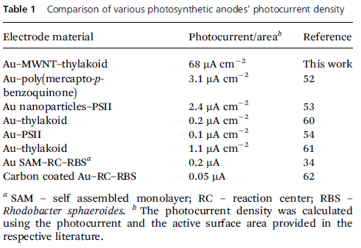
Results and Discussions.
5.3 μW cm⁻²
J. Ahmed
K. B. Lam
70 μA cm⁻²
Further enhancements in current and power densities can be achieved by
1. Reducing the anode–cathode separation distance (to lower ohmic impedance).
2. Increasing the loading of thylakoids and laccase onto the electrodes (to enhance electro-kinetics).
3. Managing the mediator diffusion (to minimize mass transfer limitation) for achieving high performance.
Notes:
A fuel cell type electrochemical cell was constructed using a thylakoid–MWNT composite anode and laccase–MWNT composite cathode and tested in an electrolyte solution.
The polarization curves showed a maximum current density of 70 μAcm⁻² and a maximum power density of 5.3 μWcm⁻².
Table 1 compares the photo-current densities observed in this work with that of other photosynthetic systems.

Slide 22
Conclusion.
This paper have demonstrated the high photo-electrochemical activity of immobilized thylakoid–MWNT composites for light energy harvesting applications.
The thylakoid–MWNT composite electrode yielded a maximum current density of 68 μA cm⁻² and a steady state current density of 38 μA cm⁻², which are higher than the previously reported values.
The photo-electrochemical cell delivered a maximum power output of 5.3 μW cm⁻².

Slide 23
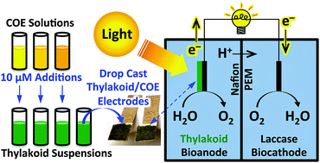
Energy Environ. Sci., 2015, 8, 2698
The photobioelectrochemical activity of thylakoid bioanodes is increased via photocurrent generation and improved contacts by membrane intercalating conjugated oligoelectrolytes†
Nathan D. Kirchhofer,^{‡a} Michelle A. Rasmussen,^{‡b} Frederick W. Dahlquist,c Shelley D. Minteer^{*b} and Guillermo C. Bazan^{*acd}
Notes:
This paper title is "The photobioelectrochemical activity of thylakoid bioanodes is increased via photocurrent generation and improved contacts by membrane intercalating conjugated oligoelectrolytes".
In this study, the conjugated oligoelectrolytes (COEs) was used to improve the electron transfer between thylakoid and electrode.

Slide 24
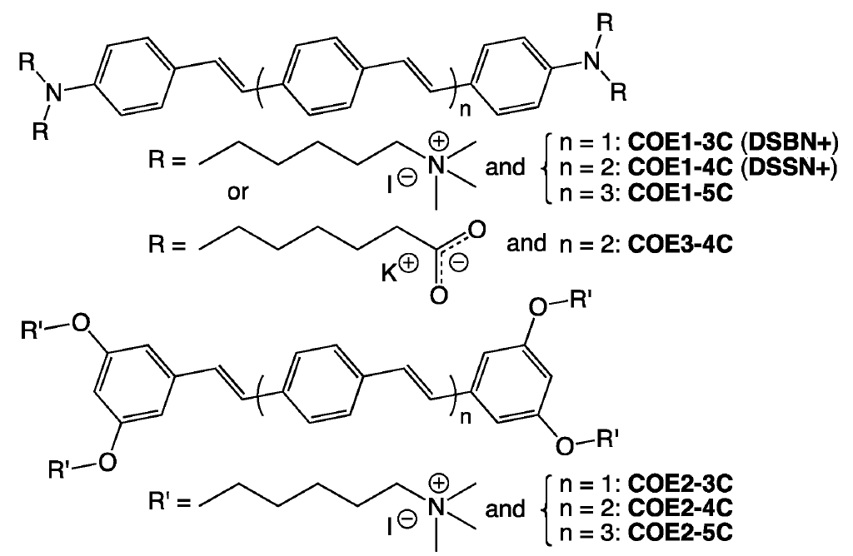
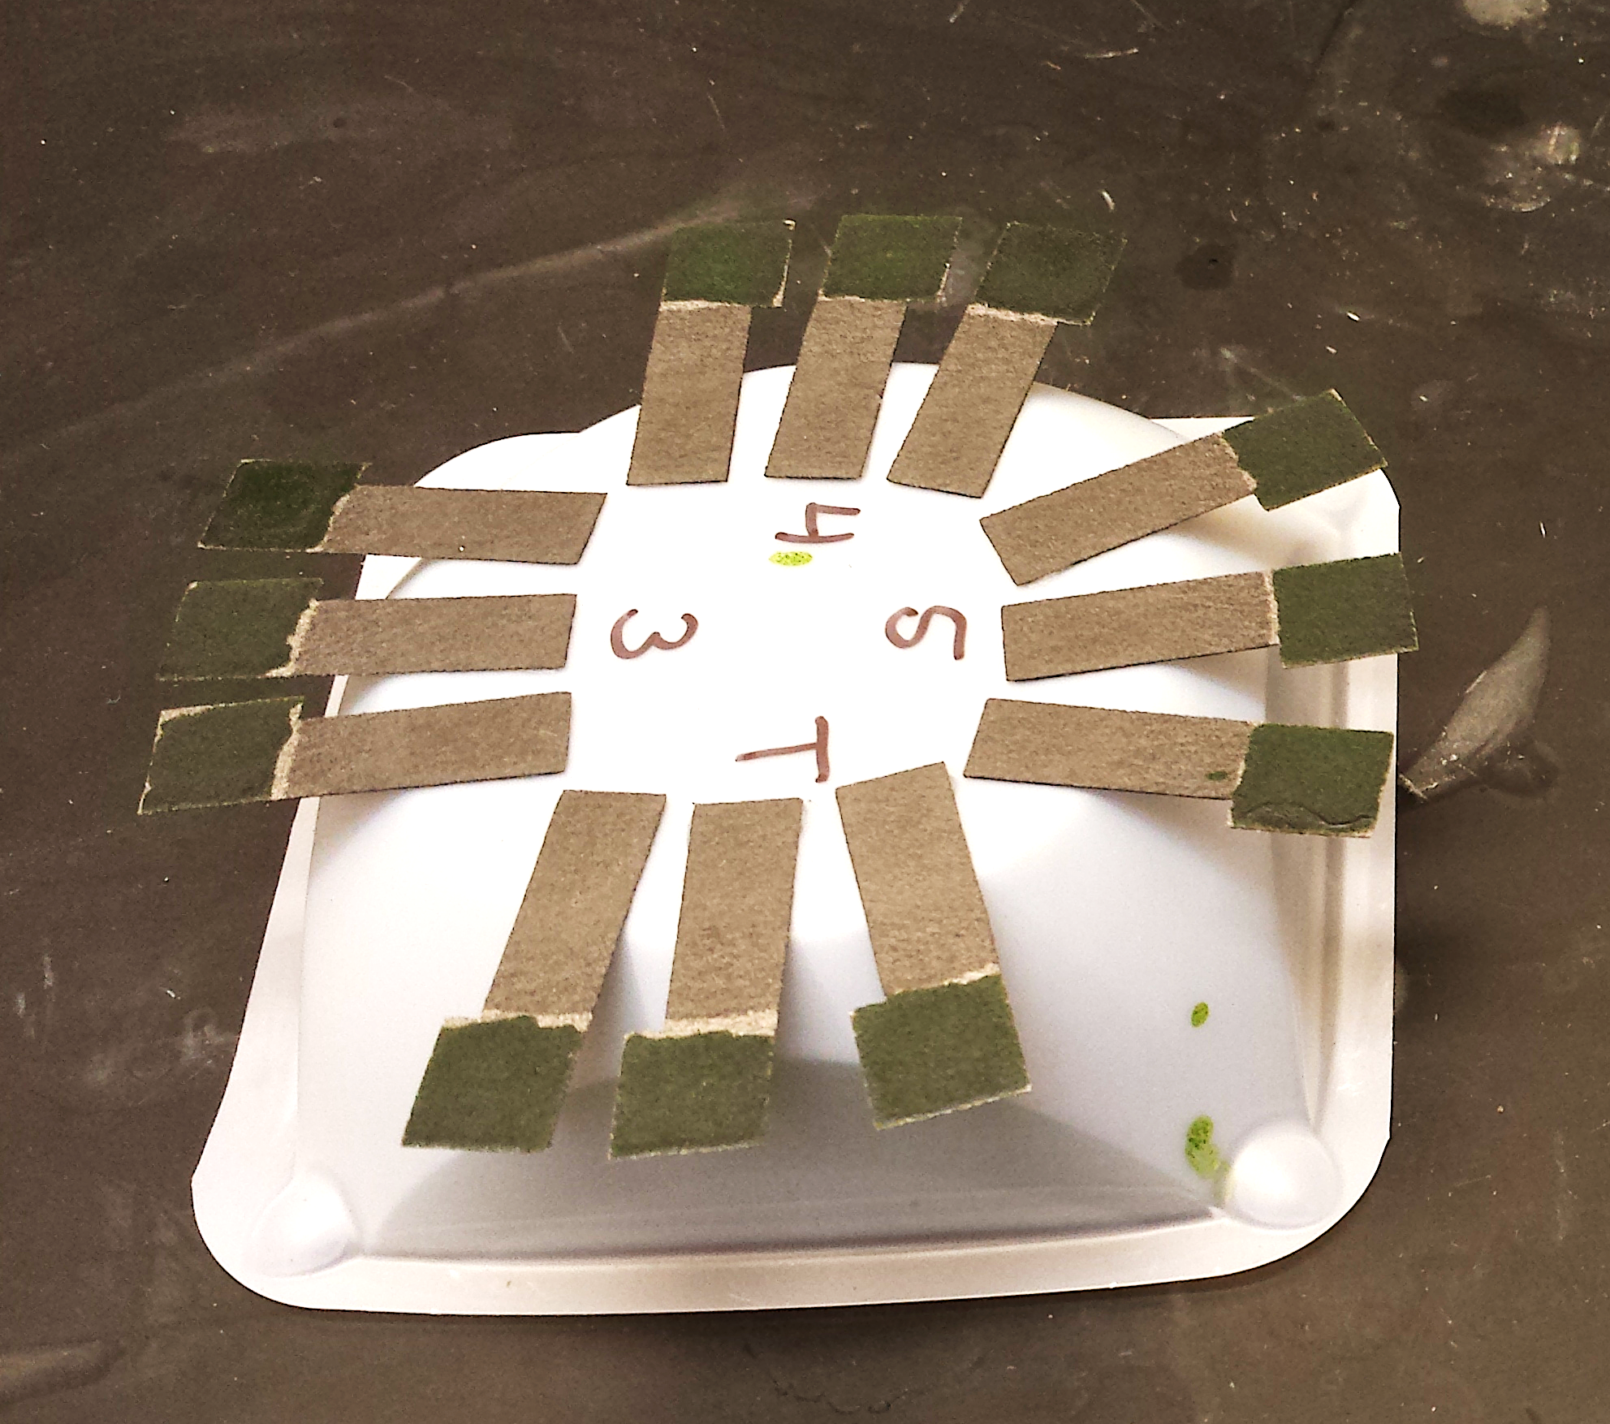
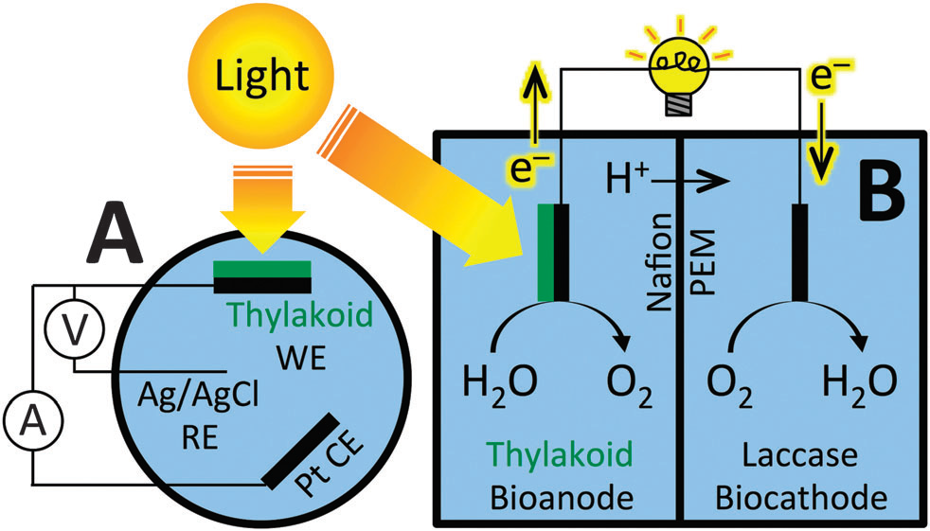
Experimental Section
Thylakoid/COE electrodes
Fig. 1 The seven COE derivatives used in this study. Note that COE1-3C and COE1-4C may also be referred to as DSBN+ and DSSN+, respectively, as seen previously in the literature.
Fig. 2 A schematic diagram of thylakoid-bioanode-based device architectures used for this work. (A) The three-electrode electrochemical cell. WE: working electrode; RE: reference electrode; CE: counter electrode.Note that the WE and CE are analogous to an anode and cathode, respectively. Also note that a potential is poised between the WE and RE, while current is allowed to flow at the WE and CE, as controlled by a potentiostat (not pictured). (B) The two-chamber bio-solar cell. A Nafions proton exchange membrane (PEM) allows for charge balance during electron flow. Note that the thylakoid bioanode is identical to the WE in the three-electrode device.
< Three-electrode electrochemical cell >
< Bio-solar cell >
Notes:
Fig 1 shows the seven conjugated oligoelectrolytes (COEs) derivatives used in this study.
This COEs are water soluble organic semiconducting oligomers with high membrane affinity.
In this study, the COEs was used to improve electrical contacts between thylakoid and electrode.
The thylakoid bioanodes have been modified with the seven COE derivatives by directly adding COEs to the thylakoid suspensions.
The mixed solution was pipetted and spread onto one side of electrode.
The resulting thylakoid/COE electrodes were employed in both three-electrode electrochemical cells and bio-solar cells.

Slide 25
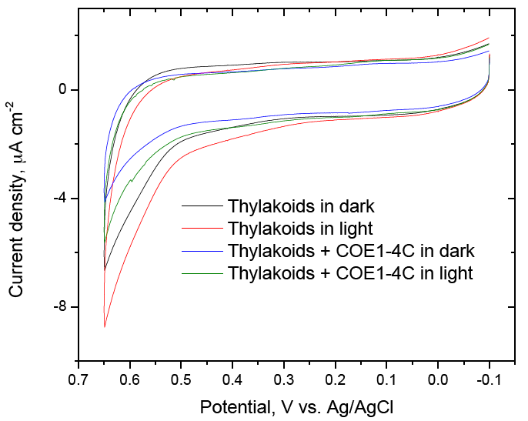
Results
Fig. S2. Representative dark and light CV of thylakoid and thylakoid/COE electrodes. Buffer was 100 mM, pH 7.4 phosphate; scan rate = 10 mV/s.
Fig. 3 Optimization of COE concentration for maximal current output. Measurements were conducted by amperometry at a poised potential of E = 0.45 V vs. Ag/AgCl in 0.1 M, pH = 7.4 phosphate buffer. Photocurrent and dark current are presented stacked to illustrate the light current produced for each experimental condition (light current = dark current +photocurrent). Error bars represent ±1 std. dev.
The COEs are not contributing to anodic current via redox activity or chemical degradation.
Dark current density is not significantly affected by the COE1-4C concentration.
However, photocurrent density was changed by the COE1-4C concentration
Notes:
Fig. S2 shows the representative dark and light CV of unmodified thylakoid and thylakoid/COE electrodes.
As you can see in this fig S2, the essentially no voltammetric difference exists between thylakoid/COE electrodes and unmodified thylakoid electrodes.
These data indicate that COEs are not contributing to anodic current via redox activity or chemical degradation.
In the Fig S2, a small reversible redox wave was observed at a central potential of ~ 0.35 V.
Therefore, in this paper, all subsequent amperometric experiments were conducted at 0.45 V to allow oxidation of this redox species.
Fig 3 shows the optimization of COE concentration for maximal current output.
Dark current density is not significantly affected by the COE1-4C concentration.
However, photocurrent density was changed by the COE1-4C concentration.
At 10 uM COE1-4C concentration, the highest photocurrent density was observed.

Slide 26
Results
Unmodified thylakoid electrode
Photocurrent = Llight - Dark current
Thylakoid/COE1-4C electrode
Fig. 4 Amperometric current measurements. All data were collected at 0.45 V vs. Ag/AgCl in 0.1 M, pH = 7.4 phosphate buffer. Red arrows indicate when the light was turned on and black arrows when it was turned off. (A) Representative time course of current density output from an unmodified (No COE) thylakoid electrode under modulated illumination. (B) Representative time course of current density output from a thylakoid/COE1-4C electrode under modulated illumination. (C) Summary of triplicate average current density outputs from thylakoid and thylakoid/COE electrodes for all tested COEs. In all cases, light current is equivalent to the sum of photocurrent (red) and dark current (black). Error bars are ±1 std. dev.
Notes:
Fig 4A shows amperometric current output for an unmodified thylakoid electrode.
As you can see in the fig 4B, the light current output was increased by the COE1-4C addition.
All COEs type is summarized in Fig. 4C and Table 1
At the COE1 type and COE3-4C, the relatively increased photocurrents was observed.
Particularly, compared to the COE3 type, the COE1 type derivatives have a significant effect on thylakoid light current output.
Because the thylakoid membrane surface carries a net negative charge from carboxylate moieties.
As you can see fig 4C and Table 1, dark current of thylakoid/COE electrodes is not significantly different than the unmodified thylakoid electrodes for any tested COEs.
This trend hints at COE molecular structural features playing a relevant photobioelectrochemical role.

Slide 27
Results
This data is light minus dark current density.
Notes:
Fig 5A and B show the average dark and light J–V curves for the unmodified thylakoid and thylakoid/COE1-4C bio-solar cells.
Fig 5C shows the photocurrent density (red) and photopower density (blue) for the unmodified thylakoid and thylakoid/COE1-4C bio-solar cells.
This data is light minus dark current density.
Compared to the unmodified thylakoid, the increased light and dark current by the COE derivatives indicate the improved contact between thylakoid and electrode.
And, longer COEs derivatives such as COE1-4C, COE1-5C, COE2-5C and COE3-4C enhance photocurrent generation.
(Fig 5D가르키면서) In the performance tests for thylakoid/COE bio-solar cell, the best overall performance enhancement is afforded by COE1-4C.

Slide 28


Conclusion.
The certain COEs have been shown to improve electrical contacts and photocurrent generation in thylakoid membrane- based photo-bioelectrochemical devices.
The molecular length of COE1-4C appears to be the most ideally suited to enhance thylakoid dark- and photo-current outputs, as compared to its shorter and longer counterparts.
Notes:
The certain COEs have been shown to improve electrical contacts and photocurrent generation in thylakoid membrane- based photo-bioelectrochemical devices.
The molecular length of COE1-4C appears to be the most ideally suited to enhance thylakoid dark- and photo-current outputs, as compared to its shorter and longer counterparts.
the molecular length and pendant charge of COEs differentially contribute to photobioelectrochemical enhancements.

Slide 29
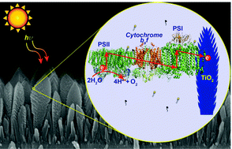
Nanoscale, 2016, 8, 1868
Directed assembly of the thylakoid membrane on nanostructured TiO₂ for a photo-electrochemical cell†
Shalinee Kavadiya,ª Tandeep S. Chadha,ª Haijun Liu,^{b} Vivek B. Shah,ª Robert E. Blankenshipb and Pratim Biswas^{*a}
Notes:
This paper title is "Directed assembly of the thylakoid membrane on nanostructured TiO₂ for a photo-electrochemical cell".
This paper was published in nanoscale journal.
The impact factor of nanoscale journal is 7.394.

Slide 30
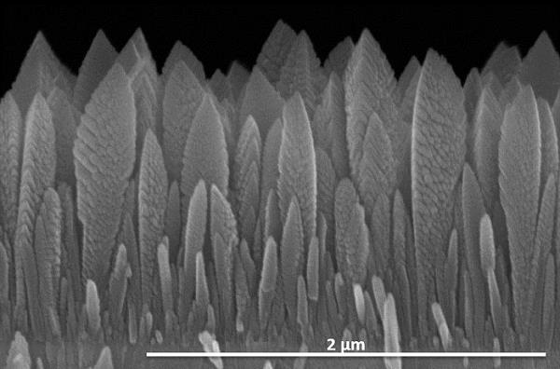
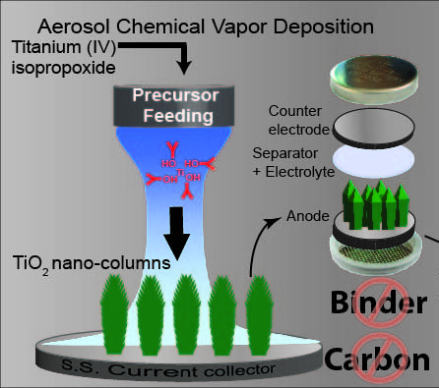
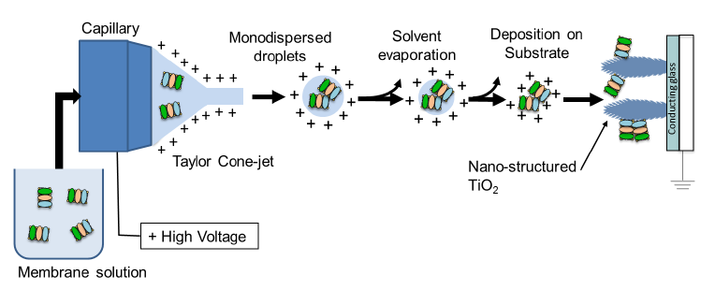
Experimental Section
The aerosol chemical vapor deposition (ACVD) system is used to deposit 1-D, single crystal, nanostructured TiO₂.
Fig. S2 SEM image of 1-D single crystal nanostructured TiO₂.
Fig. S1 Overview of linker-free deposition of thylakoid membrane on nanostructured TiO₂ columns using electrospray.
Notes:
In this paper, the one dimensional, columnar, single crystal TiO₂ nanostructure used as working-electrode.
An electrospray deposition technique is used to deposit thylakoid membranes onto the TiO₂ nanostructures.
Electrospray deposition technique allows a systematic study of the effect of surfactant on the performance by fabrication of different cell configurations.

Slide 31
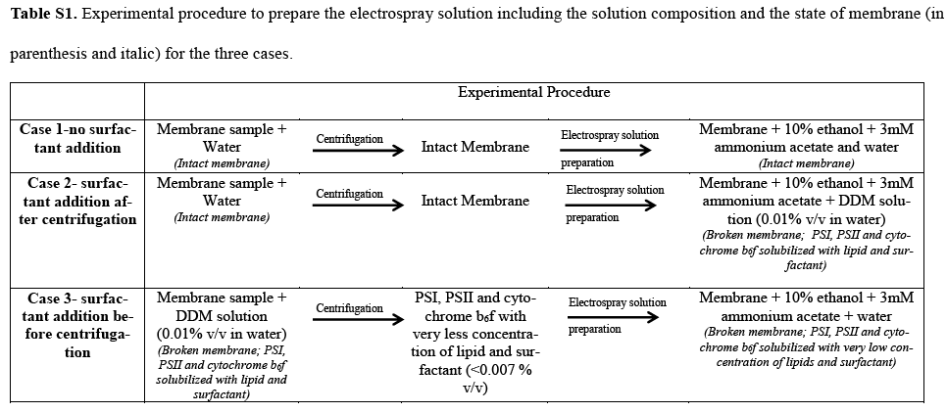
Results
When the membrane-sensitized TiO2 electrode is exposed to the electrolyte solution, the membranes orient and adhere to the TiO₂ surface by hydrophobic and van der Waals interactions.
No surfactant added
Surfactant added before centrifugation
Surfactant added after centrifugation
The difference in the surfactant addition methodology affects the membrane assembly and orientation on the TiO₂ surface.
Table S1. Experimental procedure to prepare the electrospray solution including the solution composition and the state of membrane (in parenthesis and italic) for the three cases.
Notes:
Fig. 1 shows the schematic diagram of the electrospray solution, droplet, deposition on TiO₂, and orientation on TiO₂ after exposure to the electrolyte for all the three cases.
For case 1, the surfactant is not added; the membrane patches remain intact (Fig. 1a).
For case 2, a solution of surfactant in water is added to the membranes.
By the addition of the surfactant, the membranes break and PSI, PSII, cytochrome b₆f, and other protein complexes are solubilized with the surfactant and lipid molecules (Fig. 1b).
Since the concentration of the surfactant is high in this case, thus few individual PSI, PSII and cytochrome b₆f molecules resuspended into the electrolyte.
For case 3, surfactant concentration is reduced in the electrospray solution by centrifugation.
The spray droplet contains PSI, PSII and cytochrome b₆f, along with a small number of surfactant and lipid molecules (Fig. 1c).
PSI, PSII and cytochrome b₆f aggregate on the surface and adhere to the TiO₂ without diffusing to the electrolyte, whereas the surfactant diffuses into the electrolyte.

Slide 32
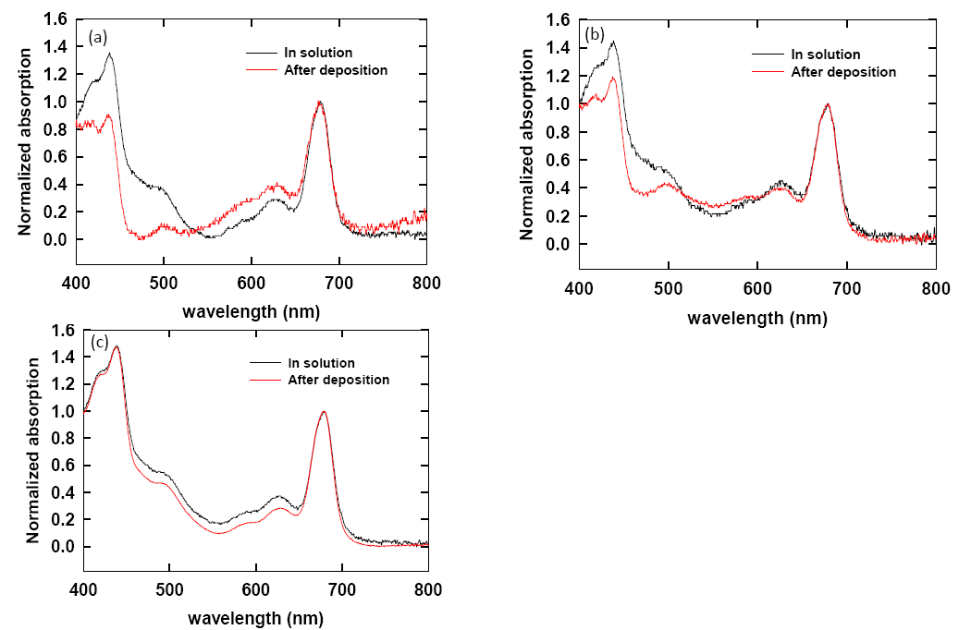
Results
Peak around 680 nm correspond to the reaction centre chlorophyll a molecules of PSI and PSII.
The 440 nm and 550 nm peaks correspond to the chlorophyll a Soret band and carotenoid respectively.
No absorption band shift in the characteristic peaks validates that the membrane characteristics are not altered by detergent treatment and the electrospray deposition process.
Figure S4. Absorption Spectra of the membrane in solution and after deposition ITO slide measured for (a) Case 1 –no surfactant addition, (b) Case 2 -surfactant addition after centrifugation and, (c) Case 3 -surfactant addition before centrifugation
Notes:
Figure S4 is the absorption spectra of the membrane in solution and after deposition ITO slide.
No absorption band shift in the characteristic peaks validates that the membrane characteristics are not altered by detergent treatment and the electrospray deposition process.

Slide 33
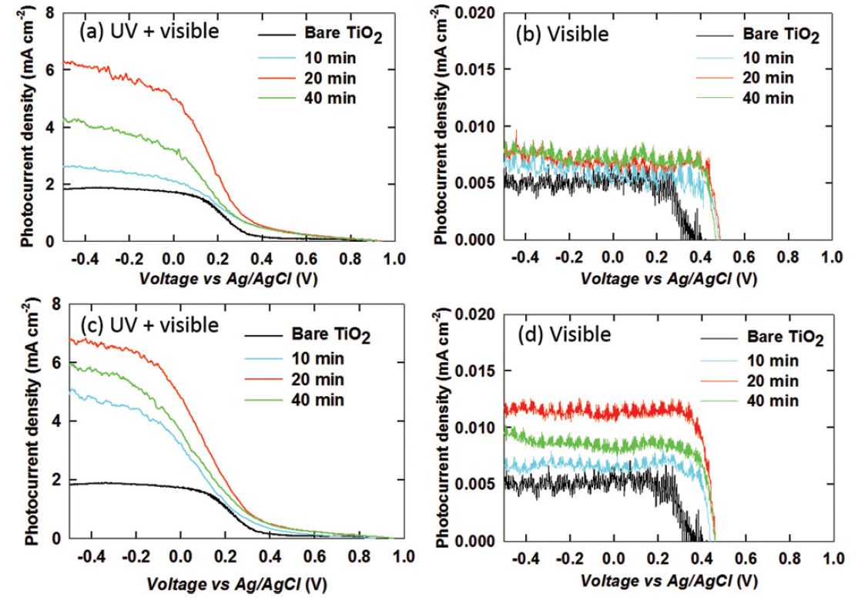
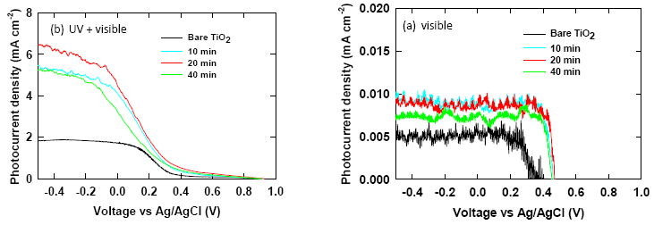
Results
Table S4 Onset potential values (in volts) for bare TiO2 and the three cases from the Linear scan voltammetry measurements under (a) UV and visible light (250-900 nm) illumination (b) Visible light (400-900 nm) for all the deposition time considered for
12 μA cm⁻²
6.7 mA cm⁻²
Onset potential increase
Fig. 2 Linear sweep voltammetry for (a,b) case 1 – no surfactant addition and (c,d) case 3 – surfactant addition before centrifugation; under (a,c) UV and visible light illumination (b,d) only visible light illumination for bare TiO2 (black), sensitized TiO2 for different deposition times 10 min (cyan), 20 min (red) and 40 min (green).
Fig. S5 Linear sweep voltammetry under (a) UV and visible light illumination (b) only visible light illumination for bare TiO2 (black), sensitized TiO2 for different deposition time 10 min (cyan), 20 min (red) and 40 min (green) for the case 2-when surfactant is added after centrifugation
Notes:
Figure 2 is Linear sweep voltammetry for (a,b) case 1 and (c,d) case 3 under (a,c) UV and visible light illumination (b,d) only visible light illumination.
As you can see, photocurrent density for the membrane sensitized TiO₂ is higher than that for bare TiO₂ for all the cases.
Furthermore, the enhanced performance of the sensitized TiO₂ electrode is confirmed by the increase in the onset potential (Table S4†).
These results indicate better charge separation on electron excitation.
For case 1, the intact lipid molecules increase the distance for electrons to transfer from the membrane to TiO₂, and creates an additional resistance in the electron transfer.
Case 2 show the superior performance of the cell compared to case 1.
Because the membranes are broken by surfactant enabling the diffusion of lipid molecules and resulting in the lower electron transfer resistance.
For the case 3, the concentration of surfactant and lipid molecules is reduced as most of them separate out during centrifugation.
In the case 3, efficient electron transfer occurs compared to the other two cases.
The highest photocurrent density of 6.7 mA cm⁻² under UV and visible light and 12 μA cm⁻² under only visible light is observed for the 20 min deposition.

Slide 34
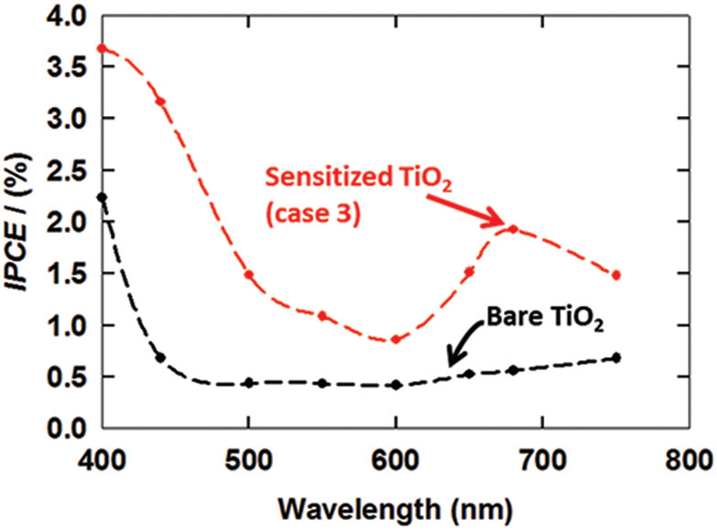
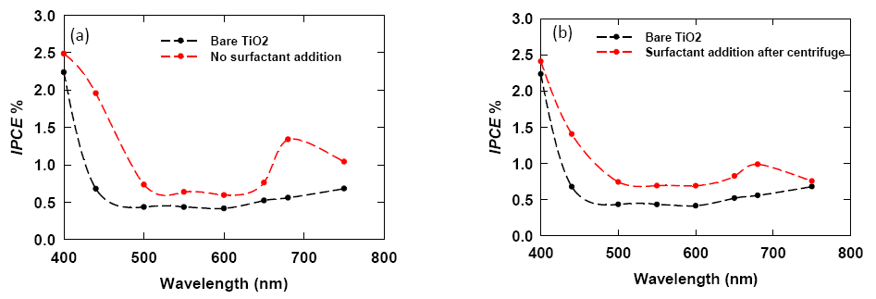
Results
1.94%
Fig. 3 Photoaction spectra for bare TiO2 (black) and sensitized TiO₂ (red) plotted against wavelength for case 3 – surfactant addition before centrifugation.
Fig. S6 Photocurrent action spectra for bare TiO2 (black) and sensitized TiO2 (red) for (a) Case 1- no surfactant addition and (b) Case 2- surfactant addition after centrifugation.
Notes:
Fig 3 is photoaction spectra for bare TiO₂ (black) and sensitized TiO₂ (red) plotted against wavelength for case 3.
The photoaction spectrum of sensitized TiO₂ shows a peak around 680 nm with a peak efficiency of 1.94%.
This confirms the photo-induced electron generation at PSII.
Fig. S6 is photocurrent action spectra for (a) Case 1 and (b) Case 2

Slide 35
Results
Fig. 5 Schematic of working of PSI only, PSII only and the thylakoid membrane on the TiO2 electrode based PEC cells. (a) PSI-based PEC cell in the absence of a sacrificial donor in the electrolyte, (b) PSI-based PEC cell in the presence of a sacrificial donor in the electrolyte,5 (c) PSIIbased PEC cell, (d) thylakoid membrane based PEC cell. Non possible cells are marked by a “red cross” and the possible cells by a “green tick” with a clear explanation based on the energy level alignment (see the circle and table). CB and VB represent the conduction and valance band of TiO2, P700 and P700* represent lower and excited energy states of PSI respectively, P680 and P680* represent the lower and excited states of PSII respectively and QB represents Quinone B. The band position values are mentioned in a table in the figure.25,34
Fig. 4 Band diagram for the working mechanism and electron transfer pathway³³ in the PEC cell based on the membrane sensitized TiO2 working electrode.
Notes:
A mechanistic pathway for electron transfer is illustrated in Fig. 4.
Absorbed solar energy by PS2 is transferred to the reaction center, and then occur charge separation of P680.
The excited electron are transferred to P700 in PSI via cytochrome b₆f.
A second electron excitation occurs at PSI and the electron moves to the excited state.
The excited electron are transferred to the conduction band of TiO₂.
From TiO₂, the electron travels through the external circuit and reaches the counter electrode.
PSI alone cannot complete the cycle of electron transfer because of the absence of a sacrificial electron donor.
This paper expect that electron transfer follows the Z-scheme of photosynthesis leading to the increase in the photocurrent density.

Slide 36
Conclusion.
This work shows that re-engineering the natural photosynthesis circuit by the novel technique of electrospray deposition can result in an environmentally friendly method of harvesting sunlight.
The maximum photocurrent density observed is 6.7 mA cm⁻² under UV and visible light, and 12 μA cm⁻² under visible light illumination.

