Slide 1
Chapter 7
Atomic Structure and Periodicity
7.1 Electromagnetic Radiation
7.2 The Nature of Matter
7.3 The Atomic Spectrum of Hydrogen
7.4 The Bohr Model
7.5 The Quantum Mechanical Model of the Atom
7.6 Quantum Numbers
7.7 Orbital Shapes and Energies
7.8 Electron Spin and the Pauli Principle
7.9 Polyelectronic Atoms
7.10 The History of the Periodic Table
7.11 The Aufbau Principle and the Periodic Table
7.12 Periodic Trends in Atomic Properties
7.13 The Properties of a Group: The Alkali Metals

Slide 2
Atomic Theory
Democritus and Leucippus (400 B.C.) : proposed atoms mostly on intuition but no real convincing experimental evidence.
Lavoisier and others : chemical experiment and stoichiometry
Dalton : first systematic atomic theory
→ What is the nature of an atom?
Thomson : pudding model
Rutherford : a nucleus is at the center of an atom
Detailed atomic structure
Elements have periodic properties
New findings in the late 19C and early 20C that could not be explained by classical mechanics (Newtonian mechanics)
  -Electromagnetic radiation
  -Heat capacity
Quantum mechanics had been developed in the early 20C

Slide 3
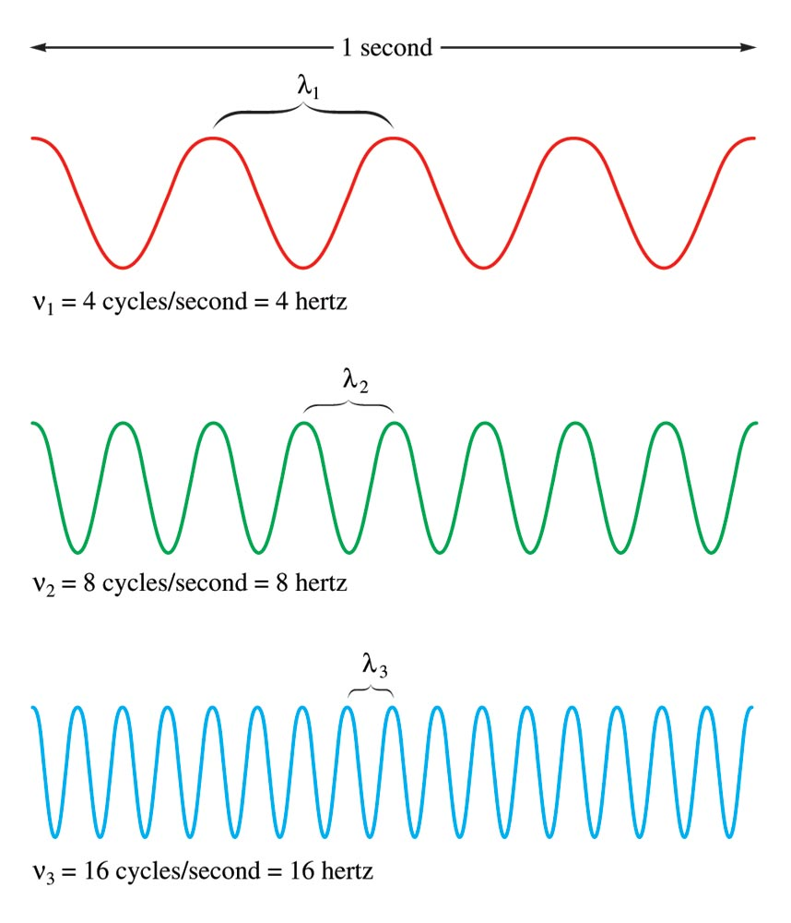
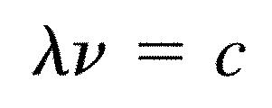
7.1 Electromagnetic Radiation
Waves
Three characteristics:
  Wavelength(λ) – distance between two peaks or troughs in a wave.
  Frequency (ν)-number of waves (cycles) per second that pass a given point in space, Hz
  Speed (c)
Transverse vs. longitudinal waves
What is the difference?
Take Examples

Slide 4
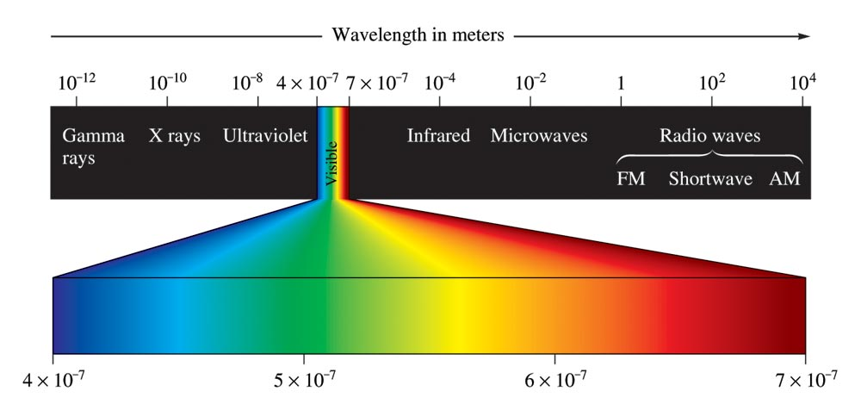
Electromagnetic Radiation (Wave)
Has electric and magnetic field.
Electric field and magnetic field are perpendicular each other and to the propagation direction of the wave.
Speed is light speed in vacuum. c = 2.9978 x 10⁸ m/s

Slide 5
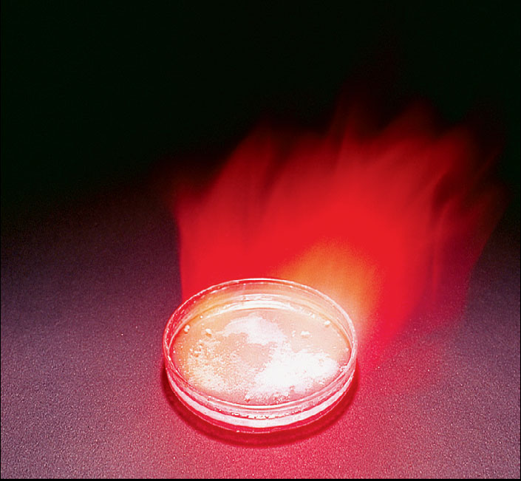
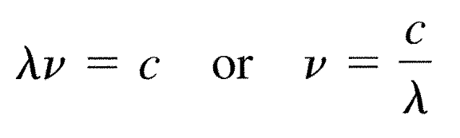
Example 7.1 Frequency of Electromagnetic Radiation
The brilliant red color seen in fireworks are due to the emission of light with wavelengths around 650 nm when strontium salt such as Sr(NO₃)₂ and SrCO₃ are heated. Calculate the frequency of red light of wavelength 6.50 x 10² nm.
Solution
= 6.50 x 10² nm = 6.50 x 10⁻⁷ m
ν = c/λ = 2.9979 x 10⁸ m/s / 6.50 x 10⁻⁷ m = 4.61 x 10¹⁴ /s = 4.61 x 10¹⁴ Hz

Slide 6
7.2 The Nature of Matter
Matter and Energy
Does matter consist of particles while energy is described as a wave?
Blackbody radiation
Max Planck’s radical suggestion
  Energy is quantized.
  Energy can be gained or lost only in whole-number multiples of the quantity hν.
  h: Planck constant. 6.626 x 10⁻³⁴ J∙s
Energy can occur only in discrete units of size hν.
Each of these small “packets” of energy is called a quantum.
ΔE = nhν
n = 1, 2, 3, …

Slide 7
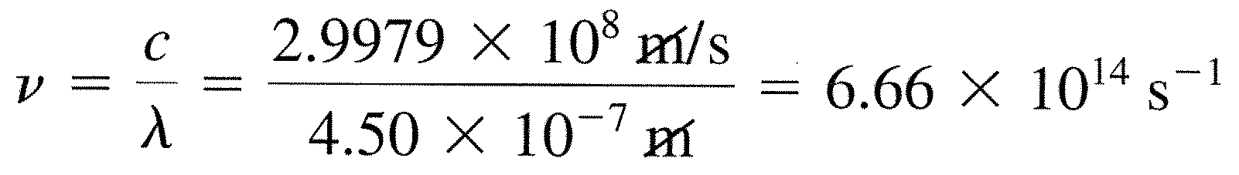
Example 7.2 The Energy of a Photon
The blue color in firework is often achieved by heating CuCl to about 1200ºC. Then the compound emits blue light having a wavelength of 450 nm. What is the increment of energy (the quantum) that is emitted at that wavelength?
Solution
Albert Einstein proposed that electromagnetic radiation is itself quantized. He suggested EM radiation can be viewed as a stream of “particles” called photons.
ΔE_{photon} = hν = hc/λ

Slide 8
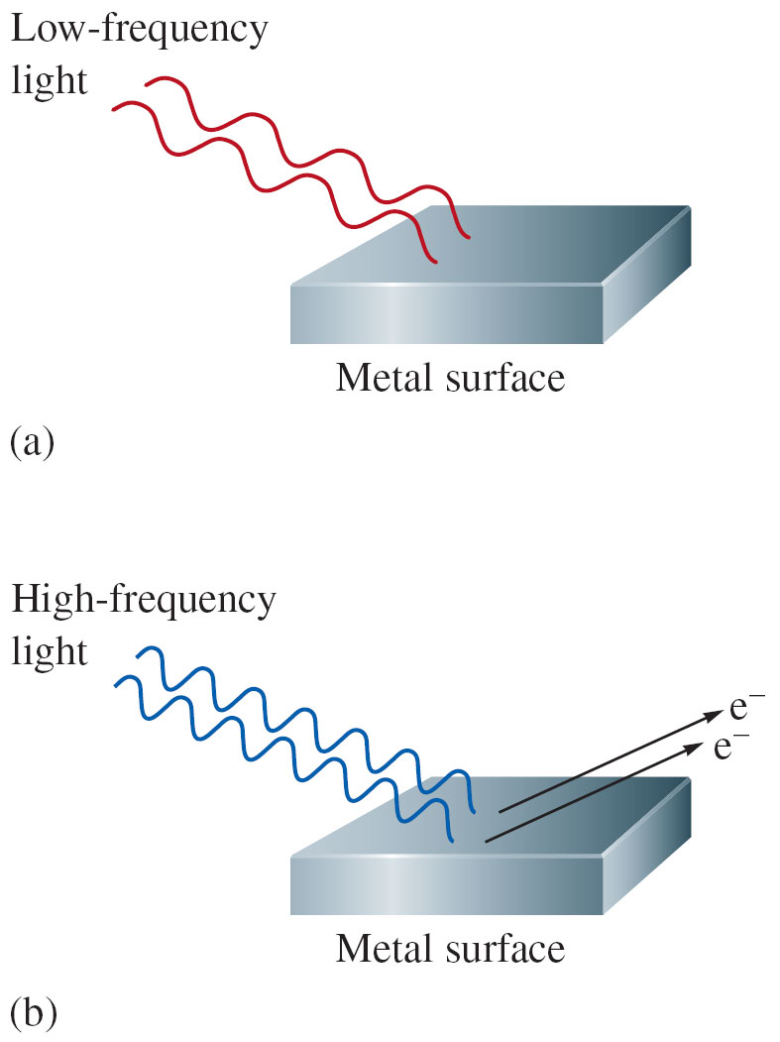

The Photoelectric Effect
Observations
No electrons are emitted by a given metal below a specific threshold frequency ν₀.
When ν < ν₀, no electrons are emitted regardless of the intensity of the light.
When ν > ν₀, the number of electrons increases with the intensity of the light.
For light with frequency greater than the threshold frequency, the kinetic energy of the emitted electrons increases linearly with the frequency of the light.
Minimum required energy to remove electrons = E₀ = hv₀
Kinetic energy of an electron:

Slide 9
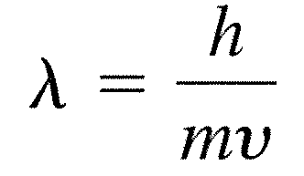
Energy-Matter is related by the equation,
E = mc² from Einstein’s special theory of relativity
Properties of Photons
  Do not have mass-have mass in a relativistic sense
  Possess only energy
Duality of Light
  Wave : reflection, refraction, diffraction, superposition
  Particle: momentum, photoelectric effect, quantized energy
Connection between wave and matter-de Broglie equation
All matter exhibits both particulate and wave properties

Slide 10
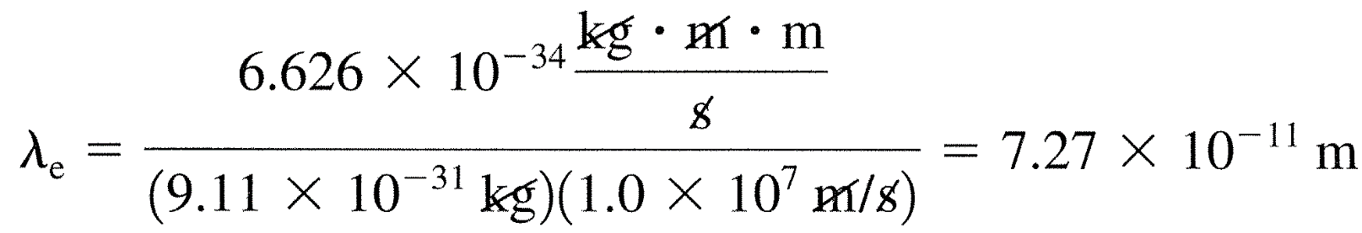
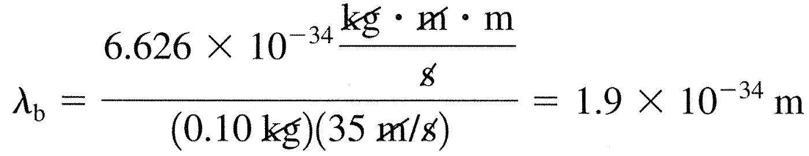
Example 7.3 Calculations of Wavelength
Compare the wavelength for an electron traveling at a speed of 1.0 x 10⁷ m/s with that for a ball (mass = 0.10 kg) traveling at 35 m/s.
Solution
Use an equation, λ = h/mv
For the electron, m = 9.11 x 10⁻³¹ kg
Pretty short wavelength-Electron microscope is possible!
Atomic arrangement in a crystal can be monitored.
For the ball

Slide 11
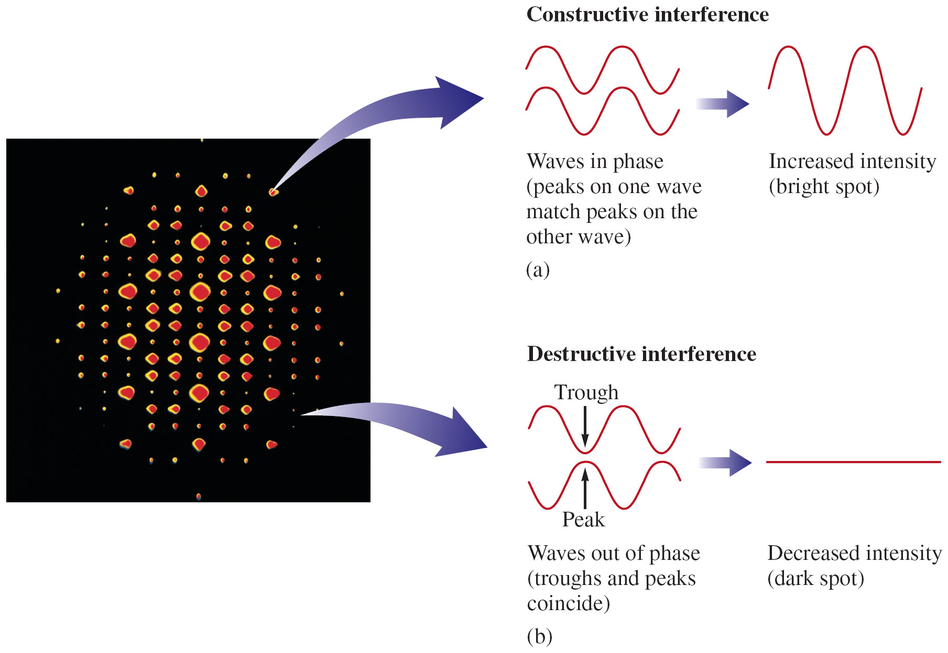
Diffraction and Diffraction Pattern

Slide 12
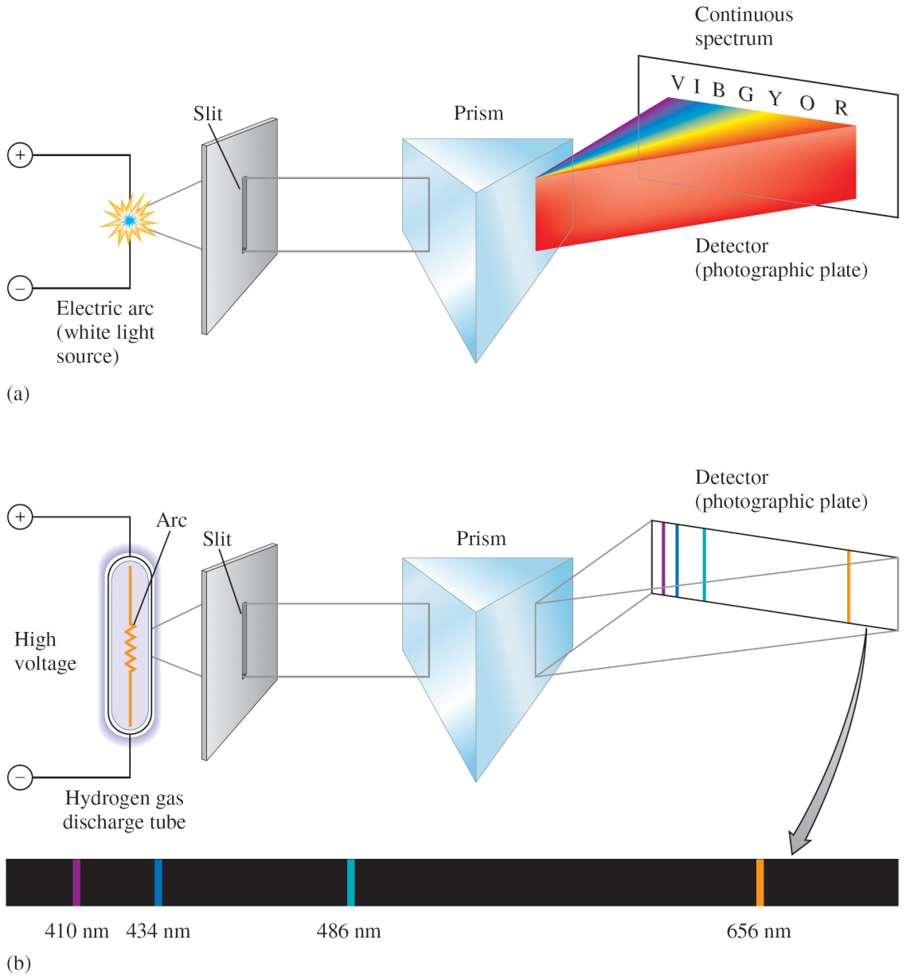
7.3 The Atomic Spectrum of Hydrogen
Continuous vs. Line Spectrum
Continuous spectrum (when white light is passed through a prism) – contains all the wavelengths of visible light
Line spectrum – each line corresponds to a discrete wavelength:
  Hydrogen emission spectrum

Slide 13
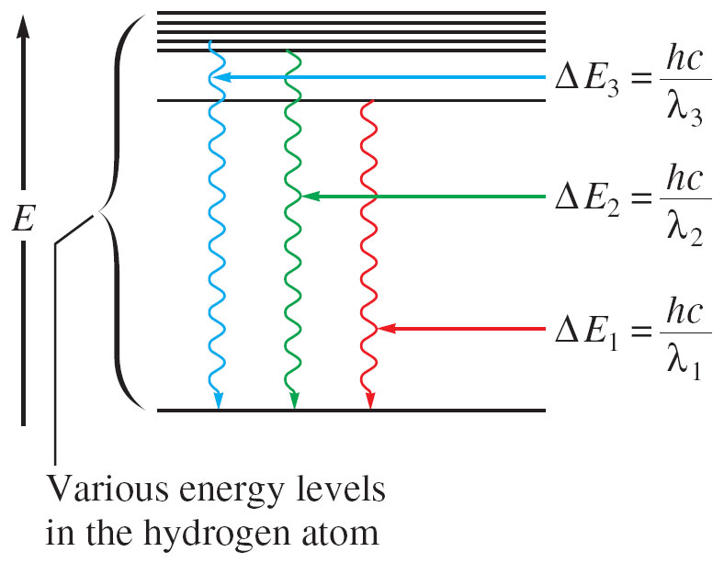
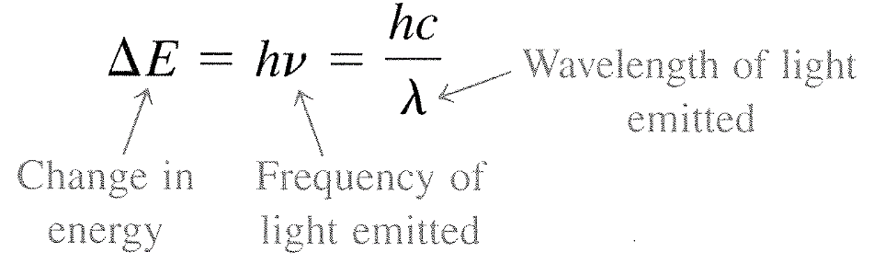
Only certain energies are allowed for the electron in the hydrogen atom.
Energy of the electron in the hydrogen atom is quantized.
E: energy level of an electron in an atom
E is not evenly distributed.
ΔE = E_{f} – E_{i}

Slide 14
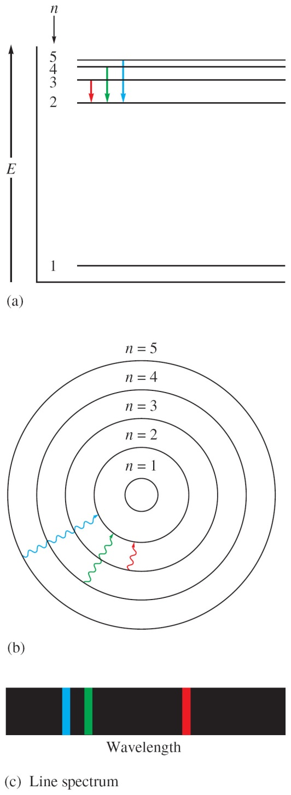
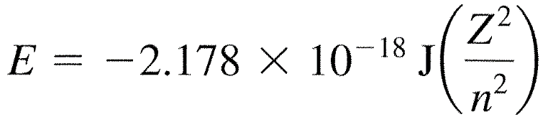
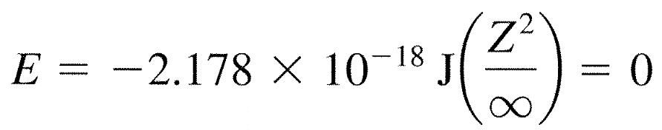
7.4 The Bohr Model
Applied classical mechanics to the hydrogen atom.
Electron in a hydrogen atom moves around the nucleus only in certain allowed circular orbits.
Bohr’s model gave hydrogen atom energy levels consistent with the hydrogen emission spectrum.
Ground state – lowest possible energy state (n = 1)
If the electron is at an infinite distance from the nucleus, n = ∞, there is no interaction and energy is zero.
Energy has the negative sign when electrons are bound in an orbit.
n : integer

Slide 15
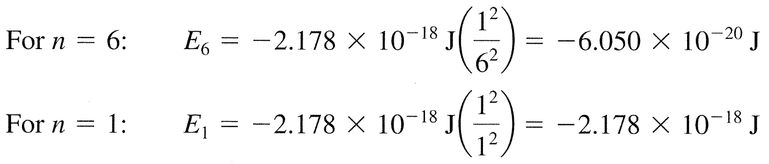
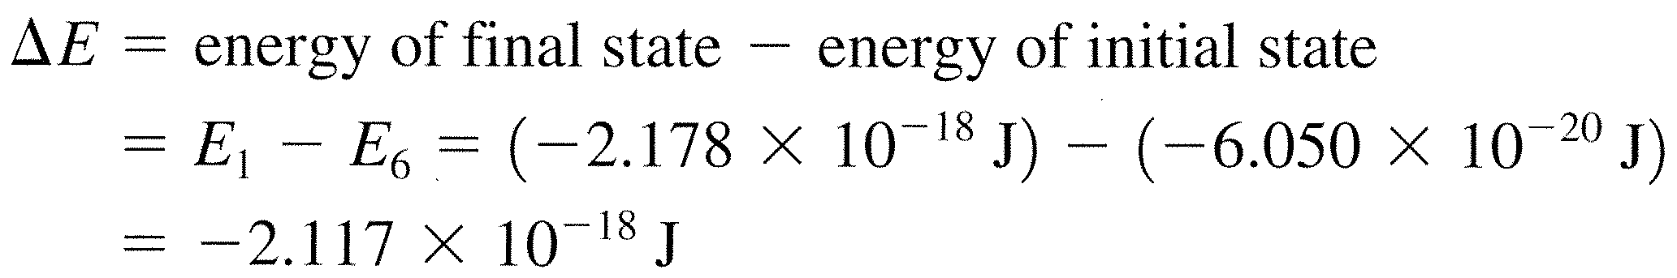
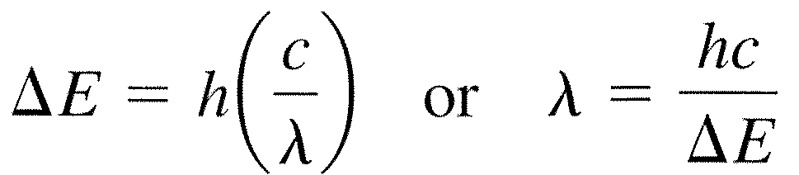
For the transition of electron from n = 6 to n = 1.
The negative sign indicates that the atom has lost energy and is in a more stable state.
The energy can be released in the form of EM radiation.

Slide 16
Example 7.4 Energy Quantization in Hydrogen
Calculate the energy required to excite the hydrogen electron from level n = 1 to level n = 2. Also calculate the wavelength of light that must be absorbed by a H atom in its ground state to reach this excited state.
Solution
= 1.216 x 10⁻⁷ m

Slide 17
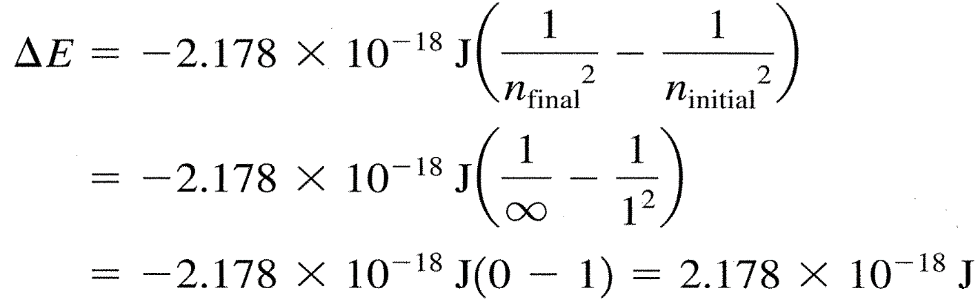
Example 7.5 Energy Energies
Calculate the energy required to remove the electron from a H atom in its ground state.
Solution
The Bohr’s model correctly fits the quantized energy levels of the hydrogen atom and postulates only certain allowed circular orbits for the electron.
Bohr’s model is incorrect. This model only works for hydrogen.
Electrons do not move around the nucleus in circular orbits.

Slide 18
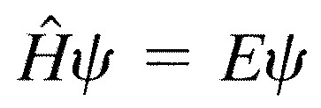
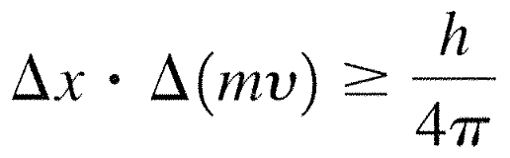
7.5 The Quantum Mechanical Model of the Atom
Three names associated with Quantum Mechanics
  de Broglie: λ = h/mv
  E. Schrödinger:
    ψ: wave function, H: Hamiltonian operator
    Orbital: a specific wavefunction
  W. Heisenberg: uncertainty principle
    There is a fundamental limitation to just how precisely we can know both the position and momentum of a particle at a given time.
The Physical Meaning of a Wave Function
The square of the wavefunction indicates the probability of finding an electron near a particular point in space
Probability distribution- intensity of color is used to indicate the probability value near a given point in space.

Slide 19
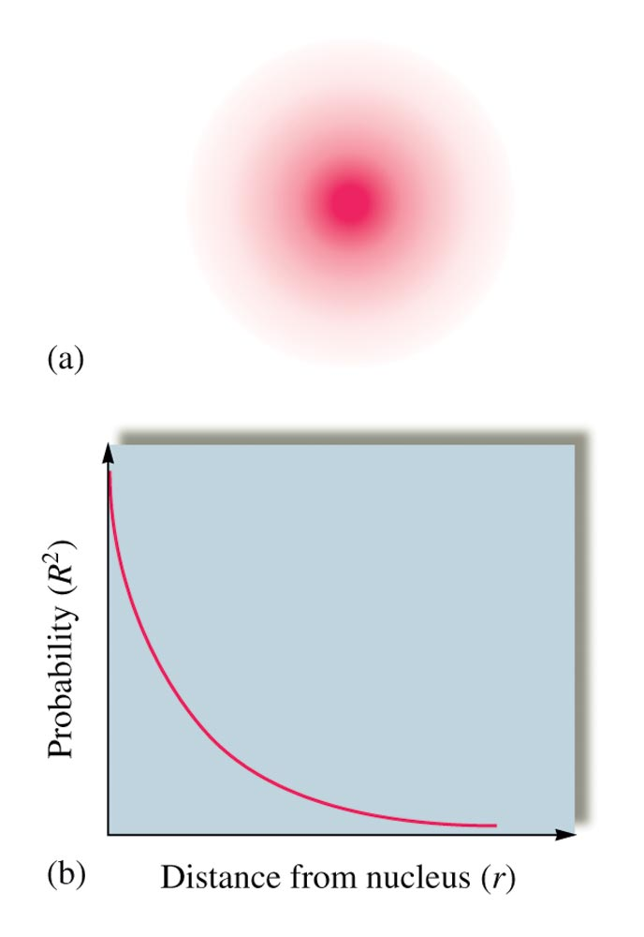
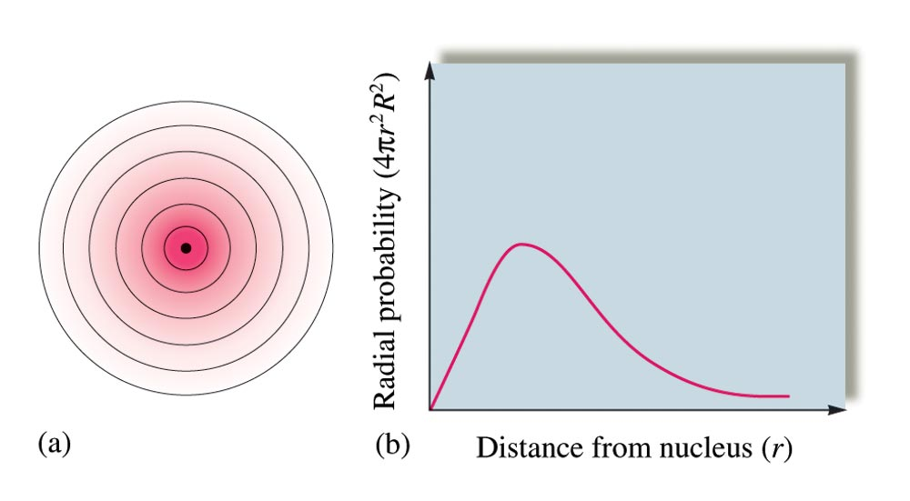
(a) Cross Section of Hydrogen 1s Orbital; (b) Radial Probability Distribution
(a) Probability Distribution for Hydrogen 1s Orbital in 3D Space (b) Probability of Finding the Electron at Points Along a Line
0.529 Å: Bohr radius
H 1s orbital has no distinct size.
Radius of the sphere that encloses 90% of the total electron probability

Slide 20
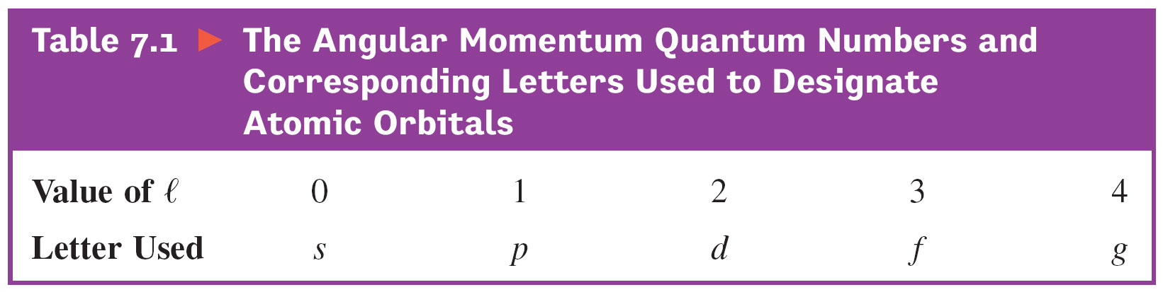
7.6 Quantum Numbers
Three quantum numbers are derived from the Schrödinger equation.
  Principal quantum number, n
    size and energy of the orbital
    n = 1 (K shell), 2 (L), 3 (M), 4 (N)
  Angular momentum quantum number, l
    shape of atomic orbitals (sometimes called a subshell)
    l = 0, 1, …, n-1
  Magnetic quantum number, m_{l}
    orientation of the orbital in space relative to the other orbitals in the atom
    m_{l} = -l, -l + 1, …, l – 1, l

Slide 21
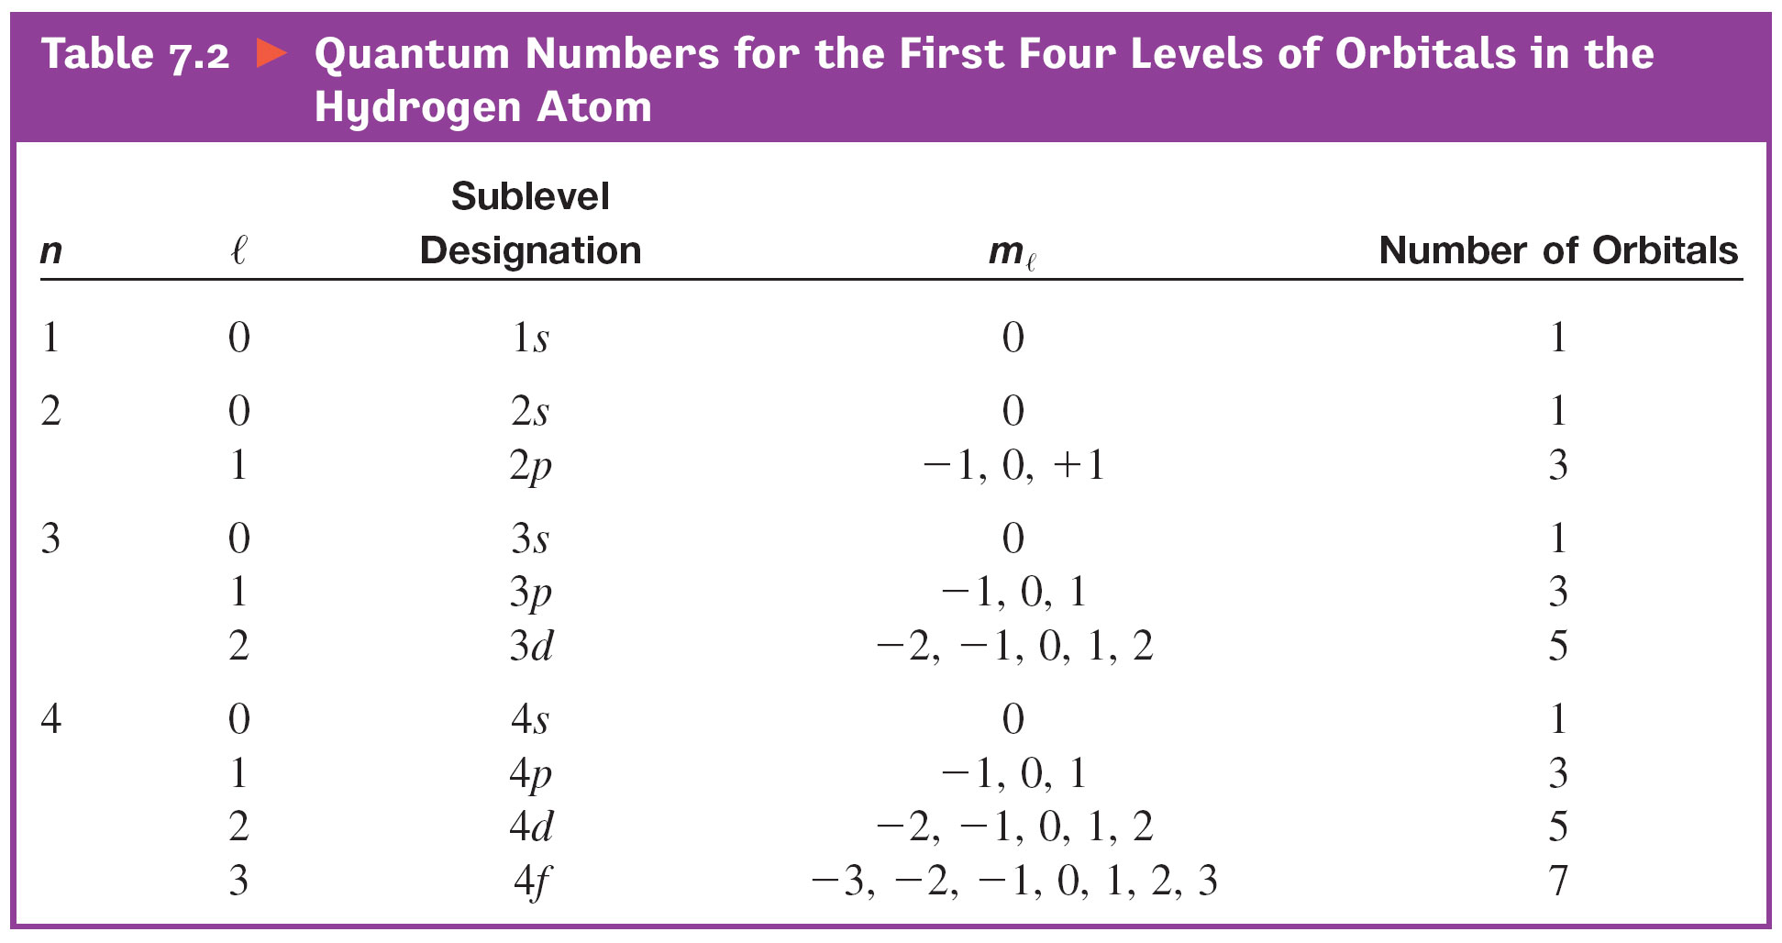
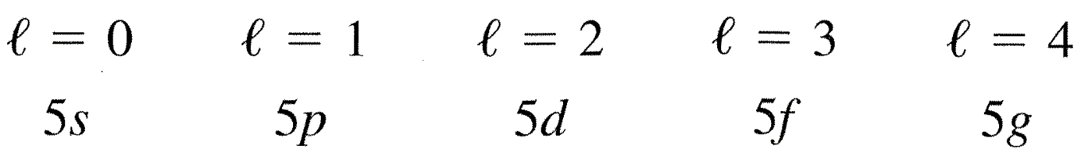
4) There is another quantum number
Spin quantum number, m_{s} = 1/2 or -1/2
Example 7.6 Electron Subshells
For n=5, determine the number of allowed subshells and give the designation of each.
Solution

Slide 22
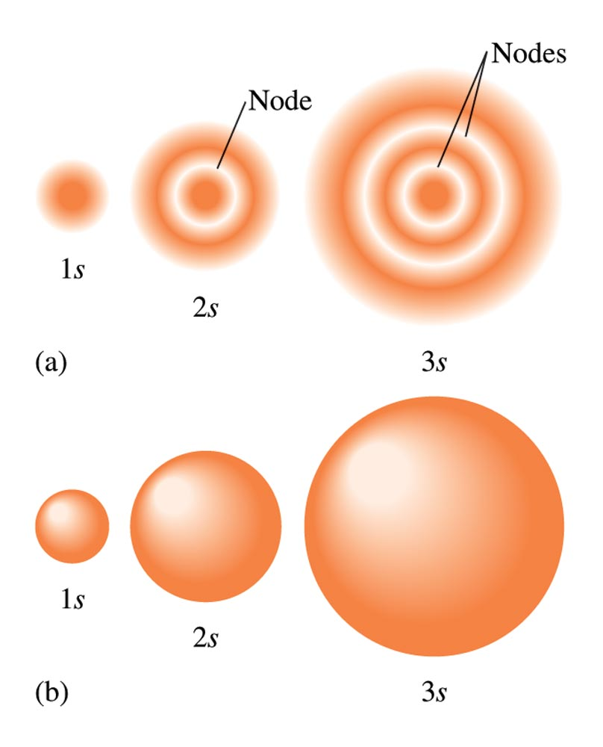
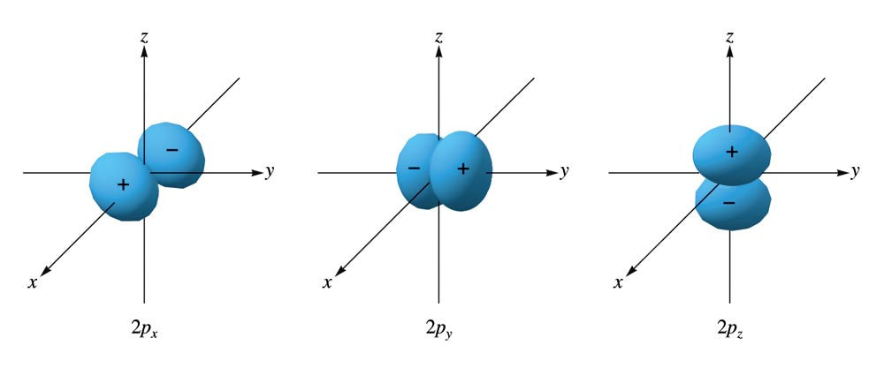
7.7 Oribital Shapes and Energies
1) s orbitals
2) 2p orbitals
The Boundary Surface Representations of All Three 2p Orbitals
Two Representations of the Hydrogen 1s, 2s, and 3s Orbitals
Electron probability distribution

Slide 23
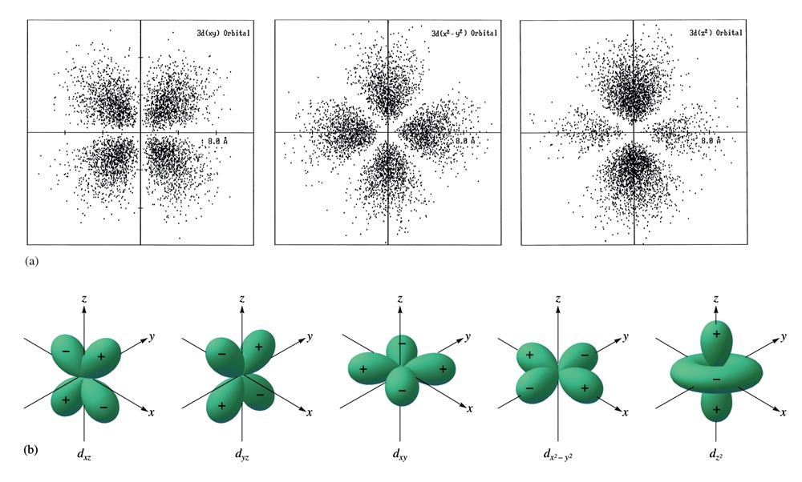
The Boundary Surfaces of All of the 3d Orbitals and electron density distribution

Slide 24
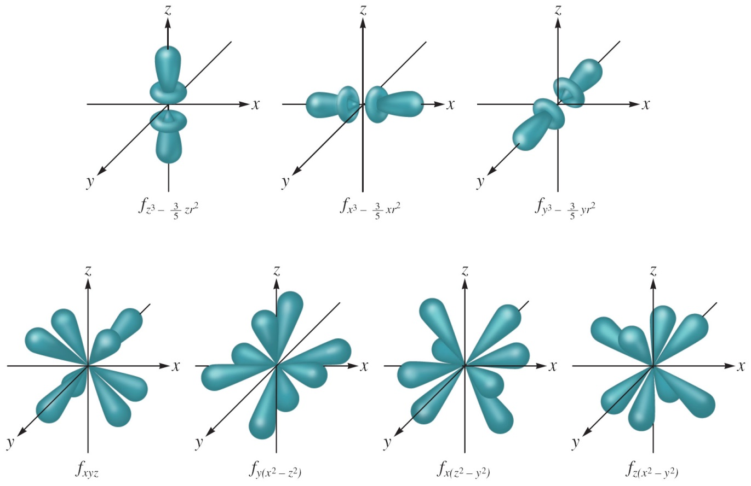
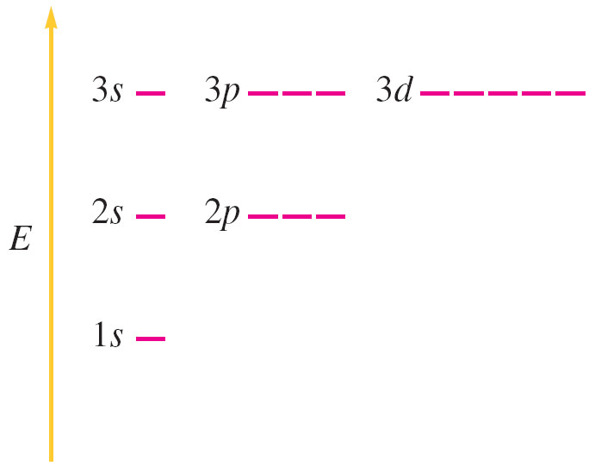
Representation of the 4f Orbitals in Terms of Their Boundary Surfaces
Same energy level. They are said to be degenerate
Orbital energy levels for the H atom

Slide 25
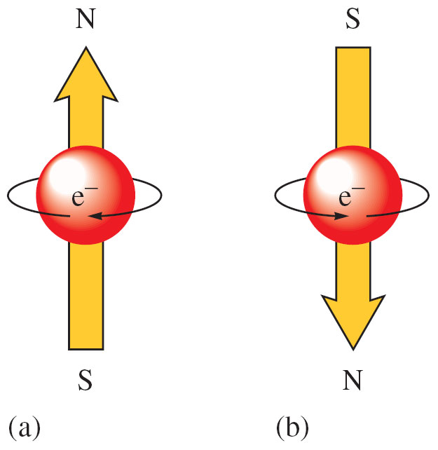
7.8 Electron Spin and the Pauli Principle
Electron spin quantum number (m_{s}) – can be +½ or -½.
Pauli exclusion principle - in a given atom no two electrons can have the same set of four quantum numbers (n, l, m_{l}, m_{s}).
An orbital can hold only two electrons, and they must have opposite spins.
7.9 Polyelectronic Atoms
Atoms with more than one electron.
Electron correlation problem:
  Since the electron pathways are unknown, the electron repulsions cannot be calculated exactly.-electron correlation problem
When electrons are placed in a particular quantum level, they “prefer” the orbitals in the order s, p, d, and then f.

Slide 26
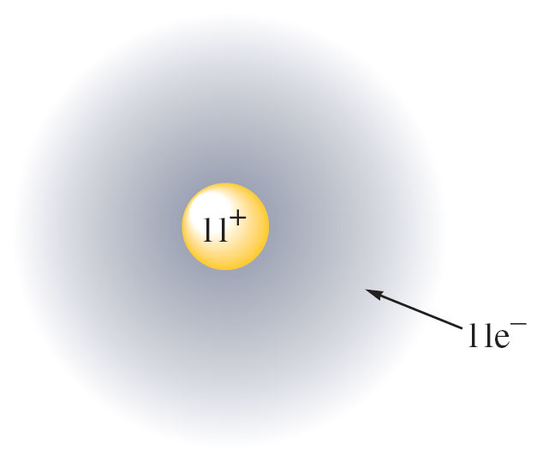
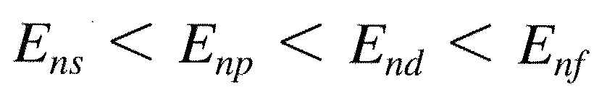
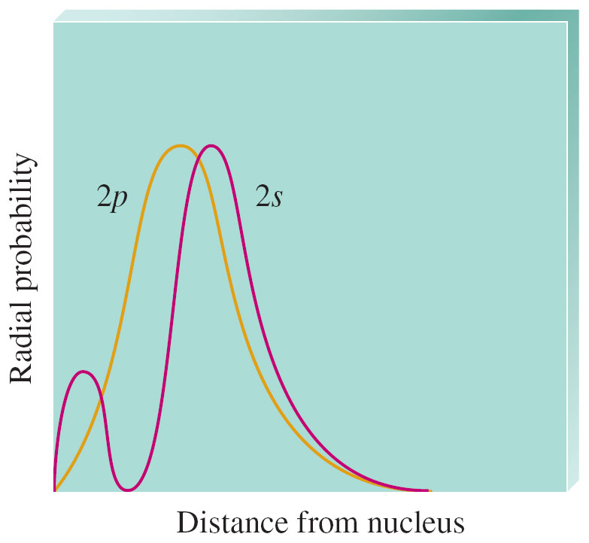
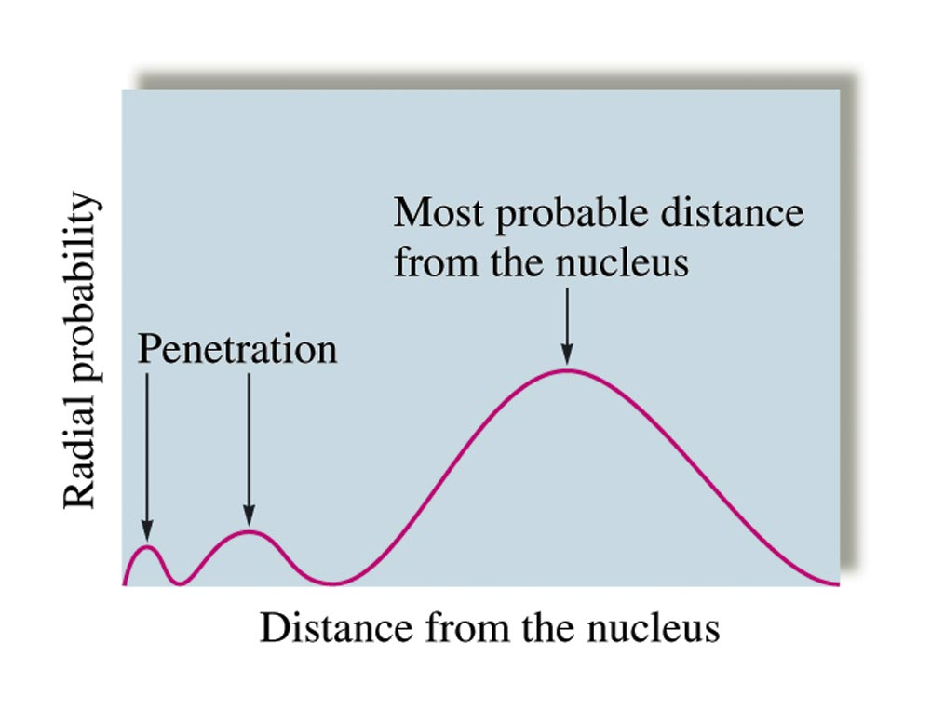
For a Na atom
Consider an outermost electron
This electron is attracted by the nucleus but feels repulsion by the other ten electrons.
The electron does not feel full nuclear charge.
The electron is shielded or screened by the other electrons from the nuclear charge.
→ Polyelectronic atoms have hydrogen-like orbitals.
For polyelectronic atoms, for a given principal quantum level, orbitals are not degenerate.
Radial probability
Penetration effect

Slide 27
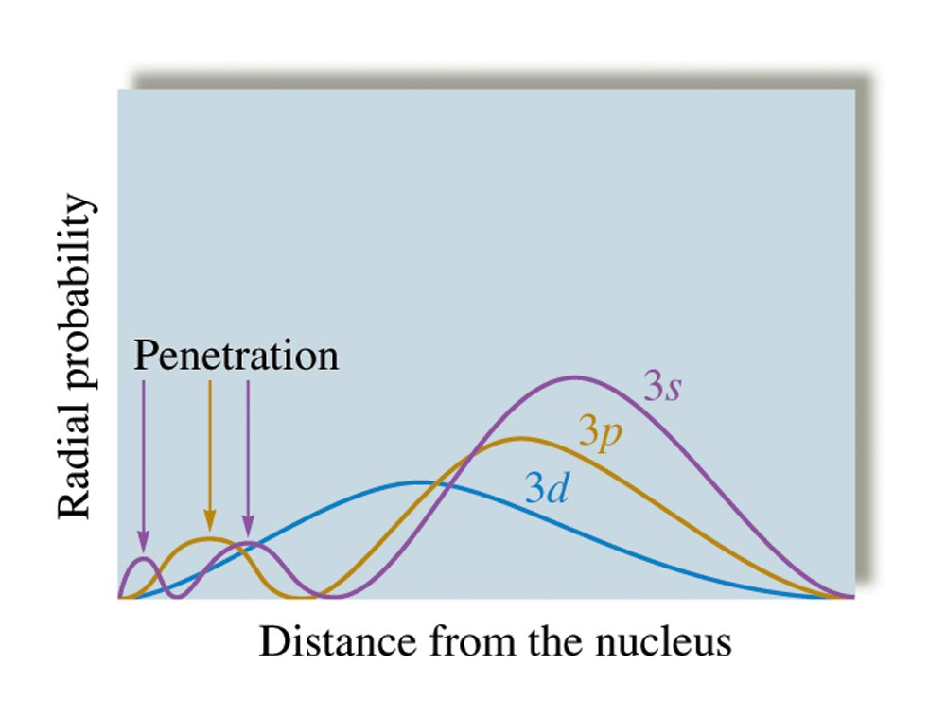
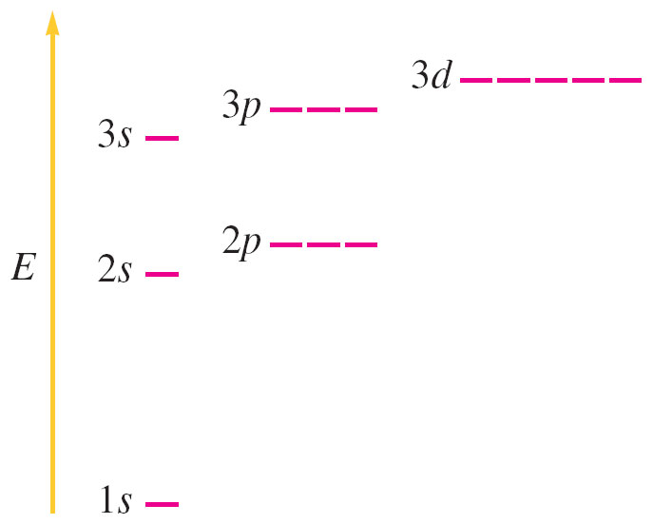
Penetration Effect
A 2s electron penetrates to the nucleus more than one in the 2p orbital.
This causes an electron in a 2s orbital to be attracted to the nucleus more strongly than an electron in a 2p orbital.
Thus, the 2s orbital is lower in energy than the 2p orbitals in a polyelectronic atom.
A Comparison of the Radial Probability Distributions of the 3s, 3p, and 3d Orbitals
Orders of Orbital Energies for Polyelectronic Atoms

Slide 28
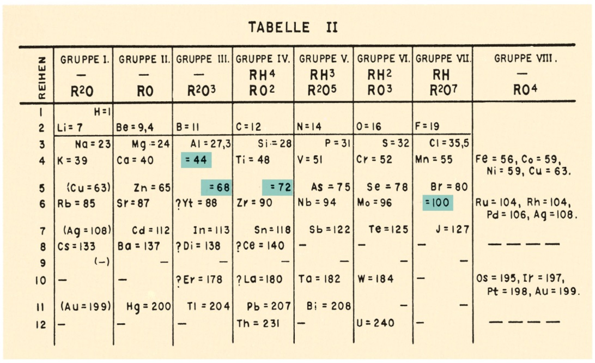
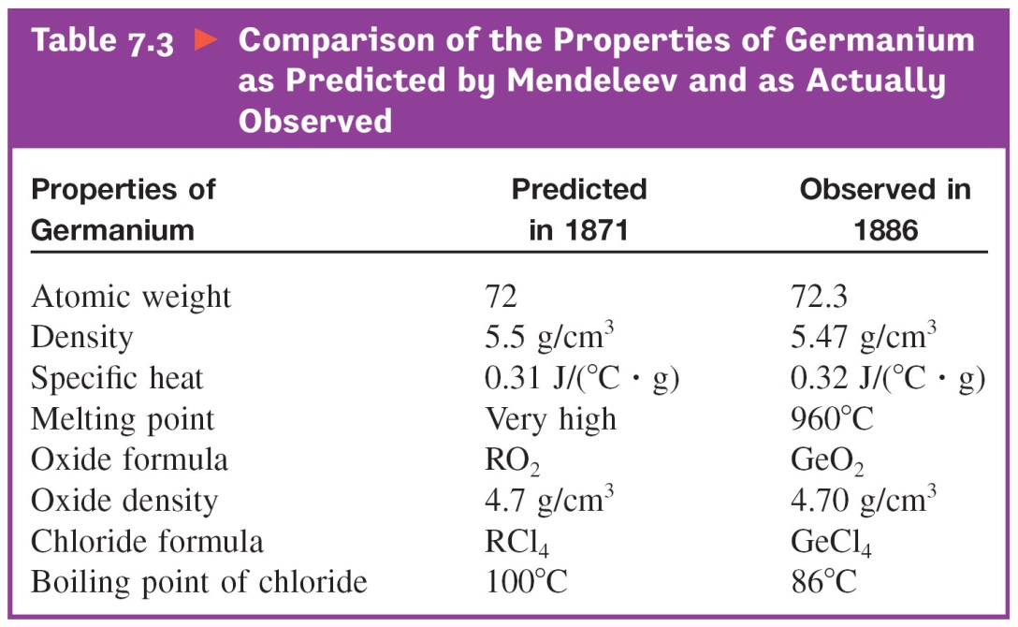
7.10 The History of the Periodic Table
Originally constructed to represent the patterns observed in the chemical properties of the elements.
Mendeleev is given the most credit for the periodic table.
He predicted new elements and their properties.-Ge, Sc, Ga, and Te
He also corrected atomic masses of In, Be, and U.

Slide 29
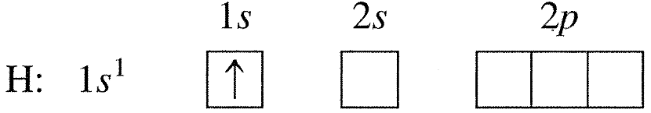
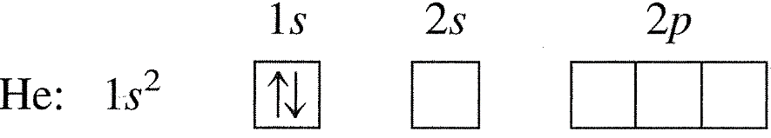
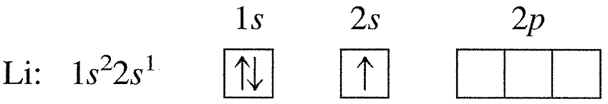
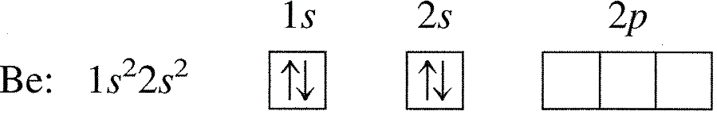
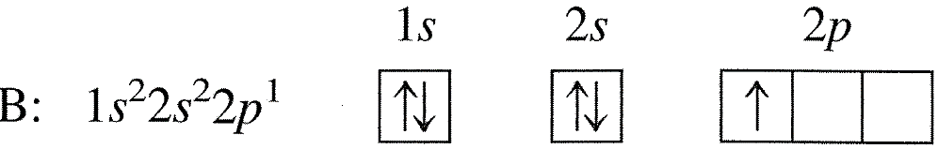
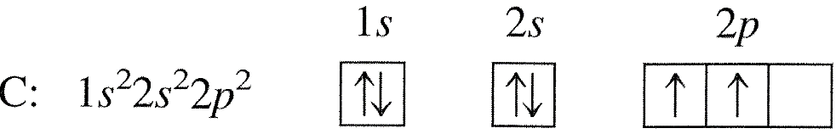
7.11 The Aufbau Principle and the Periodic Table
The Aufbau Principle
As protons are added one by one to the nucleus to build up the elements, electrons are similarly added to hydrogen–like orbitals.
Hund’s rule: The lowest configuration for an atom is the one having the maximum number of unpaired electrons allowed by the Pauli principle in a particular degenerate orbitals

Slide 30
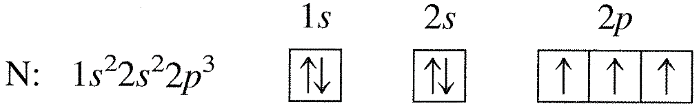
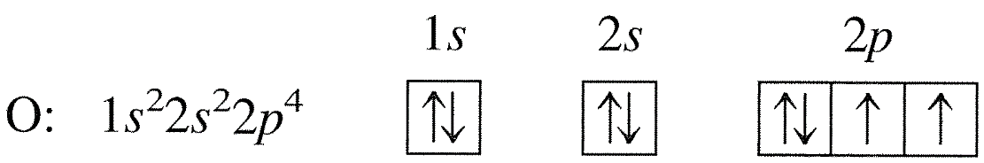

Na: [Ne]3s¹ Mg: [Ne]3s² Al: [Ne]3s²3p¹ Si: [Ne]3s²3p² etc.
Valence Electrons
The electrons in the outermost principal quantum level of an atom.
1s²2s²2p⁶ (valence electrons = 8)
The elements in the same group on the periodic table have the same valence electron configuration.

Slide 31

Ar: [Ne]3s¹3p⁶ = [Ar] K: [Ar]4s¹ Ca: [Ar]4s²
Transition metals
Sc: [Ar]4s²3d¹ = [Ar] Ti: [Ar]4s²3d² V: [Ar]4s²3d³ Cr: [Ar]4s¹3d⁵
Mn: [Ar]4s²3d⁵ Fe: [Ar]4s²3d⁶ Co: [Ar]4s²3d⁷ Ni: [Ar]4s²3d⁸
Cu: [Ar]4s¹3d¹⁰ Zn: [Ar]4s²3d¹⁰

Slide 32
The (n+1)s orbitals always fill before the nd orbitals. This early filling of the s orbitals can be explained by the penetration effect. For example, the 4s orbital allows for so much more penetration to the vicinity of the nucleus that it becomes lower in energy than the 3d orbital. Thus the 4s fills before the 3d.
After lanthanum, which has the configuration [Xe]6s²5d¹, a group of 14 elements called the lanthanide series, or the lanthanides, occurs. Note that sometimes an electron occupies a 5d orbital instead of a 4f orbital. This occurs because the energies of the 4f and 5d orbitals are very similar.
After actinium, which has the configuration [Rn]7s²6d¹, a group of 14 elements called the actinide series, or the actinides, occurs. This series corresponds to the filling of the seven 5f orbitals.
The group labels for Groups 1A, 2A, 3A, 4A, 5A, 6A, 7A, and 8A indicates the total number of valence electrons for the atoms in these groups.
Main groups (or representative elements): 1A, 2A, 3A, 4A, 5A, 6A, 7A, and 8A

Slide 33


Example 7.7 Electron Configurations
Give the electron configurations for S, Cd, Hf, and Ra using the periodic table.
Solution
7.12 Periodic Trends in Atomic Properties
1. Ionization Energy
This process requires energy
First IE
Second IE
Third IE
Fourth IE
I₁ < I₂ < I₃ << I₄ Why?

Slide 34

Large increase in energy in going from removal of valence electrons to removal of core electrons.

Slide 35


First Ionization energy
exception
Going across a period from left to right, the first IE increases.
The first IE decreases in going down a group.
As n increases, the size of the orbital increases and the electron is easier to remove.

Slide 36

Exceptions are found.
  Be → B first IEs decreases in the same period.
    Electrons in the filled 2s orbital provide some shielding for electrons in the 2p orbital from the nuclear charge.
  N → O first IEs decreases in the same period.
    Extra electron repulsions in the doubly occupied oxygen 2p orbital.
First IE in kJ/mol

Slide 37
Example 7.8 Trends in Ionization Energies
The first ionization energy for P is 1060 kJ/mol, and that for S is 1005 kJ/mol. Why?
Solution
They belong to Period 3 and we might expect S to have a greater ionization energy than P. The valence electron configuration. P: 3s²3p³, S: 3s²3p⁴. For S, the fourth p electron is placed in an already occupied orbital. The electron-electron repulsions cause the electron to be more easily removed.
Example 7.9 Ionization Energies
Consider the following electron configurations.
1s²2s²2p⁶, 1s²2s²2p⁶3s¹, 1s²2s²2p⁶3s²
Which atom has the largest first ionization energy and which one has the smallest ionization energy?
Solution
The first element has a filled 2p orbital whose electrons do not shield each other very effectively. So I₁ will be relatively large. The second and third elements have valence electron(s) whose first ionization energies are expected to be small. The third element has two valence electrons. So I₂ will be relatively small.

Slide 38

2. Electron Affinity (EA)
EA is the energy change associated with the addition of an electron to a gaseous atom.
X(g) + e⁻ → X⁻(g)
They are all exothermic.
Generally EA becomes more negative from left to right across a period.
EA for C is larger than N. C⁻(g) : stable, N⁻(g) : unstable.
O⁻(g) : can be formed but isolated O²⁻(g) is not possible.

Slide 39

exception
decreasing
When we go down a group, EA should become more positive (less energy released), since the electron is added at increasing distances from the nucleus.
There are numerous exceptions.
Smaller energy for F is attributed to the small size of the 2p orbitals. Because the electrons must be very close together in these orbitals, there are unusually large electron-electron repulsions.

Slide 40


3. Atomic Radius
r: covalent atomic radius
Metallic radii: obtained from half the distance between metal atoms in solid metal crystals.
r decreases in going from left to right across a period because of increase in effective nuclear charge.
r increases down a group because of the increase in the orbital sizes in successive principal quantum levels.

Slide 41
Example 7.10 Trends in Radii
Predict the trend in radius for the following ions: Be²⁺, Mg²⁺, Ca²⁺, and Sr²⁺.
Solution
All these ions are formed by removing two electrons from an atom of a Group 2A element. In going from Be to Sr, we are going down the group, so the sizes increases.
Be²⁺ < Mg²⁺ < Ca²⁺ < Sr²⁺
7.13 The Properties of a Group: The Alkali Metals
Information Contained in the Periodic Table
It is the number and type of valence electrons that primarily determine an atom’s chemistry.
Electron configurations can be determined from the organization of the periodic table.
Certain groups in the periodic table have special names.
Basic division of the elements is into metals and nonmetals.

Slide 43
The Alkali Metals
Li, Na, K, Rb, Cs, and Fr
  Most chemically reactive of the metals
    React with nonmetals to form ionic solids
  Going down group:
    Ionization energy decreases
    Atomic radius increases
    Density increases
    Melting and boiling points smoothly decrease
Properties of Five Alkali Metals
Element | Valence e⁻ configu-ration | Density at 25ºC | mp (ºC) | bp (ºC) | First IE (kJ/mol) | Atomic (covalent) Radius (pm) | Ionic (M⁺) Radius (pm)
Li Na K Rb Cs | 2s¹ 3s¹ 4s¹ 5s¹ 6s¹ | 0.53 0.97 0.86 1.53 1.87 | 180 98 64 39 29 | 1330 892 760 668 690 | 520 495 419 409 382 | 152 186 227 247 265 | 60 95 133 148 169

Slide 44

The Alkali Metals
Alkali metals are strong reducing agents.
Reducing power: Cs > Rb > K > Na > Li in solid alkali metals and non-metal reactions because first IE: Cs < Rb < K < Na < Li
Non-metals behave as oxidizing agents.
In aqueous solution, however,
The reducing power: Li > Na > K
Why is it in this order?

Slide 45

We have to consider hydration energy of alkali metals in water.
  Hydration energy: change in energy that occurs when water molecules attach to the M⁺ ion.
Li has highest hydration energy
Li⁺ is smallest and thus its charge density is greatest.
Polar water molecules are more strongly attracted to Li⁺ ion.
Because Li⁺ ion is so strongly hydrated, its formation from Li atom occurs more readily than the formation of K⁺ ion from K atom.
Na and K react with water more vigorously than Li. Why?
  Relatively high mp of Li
  Heat evolved melts Na and K, giving a larger area of contact with water.

