Slide 1
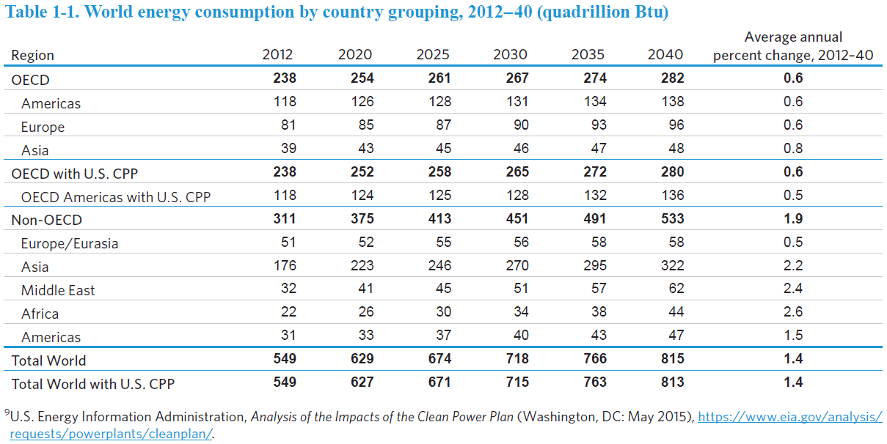
1.1 에너지 수요
BTU (British thermal unit) : heat required to raise one deg. F of one pound of water
1 BTU = 1055 J
Quadrillion = 10¹⁵

Slide 2
Some calculations
Energy consumption rate (power, 전력)
  Year 2012 : 549 quad BTU = 549 x 10¹⁵ BTU x 1055 J/BTU = 5.79 x 10²⁰ J
  Rate = 5.79 x 10²⁰ J/(365 d x 86400 s/d) = 1.84 x 10¹³ J/s = 1.84 x 10¹³ W = 18.4 TW. T (tera) = 10¹²
Solar opportunity (PNAS 2006, 103, 15729)
  Sunlight on the earth surface for 1 hr = 4.3 x 10²⁰ J
  Approximately energy from sun in 1.35 h is equal to the total energy consumed on the planet earth in 1 yr.
  Electricity generation from solar energy < 0.1%
  Electricity generation from biomass < 1.5%
  Solar energy utilization
    Capture and conversion
    Storage

Slide 3
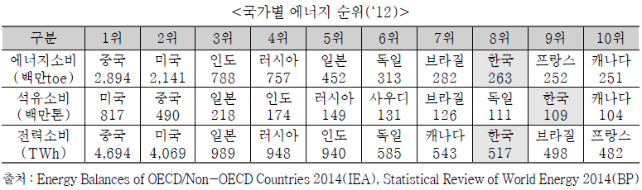
국내 에너지 현황
(2015 대한민국 에너지 편람, 에너지관리공단)
1. 에너지 소비

Slide 4
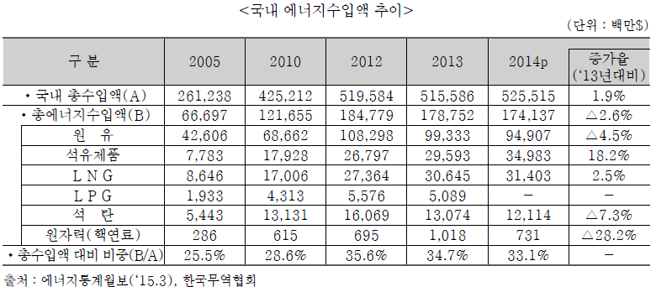
2. 에너지 수급 여건
에너지의 95.8%를 수입에 의존
2014년 기준 1,741억 달러의 에너지 수입 – 국가 전체 수입액의 33.1%

Slide 5
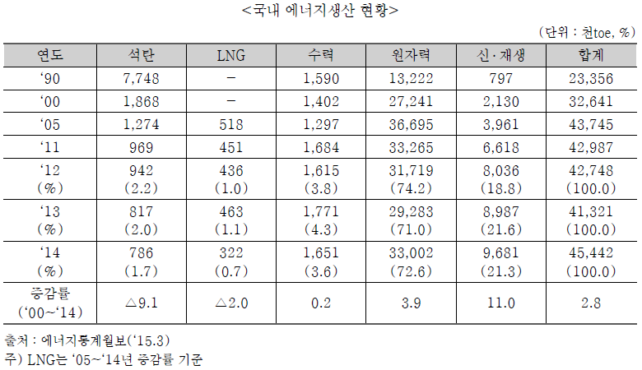
3. 국내 에너지 생산 현황
원자력 발전의 비중이 매우 높음
toe : ton of equivalent, 석유환산톤
1 toe = 10⁷ kcal, 원유 1톤의 순발열량

Slide 6
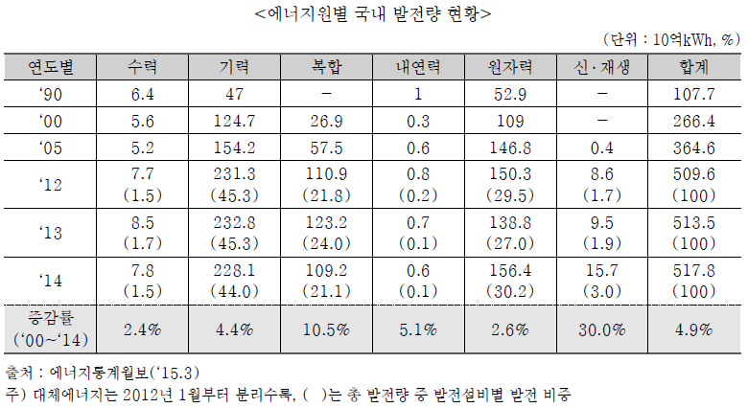

Slide 7
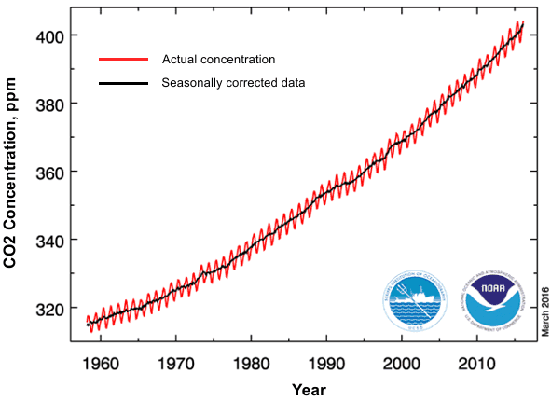
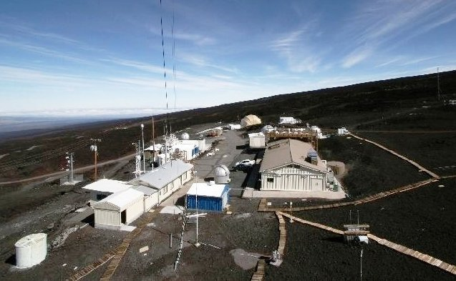
Atmospheric CO₂ concentration at Mauna Loa observatory – Keeling curve
Dec. 2016 404.48 ppm
Dec. 2015 401.85 ppm
Dec. 2014 398.91 ppm

Slide 8
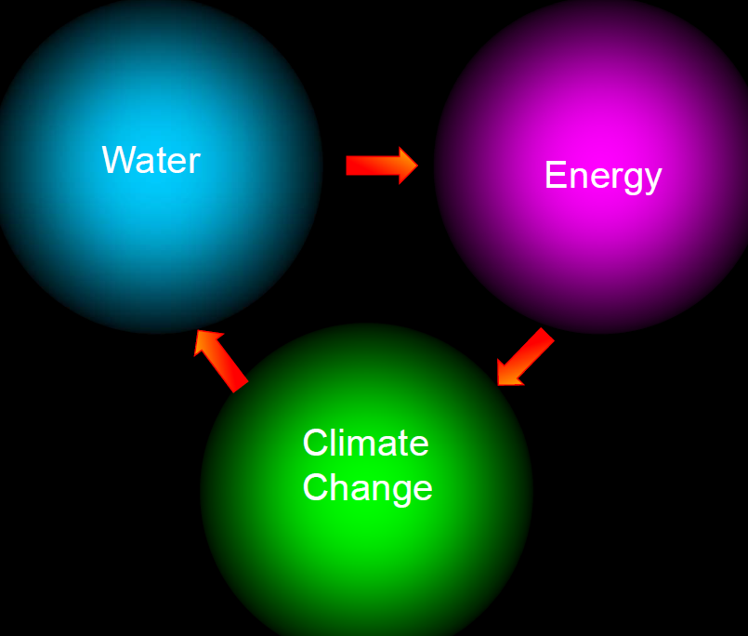
Global Water Demand
• 1 billion people lack adequate drinking water
• 2 billion people lack adequate sanitation
• By 2025, ¼ of all people could live in areas that face severe water shortages.

Slide 9
Energy Demand
• Global Energy Use (power = energy/time)
– 13,500 GW (= 13.5 TW)
(27,000 GW needed by 2050)
• Energy use in the USA
– 3340 GW energy (continuous) currently used
– 600 GW generated as electricity
→ 1 large nuclear power plant produces ~ 1 GW

Slide 10
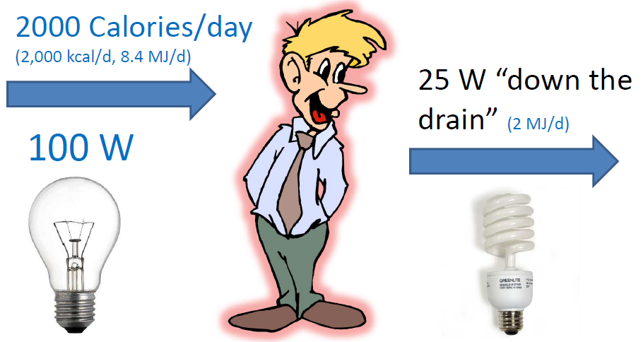
Power Consumption by People

Slide 11
Energy & The Water Infrastructure
• Annual energy used for the water infrastructure
  • 30 GW (USA), or 5‐6% of all electricity generated
• Wastewater treatment:
  • 15 GW
  • 0.6 kWh/m³ (0.12 to 1‐2 kWh/m³ )
• Drinking water treatment?
  • Desalination requires 3.7 – 650 kWh/m³

Slide 12
Energy & The Water Infrastructure
• Energy USED for wastewater treatment
  • 15 GW (USA)
  • 0.6 kWh/m³ (range: 0.12 to 1‐2 kWh/m³ )
• New energy SOURCE? (waste)water
  – Domestic & Industrial wastewaters contain 17 GW (USA)
    – Domestic wastewater contains (in the organic matter) about 2‐5 kWh/m³; or 4 ‐ 10 times that needed using conventional treatment!

Slide 13
New Energy Sources Available using
Microbial Electrochemical Technologies (METs)
• Wastewater : Organic matter in water (USA)
  – 17 GW in wastewater
  (Save 45 GW energy/yr used + produce 17 GW = 62 GW net change)
• Cellulose Biomass Energy : Get biomass → water
  – 600 GW available (based on 1.34 billion tons/yr of lignocellulose)
  (this is how much electrical power is produced in USA)
• Salinity Gradient Energy ‐ Salt & Fresh‐waters (global values)
  – 980 GW (from the 1900 GW available from river/ocean water)
  (20 GW available where WW flows into the ocean)
• Waste Heat Energy → Capture heat in “water” (USA)
  – 500 GW from industrial “waste heat”
  – 1000 GW from power plant waste heat
  (Does not include solar and geothermal energy sources)

Slide 14
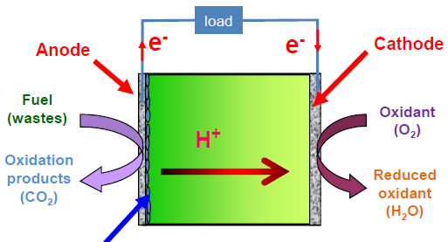
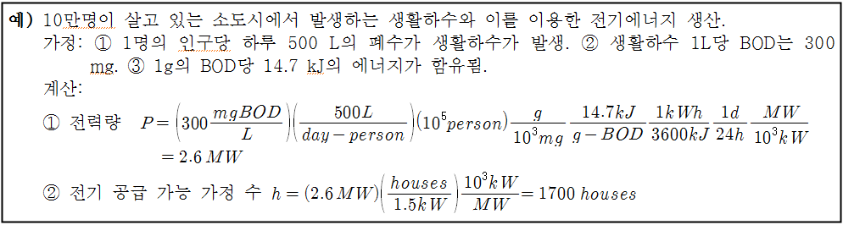
미생물연료전지의 가능성
Bacteria

