Slide 1
Artificial Photosynthesis: From Molecular Catalysts for Light-driven Water Splitting to Photoelectrochemical Cells
Photochemistry and Photobiology, 2011, 87: 946–964

Slide 2
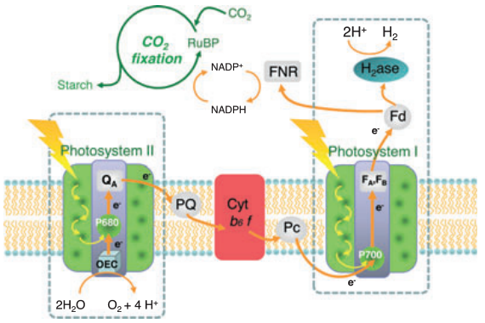
Three steps of photosynthesis
Light-harvesting and local charge separation
Spatial charge separation
Multielectronic redox catalysis

Slide 3
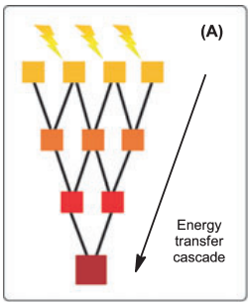
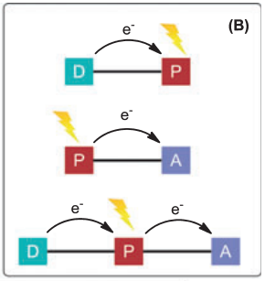
Molecular light-harvesting arrays
Dyad and triad models mimicking spatial charge separation
Photon energy is directionally transferred to a final acceptor
D: donor
P: photosensitizer
A: acceptor

Slide 4
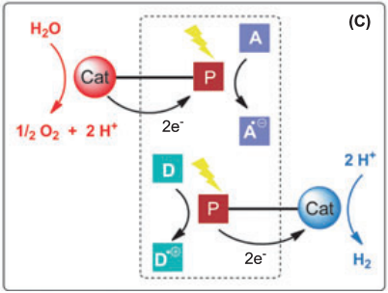
Multielectron photocatalysis
Sunlight-driven water splitting with sacrificial electron acceptor and donor

Slide 5
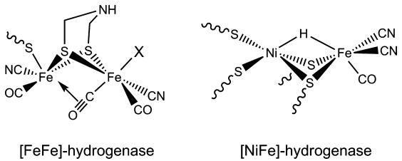
Molecular catalytic systems for visible light-driven H₂ evolution
Aim : develop noble metal-free molecular catalysts for light-driven H₂ production
Pt group metals are excellent for H₂ production but has limited supply and is of high cost
New photocatalysts based on earth-abundant first-row transition metals
Insight from structures of hydrogenase (H₂ase)

Slide 6
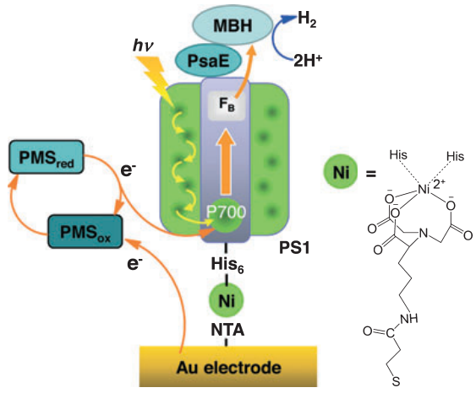
Homogeneous photocatalytic H₂-evolving systems and photocatalytic bioconstructs based on hydrogenases
1) PSI-membrane-bound hydrogenase
MBH : membrane-bound hydrogenase
PsaE : extrinsic subunit
PMS : N-methylphenazonium methyl sulfate, soluble electron carrier
λ_{max} = 700 nm, i_{ph} = 85 nA/cm²
30% was H₂

Slide 7
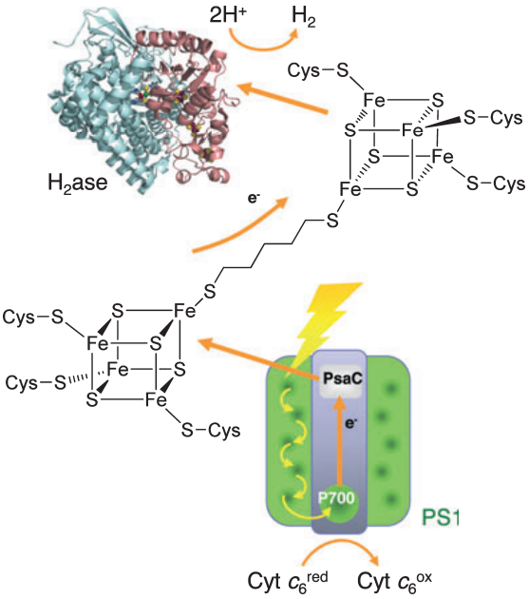
2) PSI-[FeFe]-hydrogenase
H₂ase attached to PSI via dithiol
[4Fe-4S] cluster of C13G mutant of PSI PsaC subunit to distal [4Fe-4S] cluster of C97G mutant of [FeFe]-H₂ase
Use ascorbate and PMS as sacrificial electron donor
Maintained stability for more than 2 months in the absence of O₂

Slide 8
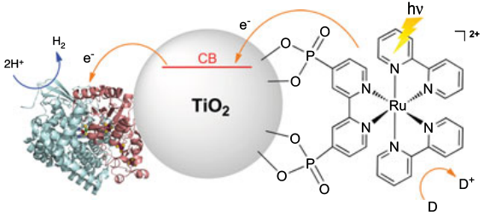
3) [NiFeSe]-hydrogenase – TiO₂ nanocrystalline thin film
Light is sensitized by Ru(bpy)₃²⁺
Use a sacrificial electron donor
Photoinstability was found

Slide 9
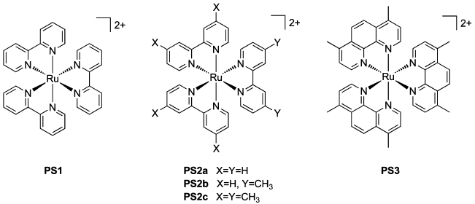
Synthetic multicomponent photocatalytic H₂-evolving systems
Two families of efficient catalysts
  Diiron mimics of the active site of [FeFe] hydrogenases
  Bioinspired cobalt complexes
Molecular photosensitizers
Ruthenium-based photosensitizers as light-harvesting units are most common

Slide 10
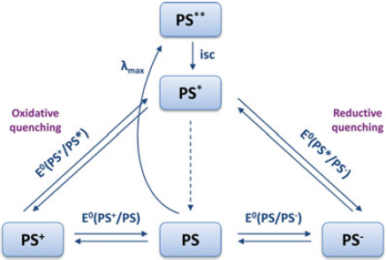
Upon light absorption
  1 e⁻ transition : d (metal) → π* (diimine ligand)
  Spin state : singlet (S=0) → triplet (S=1) by intersystem crossing due to spin-orbit coupling → ³MLCT → Ru(III)L(-1)
PS* both as a strong reductant and a strong oxidant
  E(PS⁺/PS*) = -0.86 V
  E(PS*/PS⁻) = 0.84 V

Slide 11
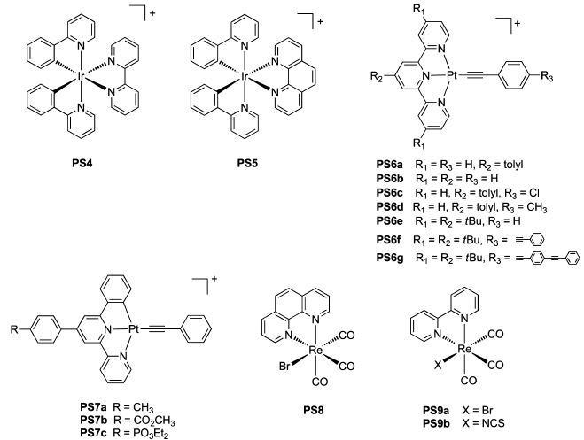
Other metal-diimine photosensitizers

Slide 12
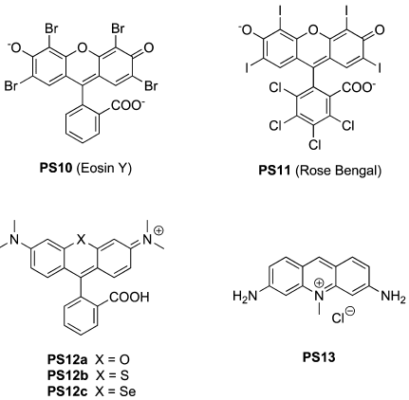
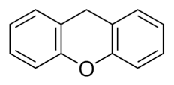
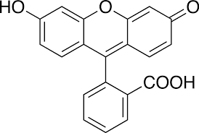
Other organic photosensitizers-a major breakthrough
Xanthene derivatives
Heavy atoms (Br, I) facilitate inter-system crossing
Fluorescein : not a good photosensitizer

Slide 13
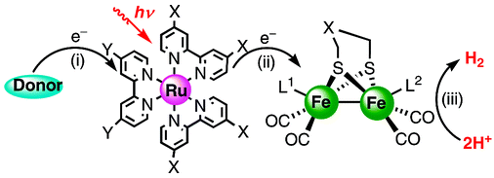
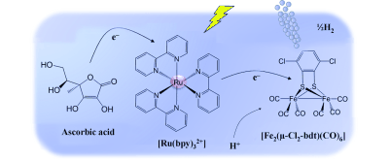
Diiron-based catalysts
Inorg. Chem. 2008, 47, 2805–2810.
TON = 86
Sacrificial donor
-ascorbic acid
photosensitizer
catalyst
Chemistry A European Journal 2010, 16, 60–63.
TON = 200

Slide 14
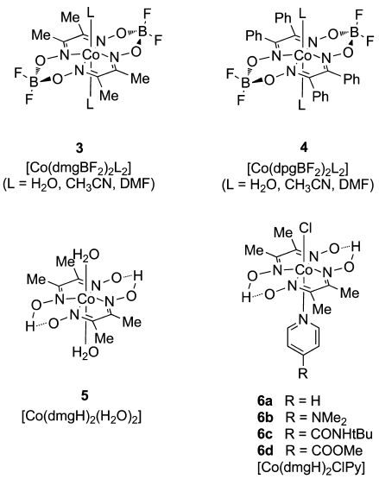
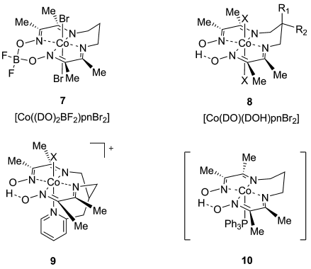
Cobaloxime and cobalt diimine-dioxime catalysts
cobalt diimine–dioxime catalysts
cobaloxime catalysts

Slide 15
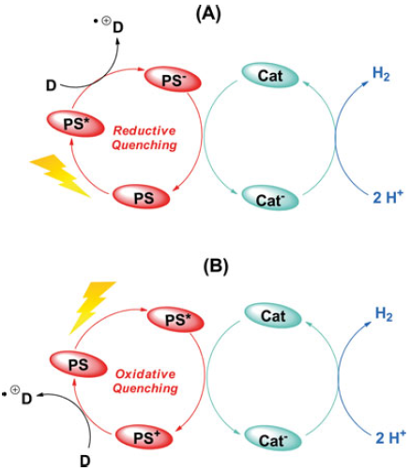
Mechanistic issues
Initiation : absorption of a photon by photosentization. PS → PS*
Oxidative quenching or reductive quenching
Oxidative quenching
  PS* + Cat → PS⁺ + Cat⁻
  D + PS⁺ → D^{+.} + PS
  2Cat⁻ + 2H⁺ → 2Cat + H₂
Reductive quenching
  D + PS* → D^{+.} + PS⁻
  PS⁻ + Cat → PS + Cat⁻
  2Cat⁻ + 2H⁺ → 2Cat + H₂

Slide 16
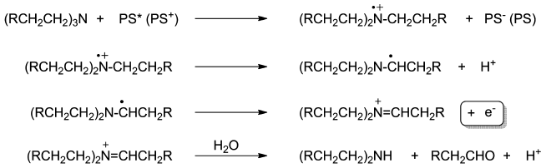
Sacrificial electron donors
-triethanolamine, TEOA
-triethylamine, TEA
Decomposition mechanism of TEA (R=H) and TEOA (R=OH) generating one electron (dark process)
The solution pH is important
  No H₂ production at pH < 6-8, or above > 12-13
Solvent effects are to be considered

Slide 17
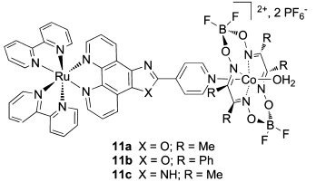
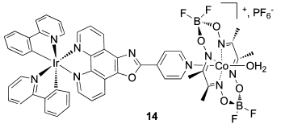
Supramolecular photocatalysts
Single-component photocatalysts by supramolecular assembly or by covalent linking
photosensitizer
catalyst
photosensitizer
catalyst
TON : 210 for 14
TON : 103 for 11a

Slide 18
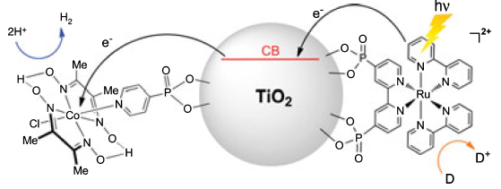
Using a TiO₂ nanoparticles
TON = 53
Supramolecular cobalt-based assemblies are more active than the corresponding multicomponent systems.

Slide 19
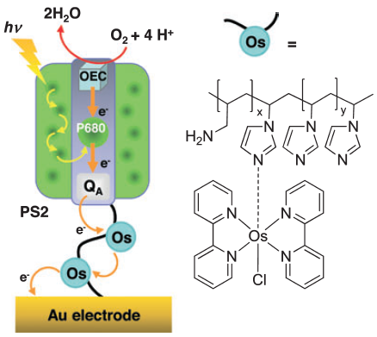
Light-driven homogeneous water oxidation
Much insight from oxygen evolving center (OEC) of PSII – Mn₄Ca
Photocatalytic bioconstructs based on PSII
Engineering PSII
Photocurrent = 45 μA/cm²
Osmium redox polymer acts as an electron acceptor
No sacrificial electron donors are needed

Slide 20
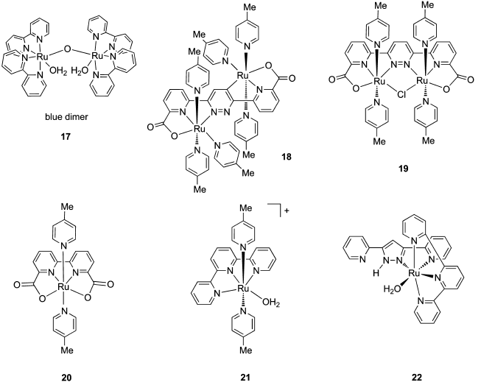
Synthetic multicomponent photocatalytic oxygen-evolving systems
Mono- and dinuclear ruthenium-based photocatalytic systems
TON = 50 O₂
580
370

Slide 21
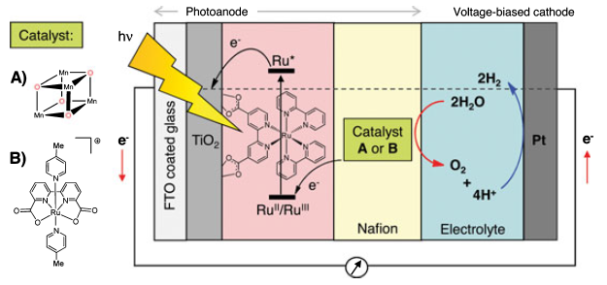
Photoelectrochemical device for water splitting
Voltage bias was applied
Three-component system: photosensitizer, catalyst, sacrificial electron acceptor
Sacrificial electron acceptor: [Co(NH₃)₅Cl]₂²⁺, S₂O₈²⁻

Slide 22
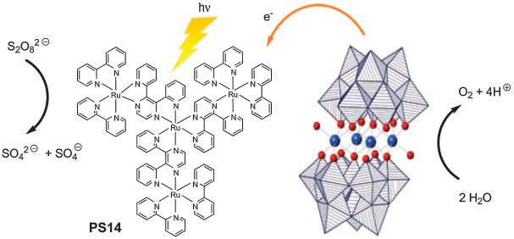
Ruthenium and cobalt-based polyoxometallates
Inorganic catalysts: more stable
Example: tungstosilicate, [Ru^{IV}₄(O)₄(μ-OH)₂(H₂O)₄(γ-SiW₁₀O₃₆)₂]¹⁰⁻ catalyzes H₂O by Ce^{IV}
TON = 385, yield 90%

Slide 23
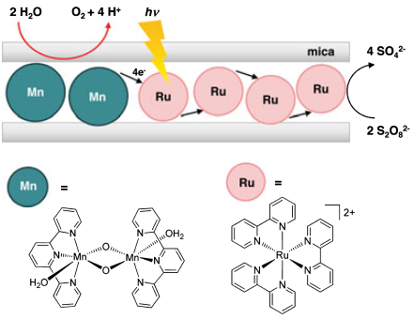
Bioinspired manganese-based photocatalytic systems
Mimicking OEC
–Dinuclear Mn(III) complexes with terpyridine or carboxylate-based ligands
-Cubane clusters
Issues to be addressed
  Stability of photosensitizers under highly oxidizing conditions
  Stability of catalysts to be systematically investigated
  Better understanding of mechanism of light-induced processes

Slide 24
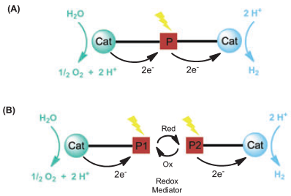
Perspectives
Challenge : developing a fully molecular-based device for H₂ and O₂ evolution system for water splitting
A fully homogeneous system where both H₂ and O₂ are evolved in one compartment
Drawback: explosive H₂-O₂ mixture, H₂ has to be purified.

Slide 25
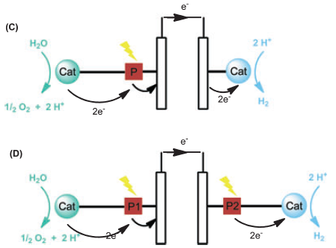
Photoelectrochemical system
  Photoanode: water oxidation
  Photocathode: proton reduction

Slide 26
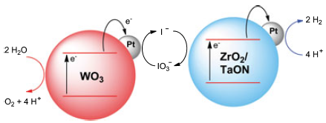
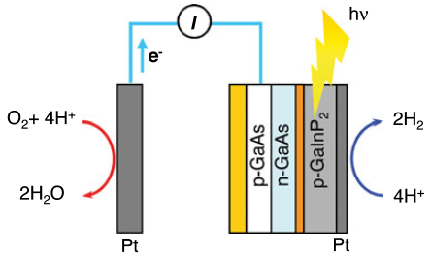
Water splitting systems using semiconductors and metals
Semiconductor : photosensitizer
Metal : catalyst
6.3%
12.4%

Slide 27
Issues to consider for molecular photocatalytic systems to be used
Catalysts for H₂ and O₂ evolution should work under the same operating conditions and tolerate the presence of H₂ and O₂.
Thermodynamic consideration
  Device A : PS* is first oxidatively quenched by H₂-evolving catalyst → use TiO₂ particle. TiO₂ oxidatively quench PS* and dye injects an electron into the CB of TiO₂, which can deliver it to a H₂-evolving catalyst.
Fine control of the kinetics of the electron transfer steps.
  -Mimics of antennae effect
  -unidirectional electron transfer
  -Formation of long-lived charge separation states
  → To be integrated in bioinspired photoelectrochemical cells

