Slide 1
Chapter 2
Exoelectrogens
(전자방출균)
-Electron transfer
Prof. Sunghyun Kim

Slide 2
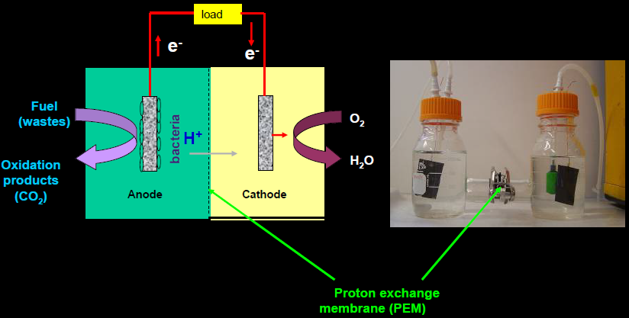
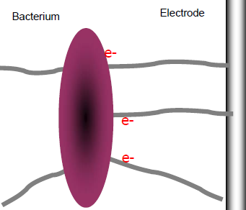
Microbial biofilm

Slide 3
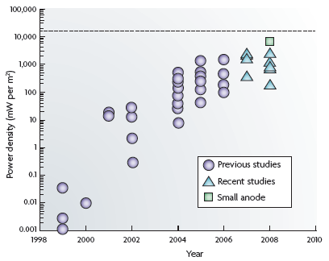
연구 수준
한계에 다다른 전력밀도 → 새로운 방식에 의한
breakthrough가 필요

Slide 4
Components of MFCs
Membrane?
Membrane vs Membrane-less
→ Membrane-less MFC (single-chamber MFC)
Mediators?
Mediator vs Mediator-less
→ Mediator-less MFC
Electrodes?
2-dimensional vs 3-dimensional
→ 3-D electrodes
Bacteria?
Exoelectrogens (electroactive) vs Non-exoelectrogens
→ Both exo- and non-exoelectrogens

Slide 5
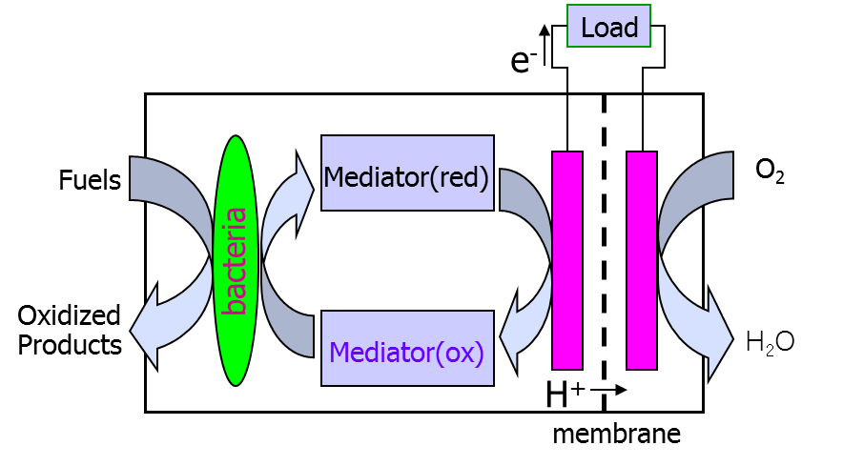
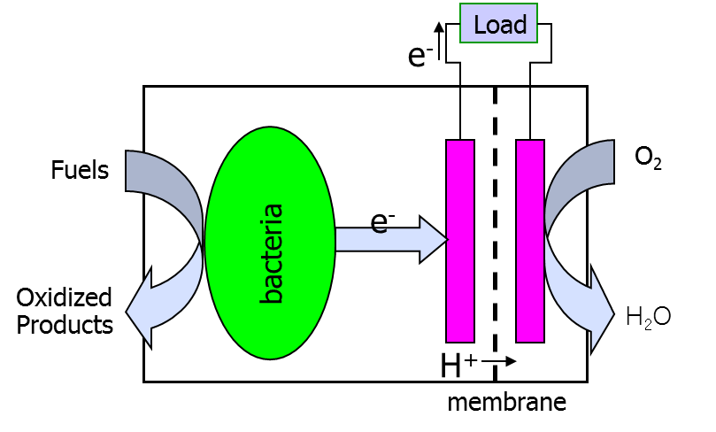

Redox mediators?
Mediator-type

Slide 6
Microorganisms
• Exoelectrogens : electroactive bacteria
– Transfer electrons exocellularly in three ways
• Self-produced mediators
• Nanowires
– Conductive appendages
• Membrane-bound electron carriers
– Anode is used instead of the normal terminal
electron acceptors
– Common species Geobacter and Shewanella
– Metal-reducing bacteria
• Non-exoelectrogens : electroinactive bacteria

Slide 7
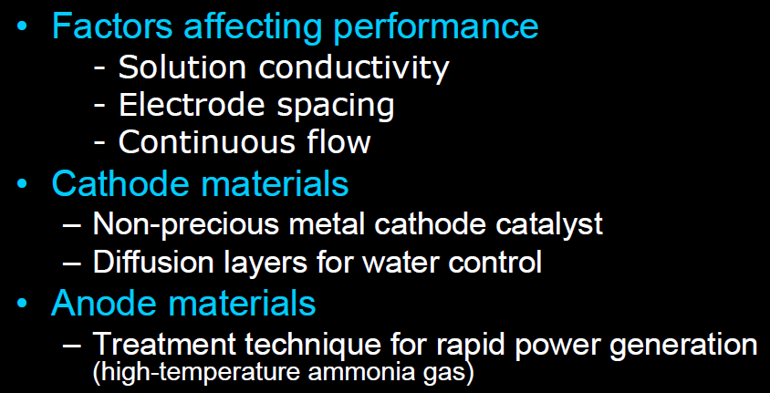

Slide 8
Discovery of direct electron transfer between microbes and electrode
oxidation
reduction
Cyclic voltammetry of Shewanella putrefaciens IR-1
Kim, B. H. et al. J. Microbiol. Biotechnol. 1999, 7, 127-131

Slide 9
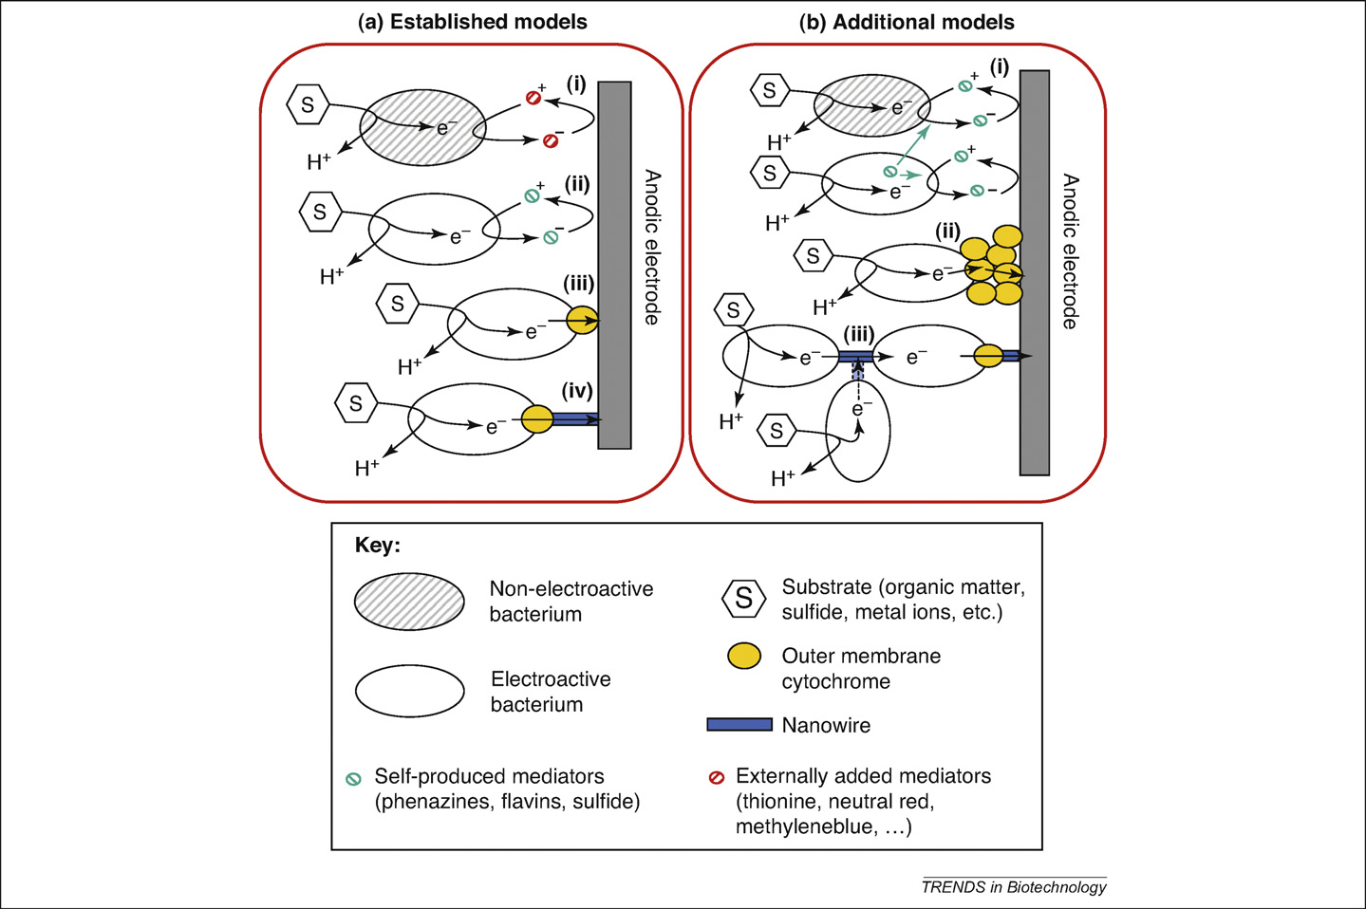
Electron-transfer mechanisms in bioanode
Trends in Biotechnology 2008, 27, 168-178

Slide 10
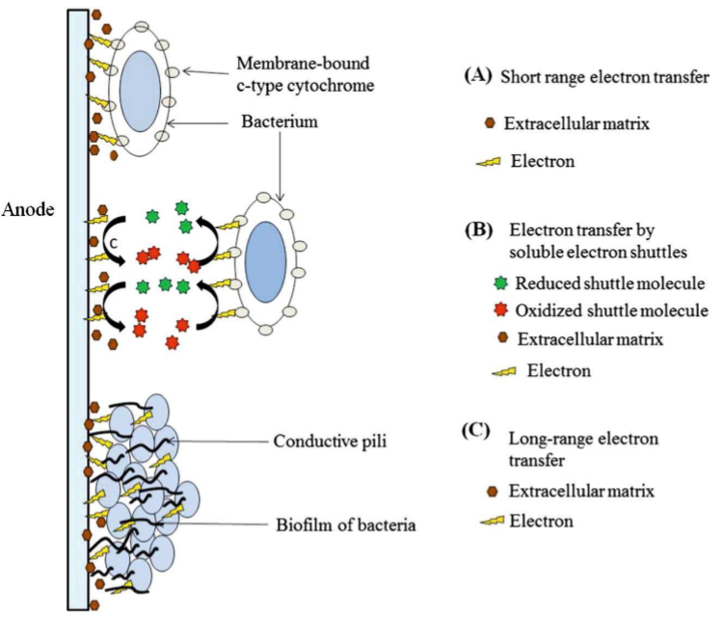
Electron transfer from microorganisms to electrodes
Int. J. Energy Res. 2015, 39, 1048-1067

Slide 11
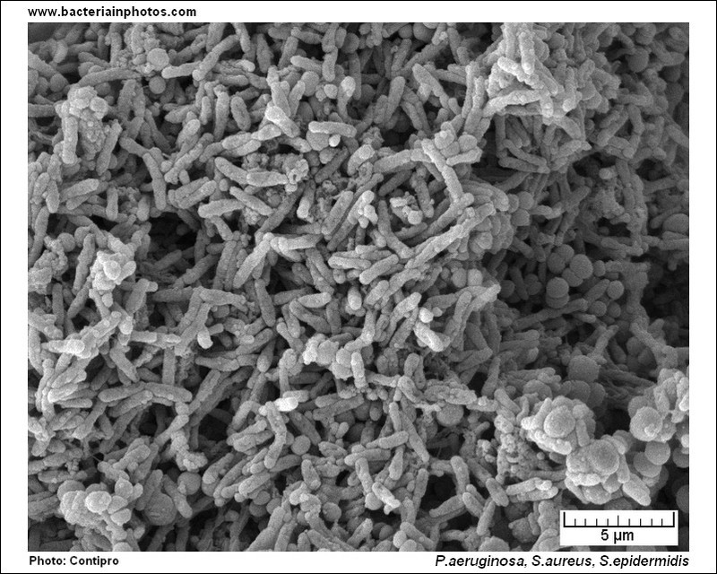
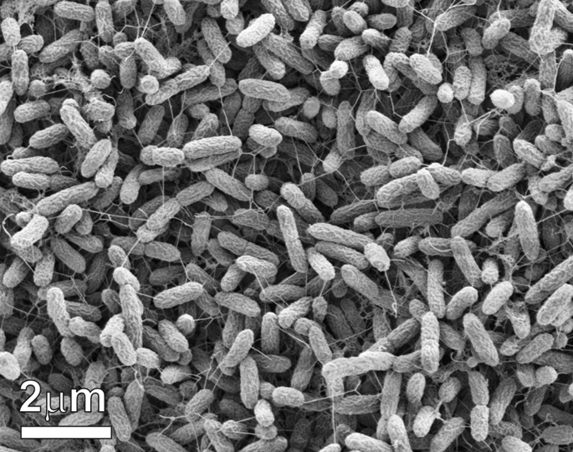
Microbial biofilm and nanowire formation

Slide 12
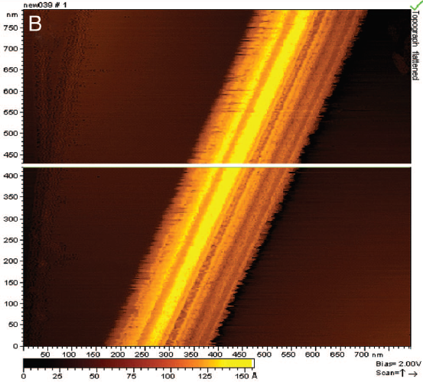
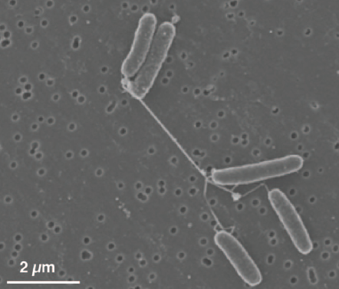
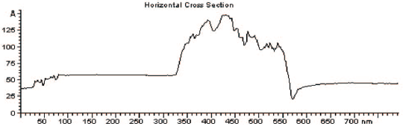
Electrically conductive bacterial nanowires produced by Shewanella oneidensis strain MR-1
PNAS 2006, 103, 11358-11363
Conductive wire bundle
Surface: Highly oriented pyrolytic graphite (HOPG)
Method: Scanning tunneling microscopy (STM)

Slide 13
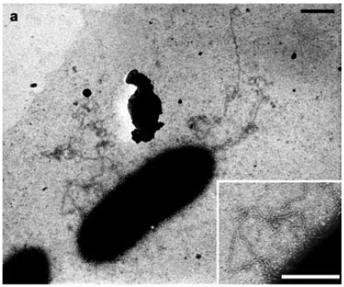
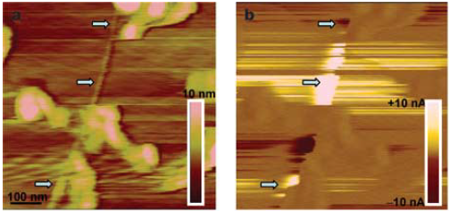
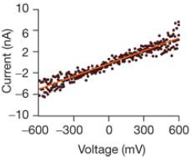
Appendage formation of Geobacter sulfurreducens
Nature 2005, 435, 1098-1101
SEM of G. sulfurreducens grown on insoluble iron oxide
a: Topographic image b: current image
Current-voltage curve of pilus

Slide 14
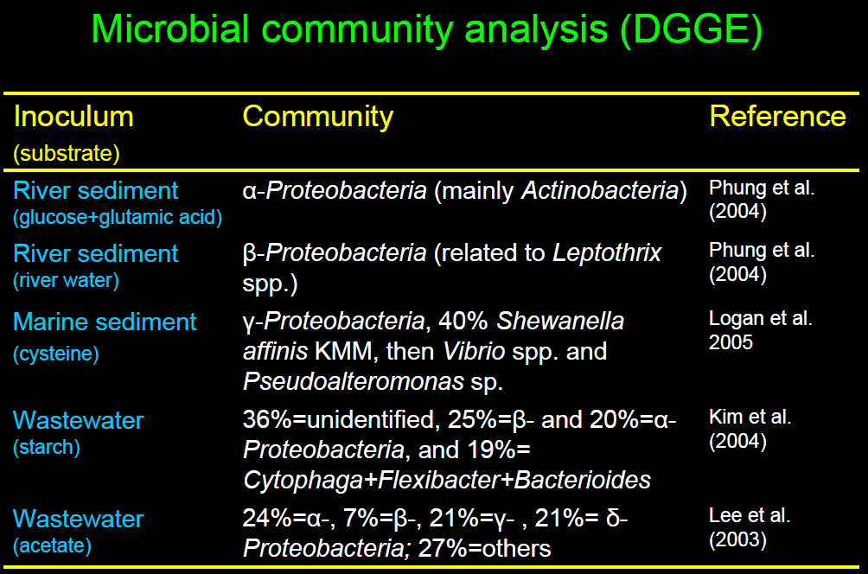

Slide 15
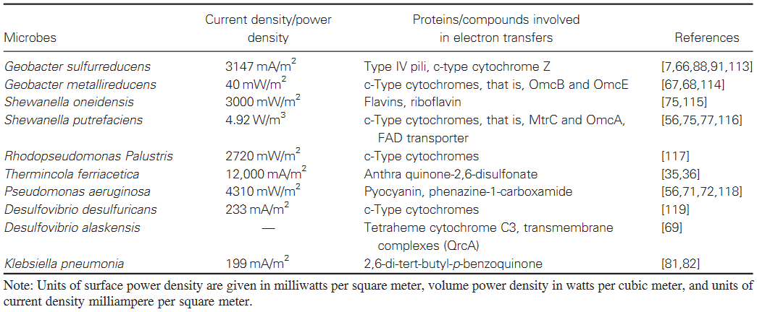
Exoelectrogens in anode
-known electron transfer intermediaries
Int. J. Energy Res. 2015, 39, 1048-1067

Slide 16
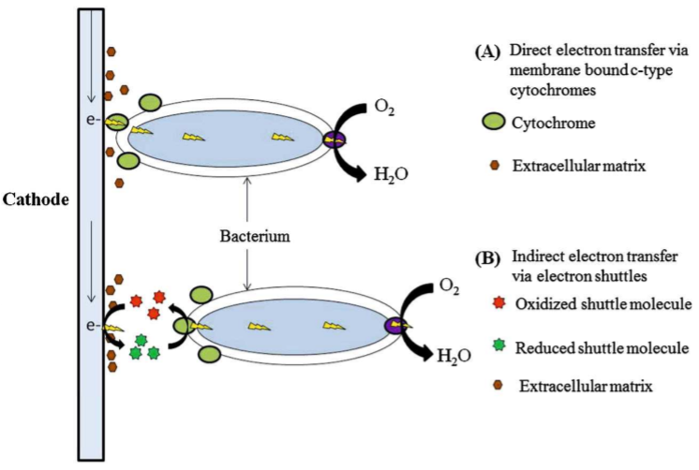
Electron transfer from electrodes to microorganisms
Int. J. Energy Res. 2015, 39, 1048-1067

