Slide 1
Photo-sensitization by Light-Harvesting Complex (LHC) as a photocurrent generation unit

Slide 2
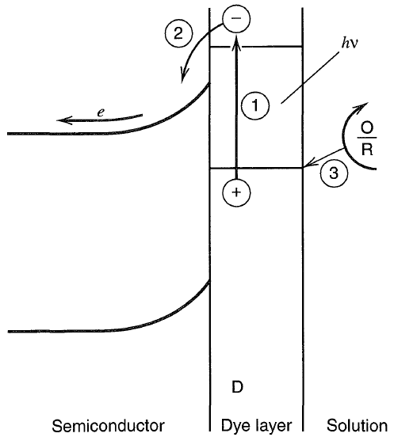
Dye sensitization
An approach to better utilization of longer wavelength light
A thin layer of dye, D, is coated on the semiconductor
E_{g} > Δ
HOMO
Δ
CB
D → D⁺ + e⁻
e⁻ is delivered to CB.
D⁺ + R → D + O
O + e⁻ → R at the counter electrode
LUMO
E_{g}
VB

Slide 3
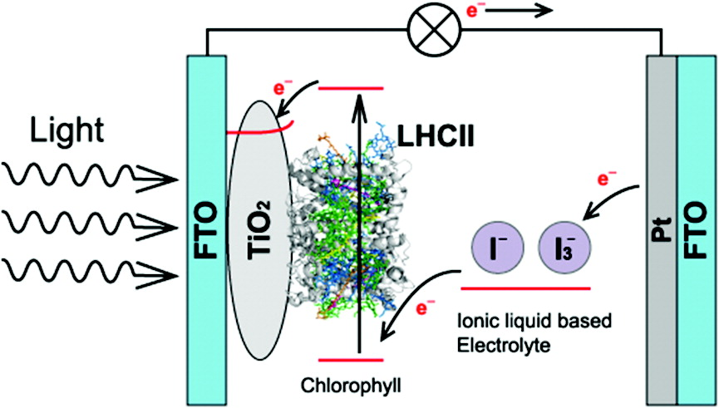
ACS Macro Lett. 2012, 1, 296−299
Immobilization and Photocurrent Activity of a Light-Harvesting Antenna Complex II, LHCII, Isolated from a Plant on Electrodes

Slide 4

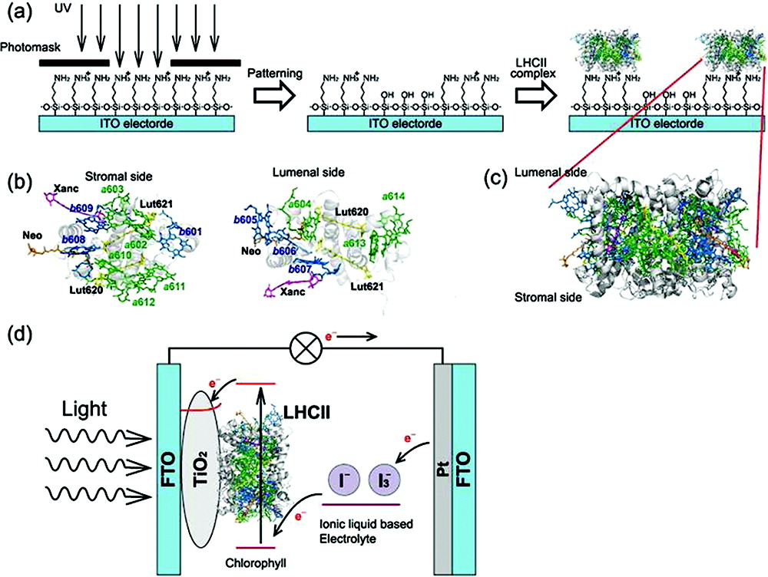
Introduction
Immobilization of LHCII onto an ITO modified with APS by electrostatic attraction
APS: 3-aminopropyltriethoxysilane
Stromal side of LHCII – negatively charged, amine surface – positively charged
In this paper, LHCII was successfully immobilized on an ITO electrode with APS or with APS dot patterning and on a TiO₂ electrode.

Slide 5
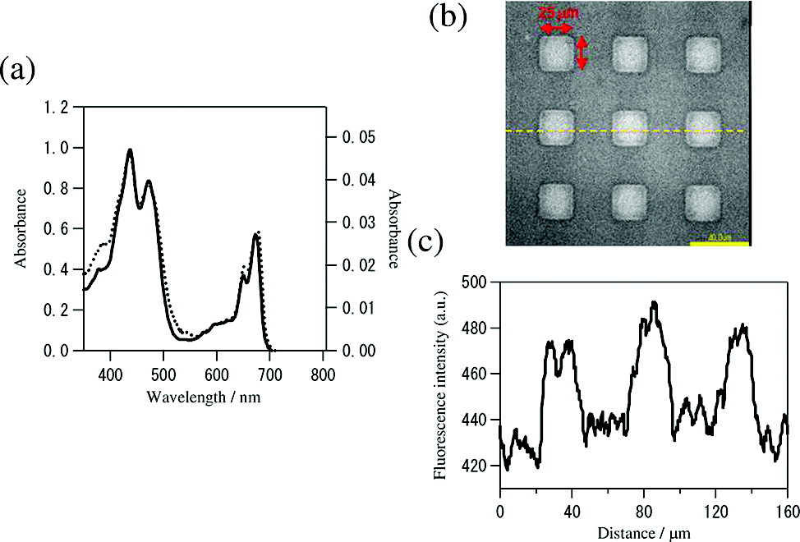
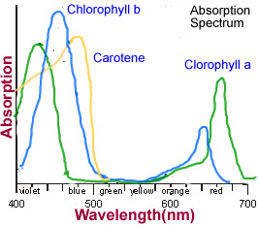
Identification of immobilized-LHC Ⅱ on APS-ITO electrode.
Chlorophyll-a : 435 nm and 674 nm
Chlorophyll-b : 472 nm and 651 nm
Solid : after immobilization
Dotted : in solution
The absorption spectrum of LHCII on APS-ITO was largely consistent with the spectrum in aqueous solution, indicating that the pigment complexes in LHCII were successfully assembled on the electrode without denaturation.
Notes:
Figure 1a shows the absorption spectra of LHCII isolated from spinach and after immobilization on an APS-ITO electrode.

Slide 6
Identification of immobilized-LHC Ⅱ on APS-ITO electrode.
No fluorescence of LHCII was observed on the SiOH domain that is not modified with APS.
Notes:
Figure 1b,c shows the fluorescence images of LHCII on the electrode with APS dot patterns and the fluorescence intensity profile.

Slide 7
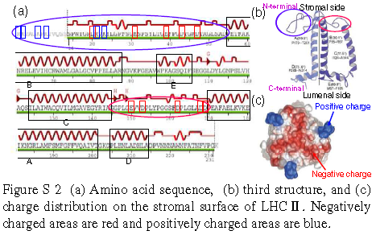
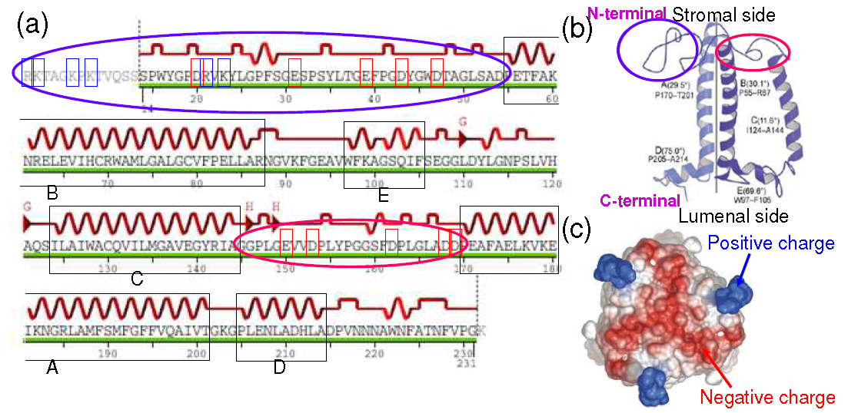
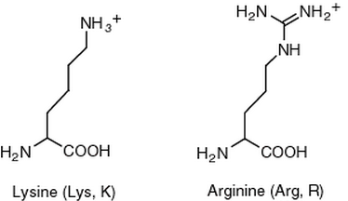
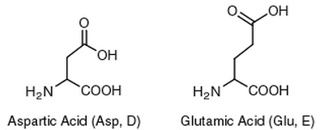
Identification of immobilized-LHC Ⅱ on APS-ITO electrode.
Anionic stromal side (LHC II)
Cationic surface (Electrode)
Electrostatic interactions
Anionic stromal side
COO⁻
Notes:
This selective attachment indicates that the assembly of LHCII onto the APS-ITO electrode was affected by electrostatic interactions
between the cationic surface of the electrode and the anionic stromal side of the LHCII polypeptide which includes anionic residues
such as aspartic acid or glutamic acid in the sequence of the protein.

Slide 8
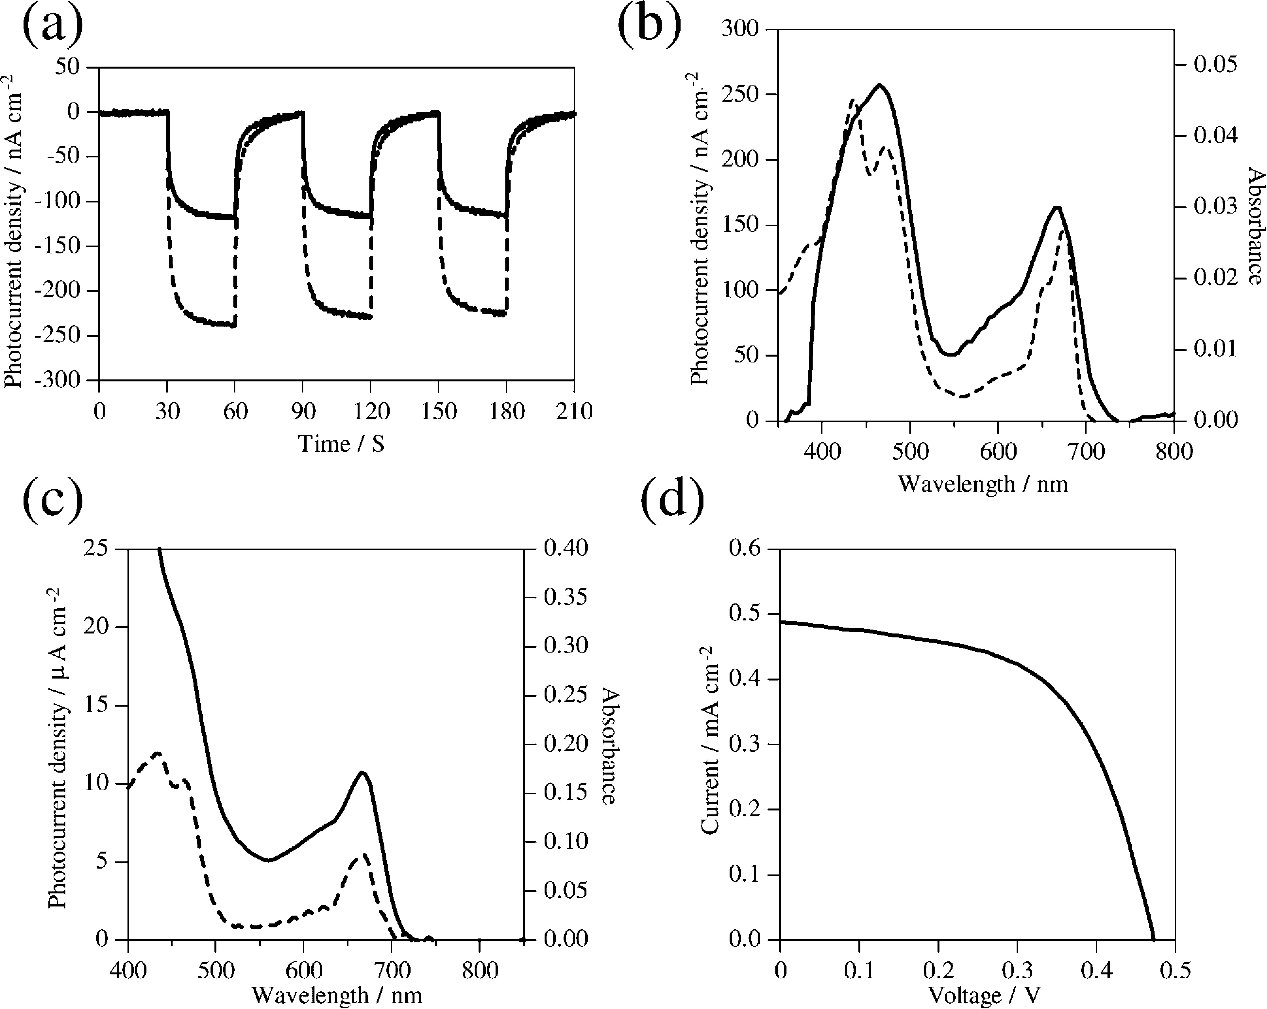
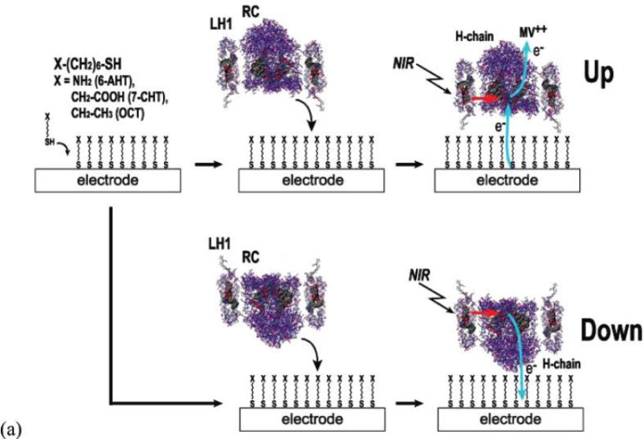
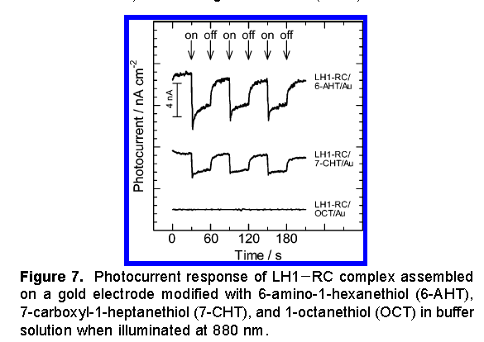
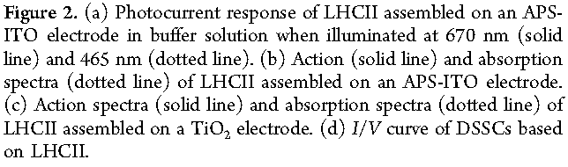
Photocurrent measurement of immobilized-LHC Ⅱ on APS-ITO electrode.
670 nm (solid line)
465 nm (dotted line)
Cathodic photocurrents were observed, implying that photoinduced electron transfer from LHCII to MV²⁺ occurred more efficiently than the back electron transfer to the electrode.
Notes:
Figure 2. (a) Photocurrent response of LHCII assembled on an APS-ITO electrode in buffer solution when illuminated at 670 nm (solid line) and 465 nm (dotted line).

Slide 9
Photocurrent measurement of immobilized-LHC Ⅱ on APS-ITO electrode.
Efficient photocurrent responses were observed upon illumination around 470 and 670 nm corresponding to chlorophyll-a/b in the complex, and this response was particularly efficient for chlorophyll-a.
The energy absorbed by the stromal chlorophylls is quickly focused on chlorophyll-a clusters such as five Chl a and is further transmitted to the neighboring LHCs or reaction centers.
Notes:
Figure 2b shows the action spectra expanded from the point where the largest negative current was obtained as shown in Figure 2a, in conjunction with the absorption
spectrum of the LHCII assembled onto APS-ITO.

Slide 10

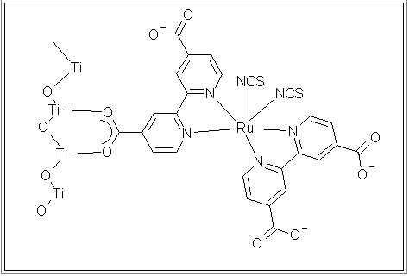
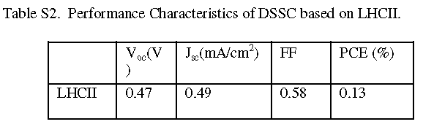
Photocurrent measurement of immobilized-LHC Ⅱ on TIO₂ electrode.
The absorption spectrum of LHCII on the TiO₂ nanostructured film was approximately consistent with the spectrum in aqueous solution, indicating that the pigment complexes in the LHCII system assembled on the TiO₂ film were stable and the native state was preserved.
Notes:
Figure 2c shows the absorption and photocurrent response spectra of the LHCII assembled on TiO₂ in the iodide / tri-iodide redox system of an
ionic liquid based electrolyte.
Figure 2d shows the I−V characteristics of the dye-sensitized solar cells (DSSC) for LHCII (Scheme 1d).
LHCII was assembled onto a TiO₂ nanostructured film.
It is likely that assembly of LHCII on the electrode was facilitated by the many carboxyl residues such as aspartic acid or glutamic acid, contained in the protein
sequence of LHCII, which binds easily to the surface of TiO₂.

Slide 11


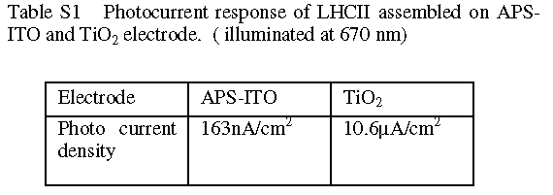

Comparison of immobilized-LHC Ⅱ on APS-ITO and TIO₂ electrode.
Remarkable enhancement of the photocurrent was observed when measured in the iodide/tri-iodide redox system of an ionic liquid based electrolyte on the TiO₂ electrode in comparison to that on the ITO electrode.

Slide 12
Conclusion.
The photocurrent action spectrum was reasonably consistent with the absorption spectrum of LHCII, indicating chlorophyll-a clusters on the stromal chlorophylls play an important role on the photocurrent activity.
Conversion efficiency of the photocurrent measured in the iodide/tri-iodide redox system of an ionic liquid based electrolyte on the TiO₂ electrode was significantly enhanced in comparison to that on the APS-ITO electrode.
These results indicate that LHCII acts as an effective photosensitizer material with a wide absorption band, and it is a potential candidate for photoenergy conversion materials.

Slide 13
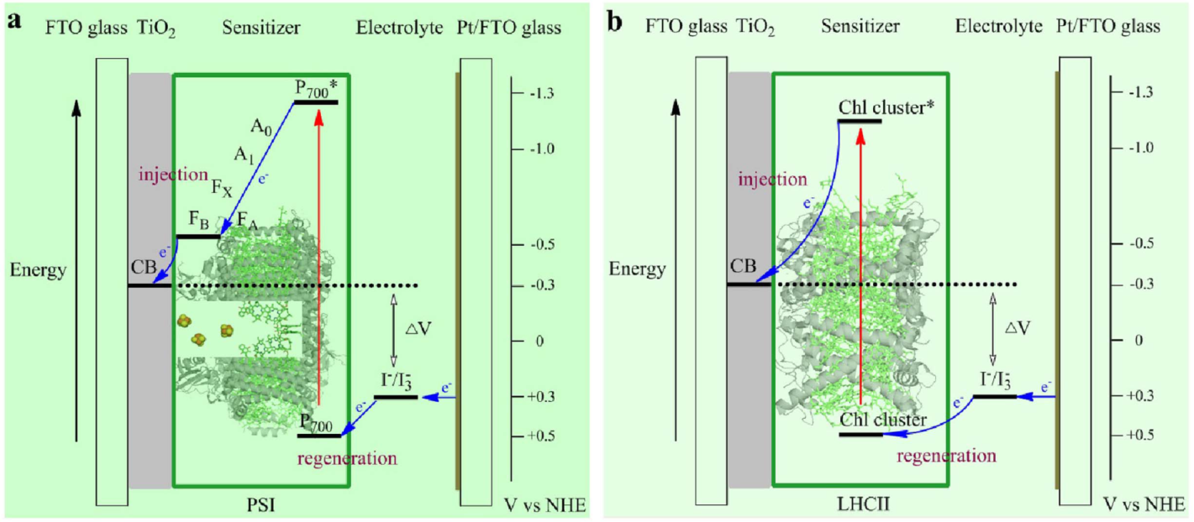
Scientific Reports, 5, 9375 (2015)
Enhanced photocurrent production by bio-dyes of photosynthetic macromolecules on designed TiO₂ film
Daoyong Yu^{1,2}, Mengfei Wang², Guoliang Zhu², Baosheng Ge^{1,2}, Shuang Liu² & Fang Huang^{1,2}
Notes:
I have chosen this paper.
This paper title is "Enhanced photocurrent production by bio-dyes of photosynthetic macromolecules on designed TiO₂ film".
This paper designed three types of TiO₂ films on FTO glass for the sensitization of Photosystem I (PSI) and light-harvesting complex II (LHCII), and explored the effects of pigment-protein complex on the performance of biohybrid photovoltaic cells.

Slide 14
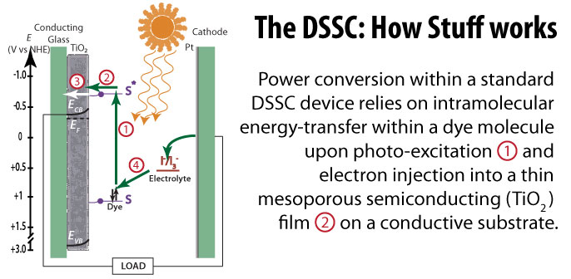
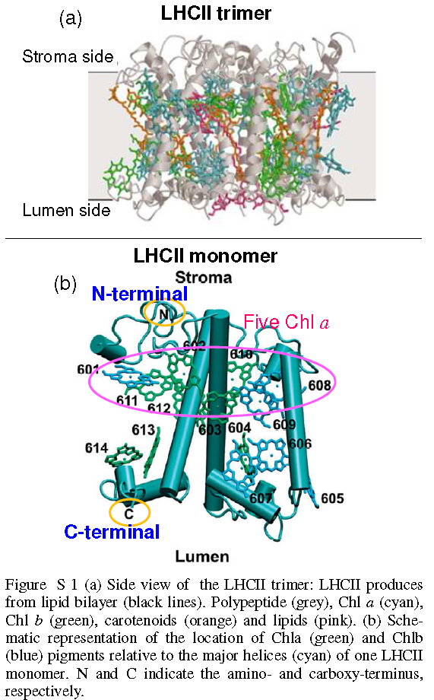
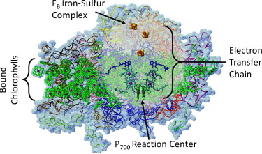
Introduction
Dye Sensitized Solar Sell (DSSC)
Photosystem Ⅰ(PSⅠ) and Light-harvesting complex II(LHCII)
PSⅠ and LHCII existed in thylakoid membrane of photosynthetic bacteria and plants and are a viable alternative natural photosensitizers.
The photons of light is collected by light-harvesting antenna complexes of PSⅠ and LHCII with internal quantum yield near 100%.
< Photosystem Ⅰ>
< Light-harvesting complex II >

Slide 15
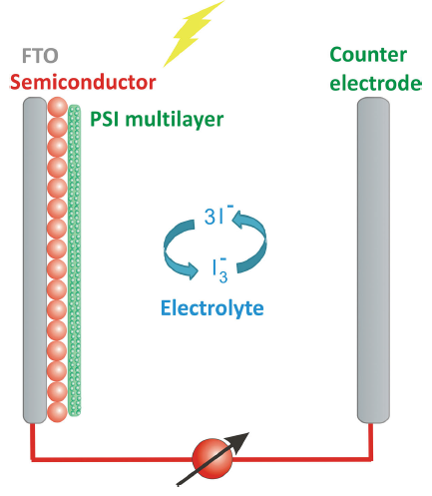
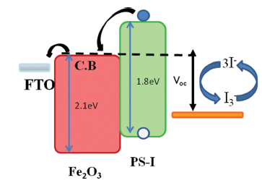
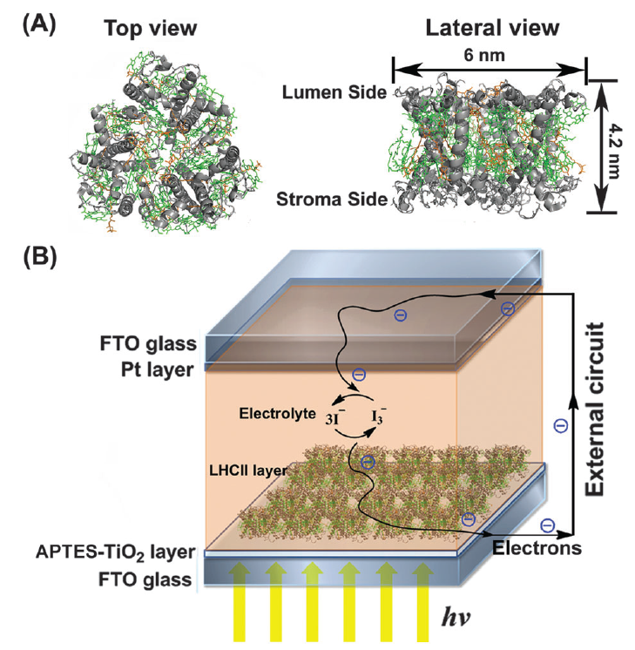
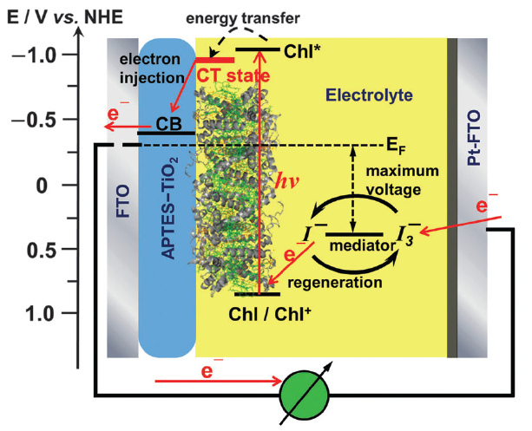

Introduction
< PSⅠ>
Adv. Funct. Mater. 2014, 24, 7467–7477
< LHC II >
Phys. Chem. Chem. Phys., 2014, 16, 20856--20865

Slide 16
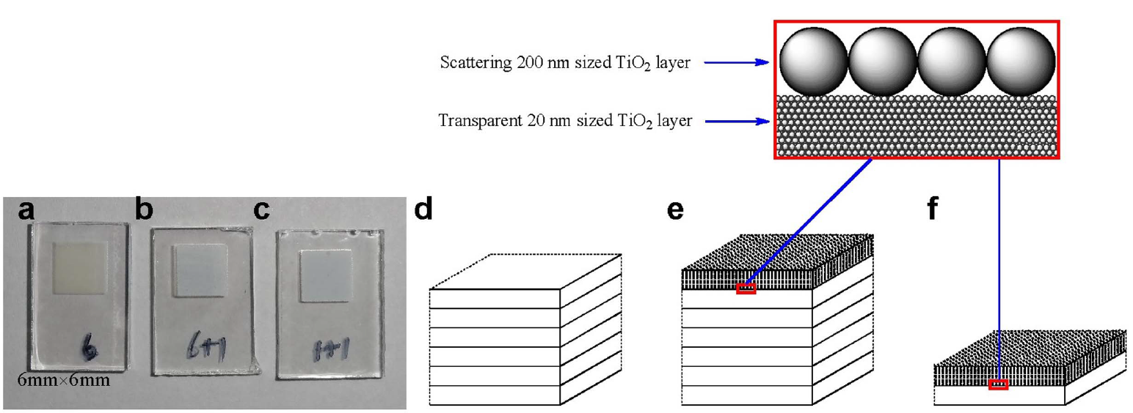
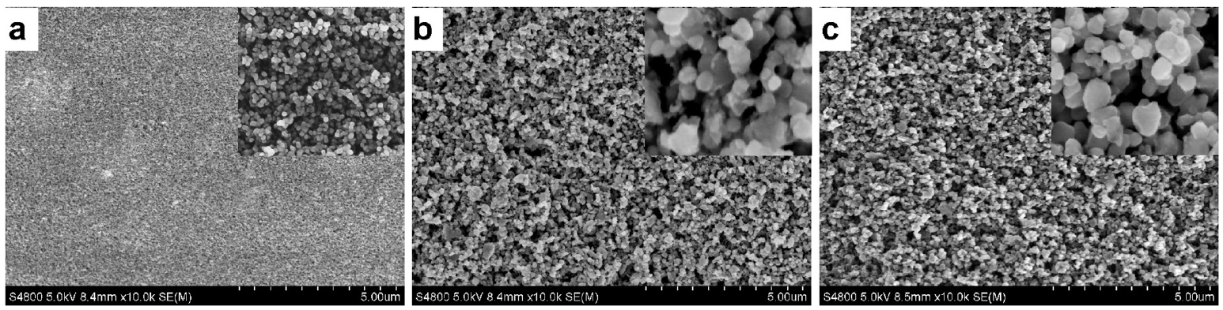
Experimental section
6 type
6+1 type
1+1 type
Figure 1 Top view photos of TiO₂ electrodes of (a) 6 type, (b) 6+1 type, and (c) 1+1 type, and schematic presentation of electrodes of (d) 6 type, (e) 6+1 type, and (f) 1+1 type.
Figure 2 Top view SEM images of nanocrystalline TiO₂ electrodes. (a) 6 type; (b) 6+1 type; (c) 1+1 type. Inner images’ width 1 mm.
6 type TiO₂ electrode was composed of 6 layers of ~2 μm thick transparent layer (mesoporous TiO₂ : ~20 nm particle size).
6+1 type TiO₂ electrode was composed of ~2 μm scattering layer (porous layer : ~200 nm particle size) on top of the 6 type TiO₂ electrode.
1+1 type TiO₂ electrode was composed of a ~2 μm scattering layer (porous layer : ~200 nm particle size) on top of ~2 μm thick transparent layer (mesoporous TiO₂ : ~20 nm particle size).
Notes:
In this paper, three types of TiO₂ electrodes were designed.
6 type TiO₂ electrode was composed of 6 layers of ~2 μm thick transparent layer (mesoporous TiO₂ : ~20 nm particle size).
6+1 type TiO₂ electrode was composed of ~2 μm scattering layer (porous layer : ~200 nm particle size) on top of the 6 type TiO₂ electrode.
1+1 type TiO₂ electrode was composed of a ~2 μm scattering layer (porous layer : ~200 nm particle size) on top of ~2 μm thick transparent layer (mesoporous TiO₂ : ~20 nm particle size).

Slide 17
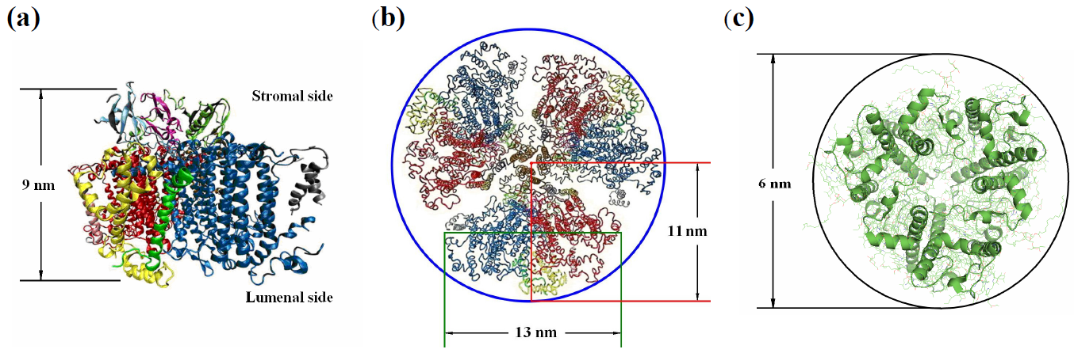
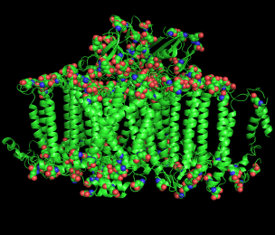
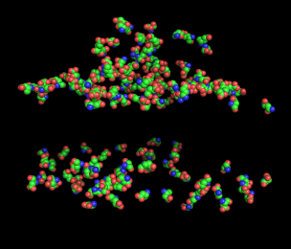
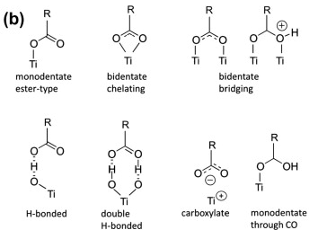
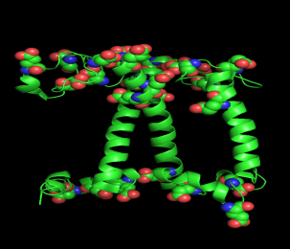
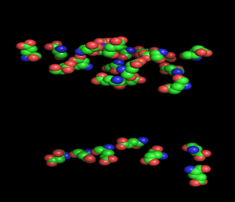
Experimental section
Figure S1 Dimensional size of PSI (PDB ID: 1JB0) and LHCII (PDB ID: 1RWT). (a) PSI monomer. (b) Lumenal side of trimeric PSI complex constructed from 1JB0. (c) LHCII trimer. Marked sizes are measured by PyMOL.
Stromal side
< PSI >
< LHCII >
H. Hug et al. / Applied Energy 115 (2014) 216–225
The assembly of PSI or LHCII on the electrode is facilitated by the many carboxyl residues such as aspartic (D) or glutamic acid (E), in the protein sequences of PSI or LHCII, which bind easily to the surface of TiO₂.
Notes:
This paper used two photosynthetic protein complexes, PSI and LHCII as bio-sensitizer.
The stromal side of PSI or LHCII has more carboxyl groups on the surface and it will tend to be preferentially fixed on TiO₂ surface.
The possible binding modes of carboxyl group to TiO₂ include coordinate covalent, carboxylate, and hydrogen bonds.

Slide 18
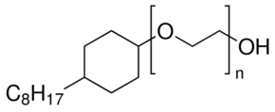
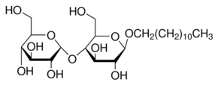
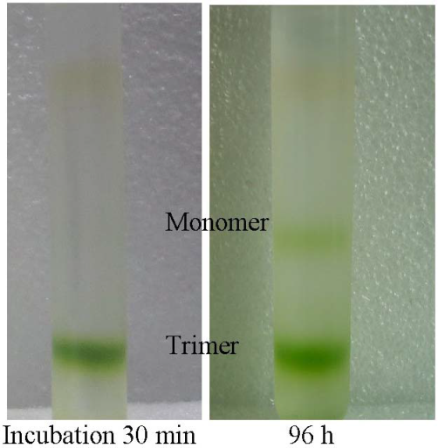
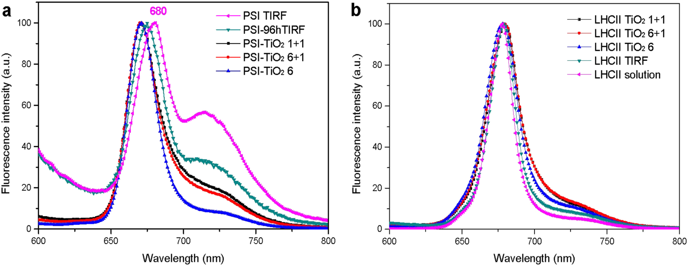
Results
t-Octylphenoxypolyethoxyethanol (Triton X-100)
n-Dodecyl β-D-maltoside (DDM)
Figure 3 Sucrose density gradient centrifugation of DDM-solubilized PSI after incubation of 30 min and 96 h respectively, performed by the method described in Ref. 42.
Figure 4 Fluorescence spectra of (a) PSI solutions and PSI-TiO₂ electrodes, (b) LHCII solutions and LHCII-TiO₂ electrodes, normalized at maxima.
The PSI trimer solubilized in DDM solution is not very stable and some trimers dissociate to monomers.
Additionally, the high concentration(400 μg Chl/mL) of PSI trimmer is stable than the low concentration(80 μg Chl/mL).
Notes:
In this paper, surfactant DDM instead of Triton X-100 was used to keep PSI or LHCII, and to inhibit the formation of multilayer on the TiO₂ surface.
As you can see in figure 3 and 4a, the PSI trimer solubilized in DDM solution is not very stable and some trimers dissociate to monomers.
On the other hand, the LHCII trimer solubilized in DDM solution is stable.

Slide 19
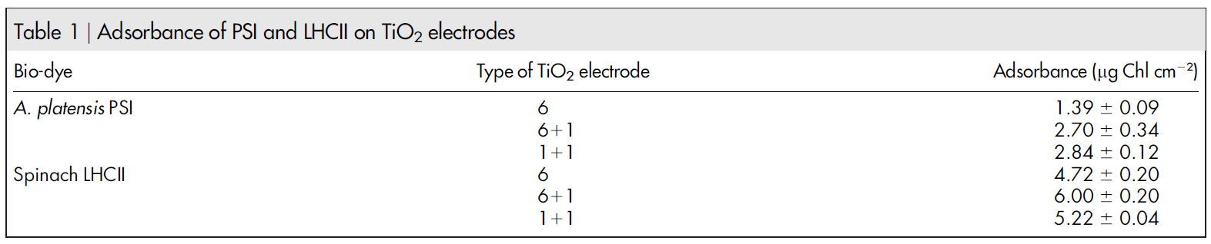
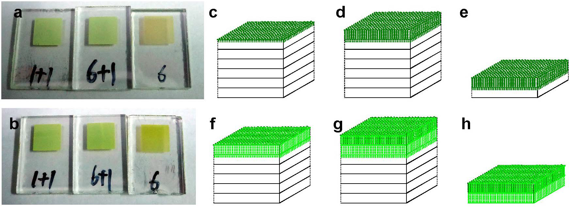

Results
( Monomer diameters: ~13 nm, Trimer diameters: ~ 22 nm )
( Trimer diameters: ~ 6 nm )
Figure 5 (a) Top view photos of PSI-sensitized TiO₂ electrodes of 1+1, 6+1 and 6 types. (b) Top view photos of LHCII-sensitized TiO₂ electrodes of 1+1, 6+1 and 6 types. Adsorption models of PSI@TiO₂ electrodes of (c) 6, (d) 6+1, and (e) 1+1 types. Adsorption models of LHCII@TiO₂ electrodes of (f) 6, (g) 6+1, and (h) 1+1 types.
PSI and LHCII are macromolecules, and the size screening effect of the mesopore in TiO₂ layer controls the adsorption depth of these macromolecular bio-dyes.
In the case of PSI, the PSI can be fixed not only on the surface but also in the inner, but can’t diffuse into the inner deeper mesopore of the transparent TiO₂ layer.
However, the LHCII can be fixed not only on the surface but also in the inner mesopores of both the scattering layer and the transparent TiO₂ layer.
Notes:
The pigments of PSI and LHCII on TiO₂ electrode are non-covalent binding, and can be easily extracted by a mixed solvent of 80% acetone.
Table 1 is the pigments concentration of PSI or LHCII on TiO₂ electrode.
Comparing the 6+1 with the 6 type electrode, addition of the scattering layer (porous layer : ~200 nm particle size) helps to increase the adsorbance of PSI and LHCII.
In the case of PSI, the PS1 can be fixed not only on the surface but also in the inner, but cannot diffuse into the inner deeper mesopore of the transparent TiO₂ layer.
However, the LHCII can be fixed not only on the surface but also in the inner mesopores of both the scattering layer and the transparent TiO₂ layer.
These results indicate that enhancing the thickness of the transparent layer can increase the absorbance of LHCII.

Slide 20
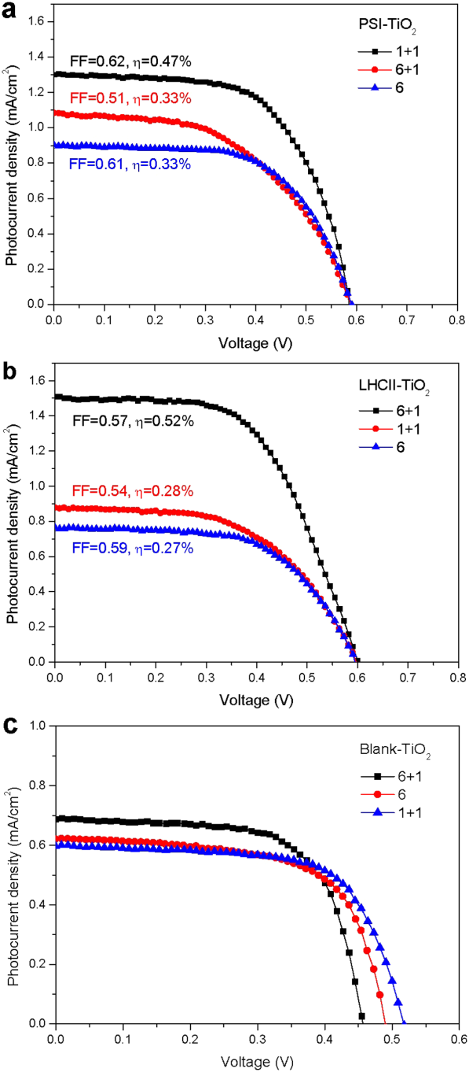

Results
Figure 6 The current-voltage characteristics measured under AM 1.5 G solar irradiance (100 mW cm⁻² photon flux) for (a) PSI-sensitized, (b) LHCII-sensitized, and (c) blank solar cells with different TiO₂ electrodes.
A _{1+1 type}
=
A _{6+1 type}
>
A _{6 type}
A _{1+1 type}
<
A _{6+1 type}
>
A _{6 type}
R_{s 1+1 type}
<
R_{s 6+1 type}
=
R_{s 6 type}
R_{s 1+1 type}
<
R_{s 6+1 type}
=
R_{s 6 type}
In the case of PSI-SSC, the adsorbances of PSI on the 6+1 type and 1+1 type electrodes are similar, but resistance of the 6+1 type is higher than the 1+1 type.
In the case of LHCII-SSC, the adsorption of LHCII on the 6+1 type is deeper than the 1+1 type, and the addition of the scattering layer increases the light absorption by LHCII in the transparent layer.
These results indicate that the adsorbance of bio-dye and the resistance of equivalent circuit for sensitized solar cell (SSC) has an important effect on the performance.
Notes:
In the case of PSI-SSC, the adsorbances of PSI on the 6+1 type and 1+1 type electrodes are similar, but resistance of the 6+1 type is higher than the 1+1 type.
As you can see in figure 6a, the efficiency of 1+1 type (PSI-SSC) is better than the 6+1 type (PSI-SSC).
In the case of LHCII-SSC, the adsorption of LHCII on the 6+1 type is deeper than the 1+1 type, and the addition of the scattering layer increases the light absorption by LHCII in the transparent layer.
As you can see in figure 6b, the efficiency of 6+1 type (LHCII-SSC) is better than the 1+1 type (LHCII-SSC).
These results indicate that the adsorbance of bio-dye and the resistance of equivalent circuit for sensitized solar cell (SSC) has an important effect on the performance.

Slide 21
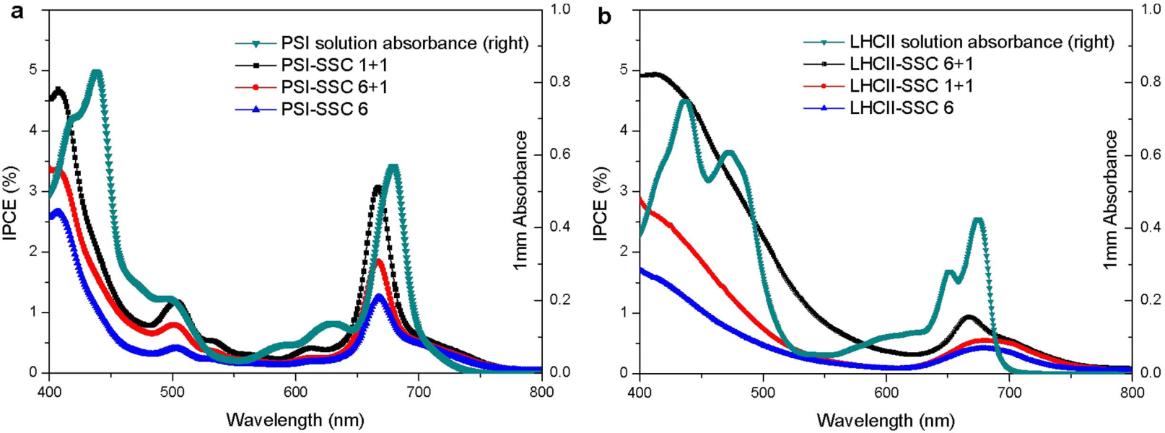
Results
Figure 7 Incident photocurrent conversion efficiencies (IPCE) as a function of wavelength. (a) PSI-SSC, (b) LHCII-SSC with photoanodes possessing different layers of TiO₂ on conductive FTO glass.
The IPCE spectra of PSI-SSC or LHCII-SSC is similar to the absorption spectrum in solution.
These IPCE results indicate that LHCII or PSI can be excited by the captured photons and inject electrons into the conducting band of the TiO₂ film.
Notes:
As you can see in figure 7, the IPCE spectra of PSI-SSC or LHCII-SSC is similar to the absorption spectrum in solution.
These IPCE results indicate that LHCII or PSI can be excited by the captured photons and inject electrons into the conducting band of the TiO₂ film.

Slide 22
Results
V_{OC} = 0.59 V
V_{OC} = 0.6 V
Figure 8 Simple energy level diagram for bio-sensitized solar cell. The potentials are shown for (a) PSI-SSC and (b) LHCII-SSC. The primary free energy losses are associated with electron injection from the excited sensitizer into the TiO₂ conduction band (CB) and regeneration of the dye by the redox couple.
Notes:
The open circuit voltage of PSI-SSC and LHCII-SSC is 0.59 and 0.60 V respectively, which is approximately indicated by the splitting between the TiO₂ Fermi level and the chemical potential of the redox electrolyte.
The PSI-SSC has the efficient energy transfer in the antenna system and the high efficiency of charge regeneration than the LHCII-SSC.
Therefore, the overall performance of PSI-SSC is higher than the LHCII-SSC.

Slide 23
Conclusion.
PSI and LHCII exist in thylakoid membrane of photosynthetic bacteria and plants and are a viable alternative natural photosensitizers.
The morphology of TiO₂ film has a large effect on both the adsorbance and the depth of bio-dye adsorption.
PSI shows its merit of high efficiency for captured energy transfer, charge separation and transfer in the electron transfer chain (ETC), and electron injection from F_{B} to the TiO₂ conducting band.

